Slide 1
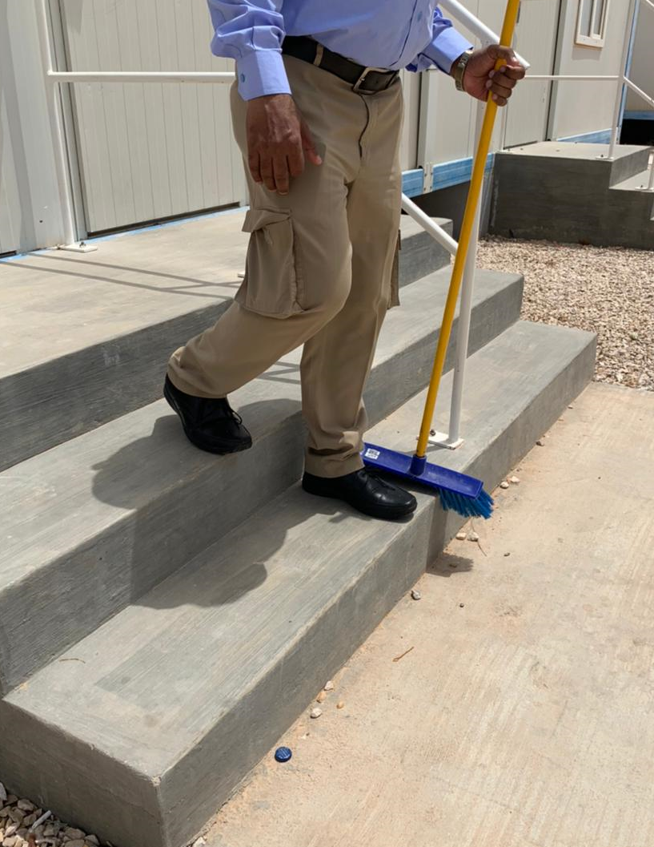
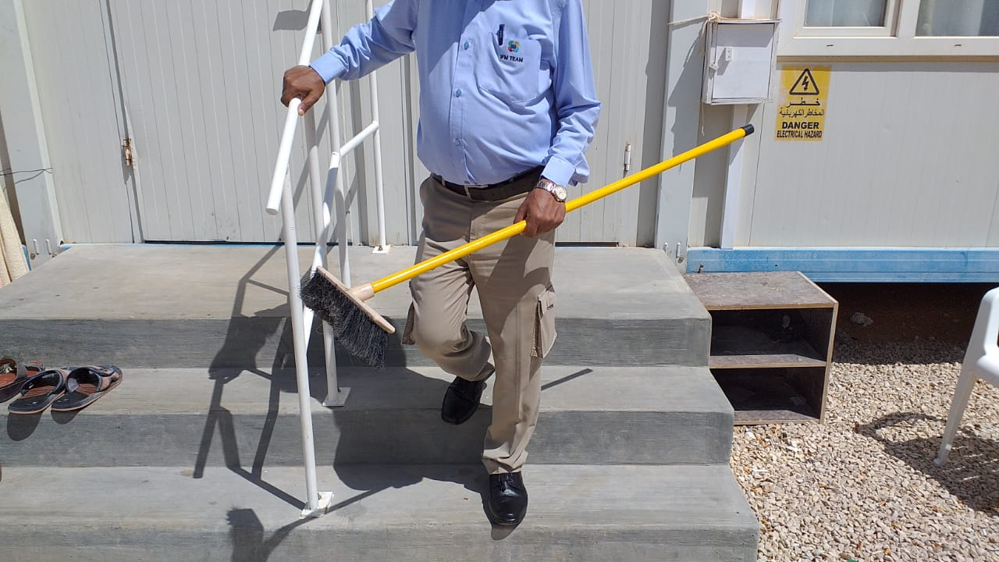
PDO Second Alert
Date: 02nd June 2021 Title: LTI#13 ( slip & fall)
What happened?
An employee was descending a small flight of stairs he misjudged the final step causing him to slip and twist his left foot resulting in a minor fracture to his ankle.
Your learning from this incident..
Always hold the hand rails when using steps/stairs, remember the 3 points of contact rule
Always pay attention to your footing
Always talk to someone if you have personal problems that may be causing you concern
Always report accidents immediately
Be Aware when using the Stairs,
never fail to hold the rail
Notes:
Ensure all dates and titles are input
A short description should be provided without mentioning names of contractors or individuals. You should include, what happened, to who (by job title) and what injuries this resulted in. Nothing more!
Four to five bullet points highlighting the main findings from the investigation. Remember the target audience is the front line staff so this should be written in simple terms in a way that everyone can understand.
The strap line should be the main point you want to get across
The images should be self explanatory, what went wrong (if you create a reconstruction please ensure you do not put people at risk) and below how it should be done.

Slide 2
Management self audit
Date:
As a learning from this incident and ensure continual improvement all contract
managers must review their HSE HEMP against the questions asked below
Confirm the following:
Do you conduct regular Hazard Hunts with your staff
Do you conduct awareness sessions on Slips, Trips & Falls
Do you regularly communicate the 3 points of contact method for using steps / stairs
Do you ensure employees are wearing correctly fitted PPE
Do you regularly remind staff to report all accidents immediately
Do you conduct regular ‘Show me How’ interactions during ‘Gemba’ Walks, Site Visits and as daily routine assurance checks
* If the answer is NO to any of the above questions please ensure you take action to correct this finding.
Notes:
Ensure all dates and titles are input
Make a list of closed questions (only ‘yes’ or ‘no’ as an answer) to ask others if they have the same issues based on the management or HSE-MS failings or shortfalls identified in the investigation.
Imagine you have to audit other companies to see if they could have the same issues.
These questions should start with: Do you ensure…………………?

