Slide 1
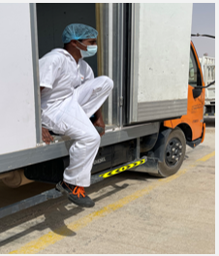
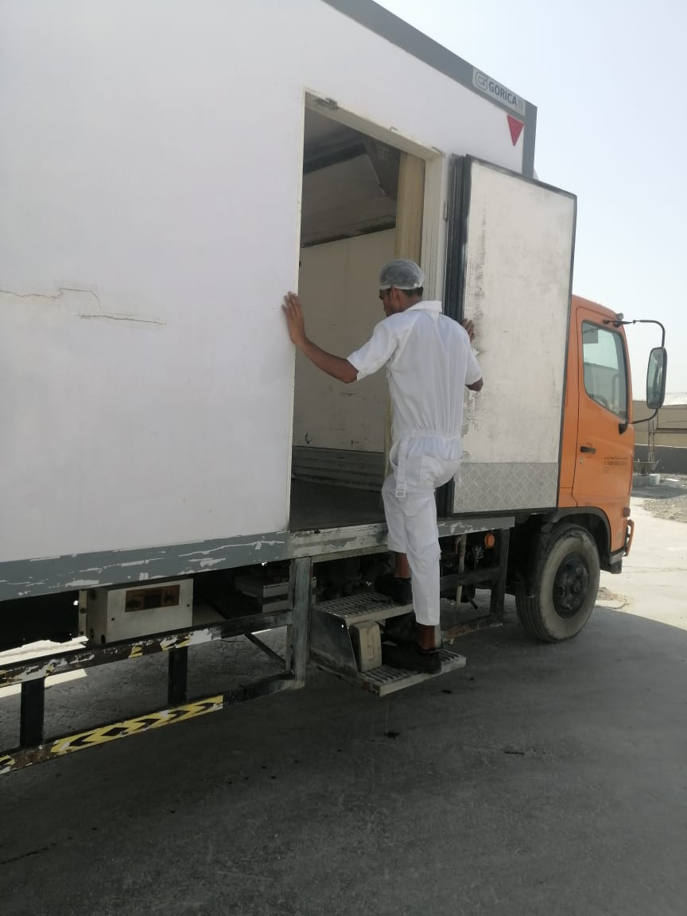
PDO Second Alert
Date: 01/05/2022 Incident title: LTI #14 Pattern: Slip, Trip & Fall Potential severity: C3P
Target Audience: Catering Attendants, Store Employees
What happened?
Catering store attendant while descending from the freezer van his heel slipped on the step, lost balance and fell down on concrete floor. He landed on the ground placing his right hand on concrete floor resulting in injury to his right wrist. The catering attendant was shifted to PAC Tawoos clinic and doctor after initial treatment and referred to Salalah for further medical management at Badar al Samaa hospital.
Why it happened/Finding :
Design of the vehicle not appropriate with no proper access/egress.
The catering attendant failed to pay enough attention while placing his leg.
No process identified for loading / unloading of domestic goods in camp.
The footing step provided at the side door was not easily accessible/visible while descending.
Your learning from this incident..
Always ensure proper access arrangements on all vehicles.
Always descend and ascend steps by facing towards vehicle.
Always ensure 3 point contact while climbing up and down.
Ensure 3 point contact while climbing up and down
Notes:
Ensure all dates and titles are input
A short description should be provided without mentioning names of contractors or individuals. You should include, what happened, to who (by job title) and what injuries this resulted in. Nothing more!
Four to five bullet points highlighting the main findings from the investigation. Remember the target audience is the front line staff so this should be written in simple terms in a way that everyone can understand.
The strap line should be the main point you want to get across
The images should be self explanatory, what went wrong (if you create a reconstruction please ensure you do not put people at risk) and below how it should be done.

Slide 2
Management self audit
Date: 01/05/2022 Incident title: LTI #14 Pattern: Slip, Trip & Fall Potential severity: C3P
As a learning from this incident and ensure continual improvement all contract managers must review their HSE risk management against the questions asked below
Confirm the following:
Do you ensure that your employees are complying with safe access egress methods?
Do you ensure that your employees are using three point contacts while using ladders?
Do you ensure that your employees are not taking short cuts while descending from vehicles?
Do you ensure all your vehicles are meeting safety requirements prior inducting to the system?
Do you ensure that risk assessment is conducted for all the activities ?
* If the answer is NO to any of the above questions please ensure you take action to correct this finding
Notes:
Ensure all dates and titles are input
Make a list of closed questions (only ‘yes’ or ‘no’ as an answer) to ask others if they have the same issues based on the management or HSE-MS failings or shortfalls identified in the investigation.
Imagine you have to audit other companies to see if they could have the same issues.
These questions should start with: Do you ensure…………………?

