Slide 1
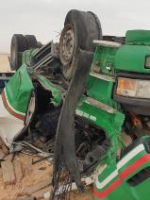
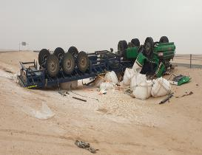
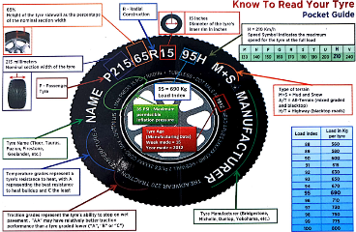
PDO Second Alert
Date:15/09/2021 Incident title: Fatality #01/LTI#20 Pattern: MVI Rollover Potential severity: D4P
Target Audience: All contractors working in PDO contract
Description of the incident:
On 15th September 2021 at approx. 16:36 a single MVI occurred involving an OTO driver travelling from Muscat to Nimr on a dual carriage-way blacktop, the trailer carrying 22 bulk bags of Potassium Chloride (non-hazardous chemical). The vehicle suffered a blow out to the driver side front tyre, causing the vehicle to swerve to the driver side and straight into the central reservation embankment before rolling over and stopping at its final resting position on its back. This resulted in fatal injuries to the driver who was trapped inside the cabin. The loads were spilled from the trailer. Another OTO driver who happened to be in the area reported to CCC JMC, the emergency number was called. Simulation Video
Your learning from this incident..
Always ensure your tyre quality is fit for purpose
Always ensure tyre pressures are correct and tyre conditions checked regularly
Always ensure you conduct daily vehicle inspection before starting your journey
Always ensure you follow defensive driver training
Notes:
Ensure all dates and titles are input
A short description should be provided without mentioning names of contractors or individuals. You should include, what happened, to who (by job title) and what injuries this resulted in. Nothing more!
Four to five bullet points highlighting the main findings from the investigation. Remember the target audience is the front line staff so this should be written in simple terms in a way that everyone can understand.
The strap line should be the main point you want to get across
The images should be self explanatory, what went wrong (if you create a reconstruction please ensure you do not put people at risk) and below how it should be done.

Slide 2
Management self audit
Date:15/09/2021 Incident title: Fat#01/LTI#20 Pattern: MVI Rollover Potential severity: D4P
As a learning from this incident and ensure continual improvement all contract managers must review their HSE risk management against the questions asked below
Confirm the following:
Do you ensure your vehicles are fitted with tyres with well known quality?
Do you ensure Compliance to SP2001 load security checks?
Do you have tyre inflation equipment and pressure gauges available for drivers to utilise?
Do you ensure drivers know how to react in the event of a tyre blow out?
Do you ensure drivers have been briefed to take rest if they feel fatigue during long journey?
* If the answer is NO to any of the above questions please ensure you take action to correct this finding
Notes:
Ensure all dates and titles are input
Make a list of closed questions (only ‘yes’ or ‘no’ as an answer) to ask others if they have the same issues based on the management or HSE-MS failings or shortfalls identified in the investigation.
Imagine you have to audit other companies to see if they could have the same issues.
These questions should start with: Do you ensure…………………?

