Slide 1
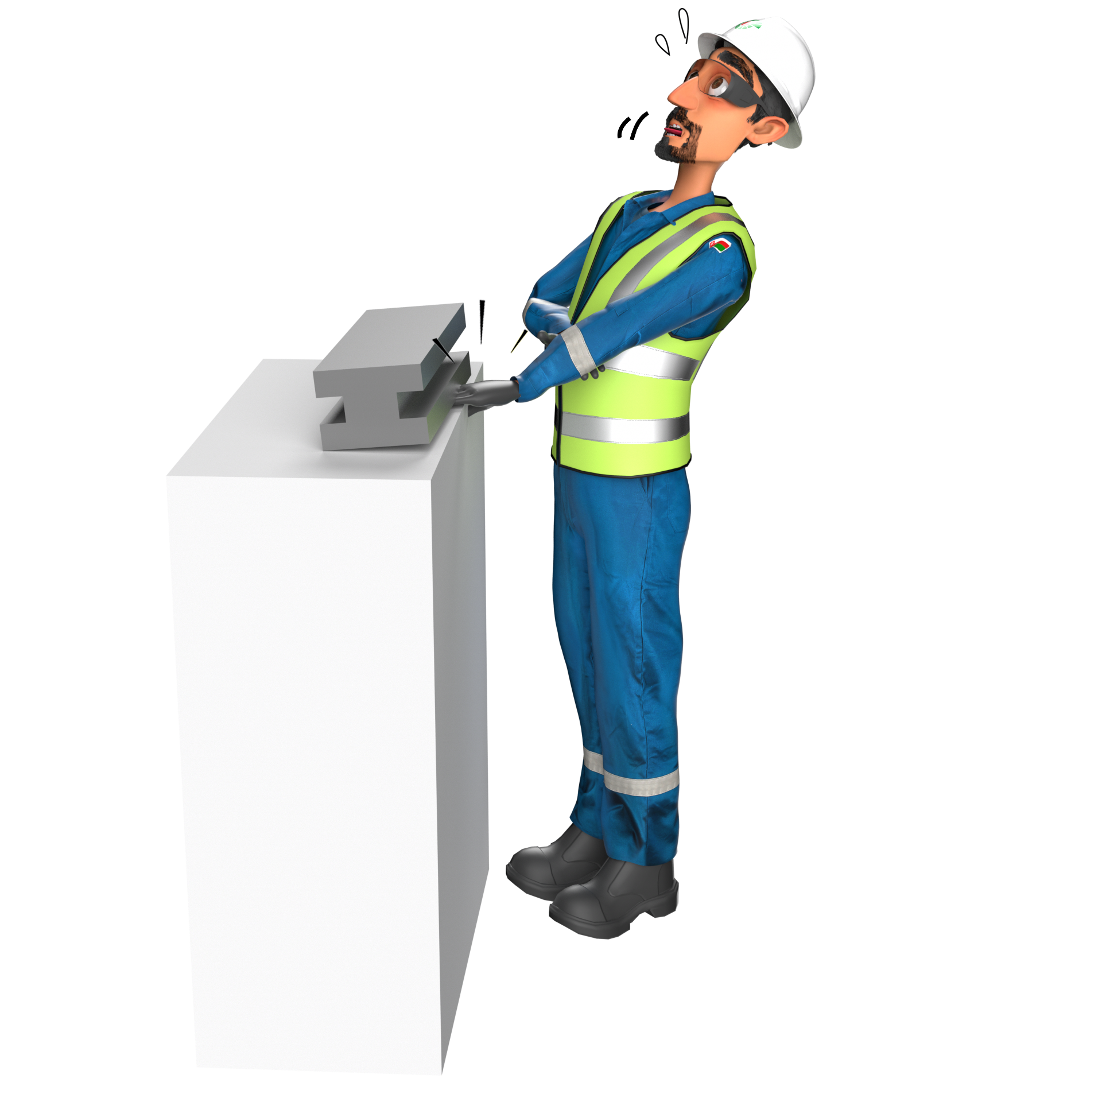
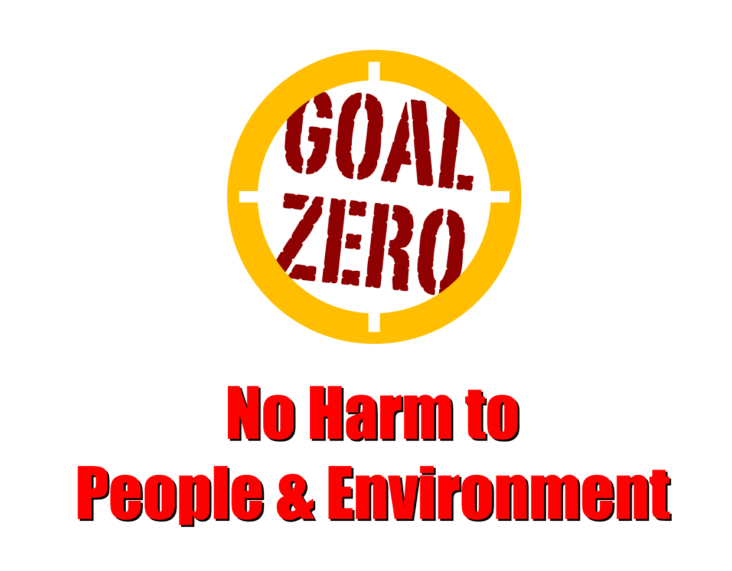
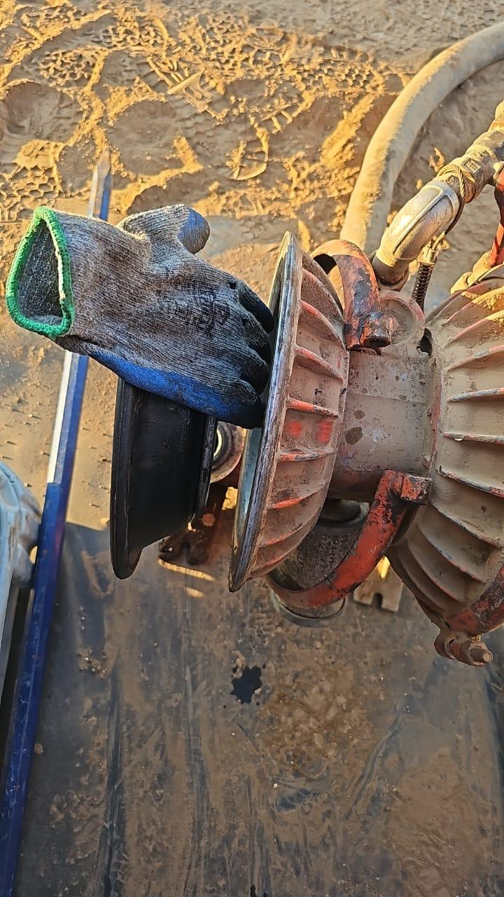
Learning From Incident - First Alert
Prevent
PIM # | 1161587 | Date | 13.12.2023 | Direct / Dept.
Incident Type | LTI#22 | Time | 11:50 AM | Location | Nimr
Category | Hands & Fingers Released Energy | Contractor |  | Activity | Maintenance on Wilden Air Pump
Target Audience: All
What happened
On 13th Dec 2023, around 11:50 AM, one of the crew members working on the waste treatment unit. While checking the performance of a Wilden Diaphragm Air Pump, the supervisor opened the chamber to inspect the diaphragm. Suddenly, the diaphragm started to move towards the chamber, causing his right hand to become trapped between the diaphragm and the diaphragm chamber. This resulted in cut injuries on the index, middle and ring finger of his right hand.
Initial Findings
The pump was isolated from energy source.
The supervisor was wearing lightweight gloves
Hand placed between diaphragm and chamber
Initial Learnings
How do you assess risk of hand injury during pump maintenance?
How do you ensure line of fire risks are identified prior to starting the job?
Are you aware of the right PPE for the specific activity you are carrying out?
Are hands-off tools available for activities that have a risk of pinch or crush points?
Use hands-off method when there is a pinch point risk
Protect hands & fingers by using hands off tools
In case of an emergency please call PDO Emergency Number (Toll Free): 2467-5555
Notes:
Mr Musleh image on the top right will change according to incident pattern, MSE3 will provide you with the image as per the pattern
What happened: A short description should be provided without mentioning names of contractors or individuals. You should include, what happened, to who (by job title) and what injuries this resulted in. Nothing more!
Initial Finding: Four to five bullet points highlighting the initial main findings from the investigation. Remember the target audience is the front-line staff so this should be written in simple terms in a way that everyone can understand.
Learnings: Four to five learning message in the form of questionnaires linked with initial findings
The strap line should be the main learning point you want to get across
The images should be self explanatory, what went wrong (if you create a reconstruction please ensure you do not put people at risk) and below how it should be done.

