Slide 1
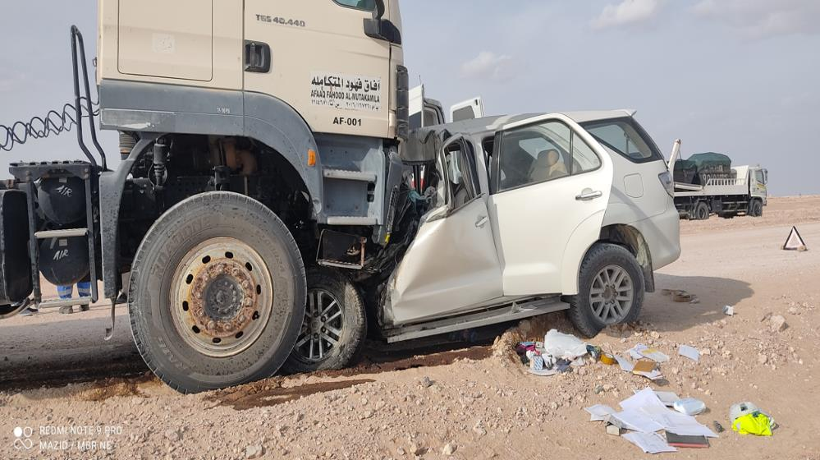
PDO Second Alert
Date:03/10/2021 Incident title: Fat#02/LTI#22 Pattern: MVI Potential severity: C4P
Target Audience: Drilling, Logistics, Operation & Construction
What happened?
On 03rd Oct’21 at 14:36:46Hrs in Mabrouk-Saih Rawl graded road the yellow plate vehicle was overtaking on a dust cloud and had a head on collision with the water tanker which was travelling from Mabrouk to Saih Rawl that resulted in a fatal injury to the driver and multiple fractures to the co-passenger.
Why it happened/Finding :
Use of non PDO Spec vehicle in PDO concession area.
Overtaking in dust cloud
Over speeding
Use of Non-approved vehicle.
Driver not trained to DDC.
Unauthorized visit to PDO concession area.
Your learning from this incident..
Do not overtake in dust cloud
Always ensure to use approved transportation for commuting
Always comply with speed limit and follow defensive driving techniques
Always follow company process when visiting the site
Notes:
Ensure all dates and titles are input
A short description should be provided without mentioning names of contractors or individuals. You should include, what happened, to who (by job title) and what injuries this resulted in. Nothing more!
Four to five bullet points highlighting the main findings from the investigation. Remember the target audience is the front line staff so this should be written in simple terms in a way that everyone can understand.
The strap line should be the main point you want to get across
The images should be self explanatory, what went wrong (if you create a reconstruction please ensure you do not put people at risk) and below how it should be done.

Slide 2
Management Self Audit
Date:03/10/2021 Incident title: FAT#02/LTI#22 Pattern: MVI Potential severity: C4P
As a learning from this incident and ensure continual improvement all contract managers must review their HSE risk management against the questions asked below
Confirm the following:
Do you ensure that all the drivers have undergone DD training?
Do you ensure that all the vehicles are in compliance to SP-2000 requirements?
Do you ensure that the visits of coastal based employees of subcontractors are with due approvals?
Do you ensure that the visitors use only approved vehicles after the designated hubs in PDO concession areas?
Do you ensure access control in the camp and site?
Do you ensure immediate escalation to Senior management for any unauthorized unplanned visits observed?
Do you ensure the intervention when you witness an unsafe act or unsafe condition?
* If the answer is NO to any of the above questions please ensure you take action to correct this finding
Notes:
Ensure all dates and titles are input
Make a list of closed questions (only ‘yes’ or ‘no’ as an answer) to ask others if they have the same issues based on the management or HSE-MS failings or shortfalls identified in the investigation.
Imagine you have to audit other companies to see if they could have the same issues.
These questions should start with: Do you ensure…………………?

