Slide 1
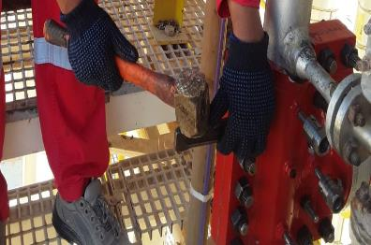
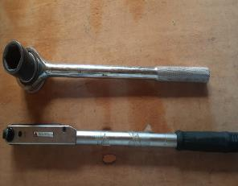
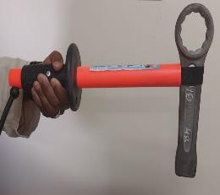
PDO Second Alert
Date:27/10/2021 Incident title: LTI#24 Pattern: Hands & Fingers Potential severity: C3P
Target Audience: Maintenance & Construction
What happened?
On 27/10/2021 at about 11:45am a Pipe Fitter engaged in seal clamp bolting activity inside the Amal station suffered injury on his left thumb as he inadvertently hammered his thumb while hammering the Ring Ended Hammering Spanner resulting in non-displaced fracture on left thumb.
Why it happened/Finding :
Pipe Fitter placed his thumb in line of fire.
Use of suitable tool (spanner with a finger saver tool) was not ensured for the activity
Crew used a spanner instead of wrench due to space constraints.
There was no intervention against the use of spanner for such jobs.
Your learning from this incident..
Always use right tool for the job
Always keep your hand and fingers away from points of potential injury
Always focus on your job and be cautious while using hammer
Intervene on unsafe acts and practices.
Notes:
Ensure all dates and titles are input
A short description should be provided without mentioning names of contractors or individuals. You should include, what happened, to who (by job title) and what injuries this resulted in. Nothing more!
Four to five bullet points highlighting the main findings from the investigation. Remember the target audience is the front line staff so this should be written in simple terms in a way that everyone can understand.
The strap line should be the main point you want to get across
The images should be self explanatory, what went wrong (if you create a reconstruction please ensure you do not put people at risk) and below how it should be done.

Slide 2
Management self audit
Date:27/10/2021 Incident title: LTI#24 Pattern: Hands & Fingers Potential severity: C3P
As a learning from this incident and ensure continual improvement all contract managers must review their HSE risk management against the questions asked below
Confirm the following:
Do you ensure your crews keep themselves away from line of fire while carrying out tasks?
Do you ensure your crews use right tool for the task?
Do you ensure competent supervision for the crews?
Do you ensure your crews provide feedback on safer tools / methods of working?
Do you ensure crew is aware is aware of their empowerment to stop unsafe practices?
* If the answer is NO to any of the above questions please ensure you take action to correct this finding
Notes:
Ensure all dates and titles are input
Make a list of closed questions (only ‘yes’ or ‘no’ as an answer) to ask others if they have the same issues based on the management or HSE-MS failings or shortfalls identified in the investigation.
Imagine you have to audit other companies to see if they could have the same issues.
These questions should start with: Do you ensure…………………?

