Slide 1
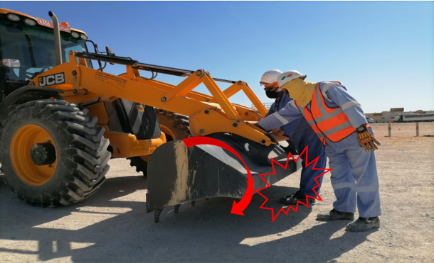
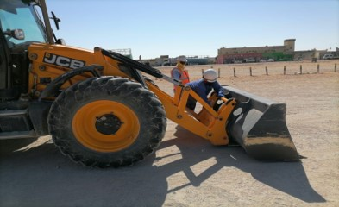
PDO Second Alert
Date: 04/11/2021 Incident title: LTI#25 Pattern: Drops Potential severity: C3P
Target Audience: Logistics, Operation & Construction
What happened?
A hired backhoe loader operator and a banksman were involved in replacement of backhoe bucket at Contractor's temporary Industrial yard. They identified that the bucket releasing lever was jammed due to mud residues and decided to clean by keeping the bucket face down position for better access for cleaning. After cleaning, while the operator was checking the lever, the banksman pulled the lever as he thought that the operator is trying to release the bucket by pulling the lever. The bucket released and skid over operator’s left leg and rest on foot causing displaced fracture of 5th metatarsal bone.
Why it happened/Finding :
The backhoe bucket kept one side raised from ground, created line of fire hazard
The operator kept his foot in a line of fire.
Inadequate communication and coordination between the operator and banksman.
Risk assessment and TBT for the specified activity was not conducted
Learnings from similar past incident with the other contractor was not implemented
Your learning from this incident..
Confirm all the hazards are identified and discussed before starting the job.
Always ensure your legs and body parts are away from line of fire.
Always ensure communication and coordination while working in a group
Ensure employees are made aware of the learnings from similar incidents and protected from pertaining hazards
Keep your body parts away from Line of Fire
Notes:
Ensure all dates and titles are input
A short description should be provided without mentioning names of contractors or individuals. You should include, what happened, to who (by job title) and what injuries this resulted in. Nothing more!
Four to five bullet points highlighting the main findings from the investigation. Remember the target audience is the front line staff so this should be written in simple terms in a way that everyone can understand.
The strap line should be the main point you want to get across
The images should be self explanatory, what went wrong (if you create a reconstruction please ensure you do not put people at risk) and below how it should be done.

Slide 2
Management self audit
Date: 04/11/2021 Incident title: LTI#25 Pattern: Drops Potential severity: C3P
As a learning from this incident and ensure continual improvement all contract managers must review their HSE risk management against the questions asked below
Confirm the following:
Do you ensure that all the activities in Industrial area are supervised effectively?
Do you ensure that LFI learnings are effectively implemented at site?
Do you ensure that equipment control devices are part of your P&E inspection program/checklist?
Do you ensure that your employees are aware of the dangers of “Line of Fire”,
Do you ensure that your employees are aware of the importance of communication and coordination while working in group?
Do you ensure that your Equipment operators follow OEM operations manual and consult with P&E department for cleaning and maintenance of equipment?
* If the answer is NO to any of the above questions please ensure you take action to correct this finding
Notes:
Ensure all dates and titles are input
Make a list of closed questions (only ‘yes’ or ‘no’ as an answer) to ask others if they have the same issues based on the management or HSE-MS failings or shortfalls identified in the investigation.
Imagine you have to audit other companies to see if they could have the same issues.
These questions should start with: Do you ensure…………………?

