Slide 1
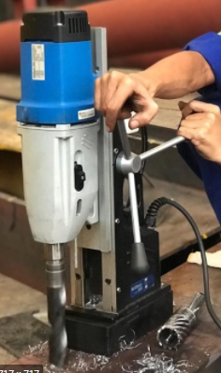
PDO Second Alert
Date:29/10/2021 Incident title: LTI#26 Pattern: Hands and fingers Potential severity: C3P
Target Audience: Drilling, Logistics, Operation & Construction
What happened?
Worker sustained fracture at his righthand metacarpal bone from the portable drilling machine , while he was attempting to drill a 10 mm hole in a 32 mm hydrotesting blind.
Why it happened/Finding :
Improper use of tool
working without supervision
Short cut and was in a haste
Your learning from this incident..
Use right tool for the right job. No short cut
Obtain work permit, safety briefing and precautions taken prior to start any work activity
NO supervisor – No work. Ensure sufficient supervisors available to manage every work safely
Ensure right tools are available as part of planning for any activity
USE THE RIGHT TOOL, FOR THE RIGHT JOB IN THE RIGHT WAY
Notes:
Ensure all dates and titles are input
A short description should be provided without mentioning names of contractors or individuals. You should include, what happened, to who (by job title) and what injuries this resulted in. Nothing more!
Four to five bullet points highlighting the main findings from the investigation. Remember the target audience is the front line staff so this should be written in simple terms in a way that everyone can understand.
The strap line should be the main point you want to get across
The images should be self explanatory, what went wrong (if you create a reconstruction please ensure you do not put people at risk) and below how it should be done.

Slide 2
Management self audit
Date:29/10/2021 Incident title: LTI#26 Pattern: Hands and fingers Potential severity: C3P
As a learning from this incident and ensure continual improvement all contract managers must review their HSE risk management against the questions asked below
Confirm the following:
Do you review and ensure that your employees are using right tool for the use ?
Do you ensure that vertical communication maintained between supervisors and workers are effective ?
Do you ensure all your activities are planned properly
* If the answer is NO to any of the above questions please ensure you take action to correct this finding
Notes:
Ensure all dates and titles are input
Make a list of closed questions (only ‘yes’ or ‘no’ as an answer) to ask others if they have the same issues based on the management or HSE-MS failings or shortfalls identified in the investigation.
Imagine you have to audit other companies to see if they could have the same issues.
These questions should start with: Do you ensure…………………?

