Slide 1
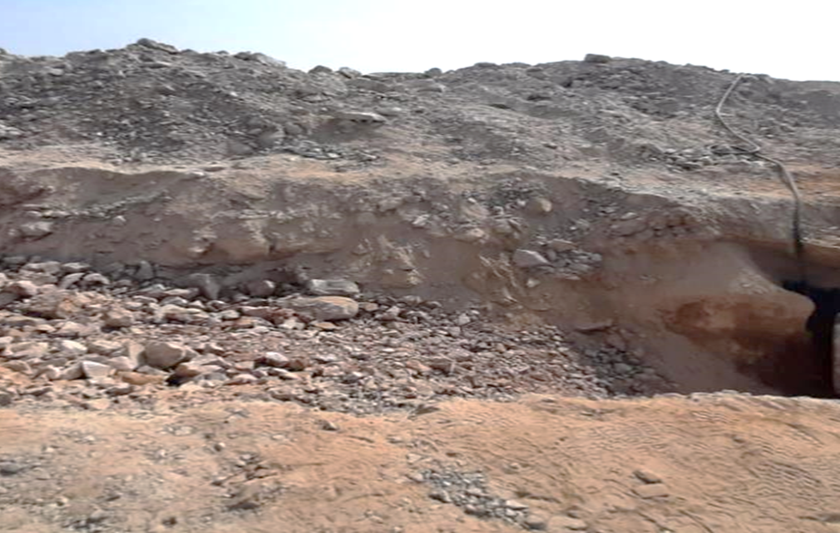
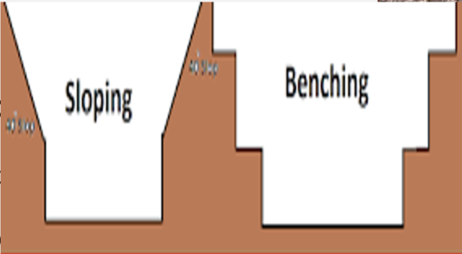
PDO Second Alert
Date:30/11/2021 Incident title: LTI#33 Pattern: Drops Potential severity: C4P
Target Audience: Drilling, Logistics, Operation & Construction
What happened?
Manual excavation was carried out inside the trench using a jackhammer. During this time, a stone embedded from the sidewall of the trench got dislodged, rolled down the access slope, and hit the left side of left leg of the Jackhammer operator resulting in a fracture of the Tibia bone.
Why it happened/Finding :
Inadequate risk assessment
Inadequate identification of hazards present in workplace.
Your learning from this incident..
Learning points for them from the investigation
Always ensure risk & controls are effectively verified before the commencement of the activity
Always ensure you conduct effective toolbox talk .
Always ensure that trenches are inspected prior to personnel entry.
Always ensure that proper slopes, step cuttings, and shoring are provided as required
Stone position
Rolled and hit operator leg
Ensure trenches are safe before personnel entry
Notes:
Ensure all dates and titles are input
A short description should be provided without mentioning names of contractors or individuals. You should include, what happened, to who (by job title) and what injuries this resulted in. Nothing more!
Four to five bullet points highlighting the main findings from the investigation. Remember the target audience is the front line staff so this should be written in simple terms in a way that everyone can understand.
The strap line should be the main point you want to get across
The images should be self explanatory, what went wrong (if you create a reconstruction please ensure you do not put people at risk) and below how it should be done.

Slide 2
Management self audit
Date:30/11/2021 Incident title: LTI#33 Pattern: Drops Potential severity: C4P
As a learning from this incident and ensure continual improvement all contract managers must review their HSE risk management against the questions asked below
Confirm the following:
Do you ensure all Hazards /controls specific to the activity are identified in HEMP and reflected in TRIC?
Do you ensure all control measures implemented are effective in controlling workplace hazards?
* If the answer is NO to any of the above questions please ensure you take action to correct this finding
Notes:
Ensure all dates and titles are input
Make a list of closed questions (only ‘yes’ or ‘no’ as an answer) to ask others if they have the same issues based on the management or HSE-MS failings or shortfalls identified in the investigation.
Imagine you have to audit other companies to see if they could have the same issues.
These questions should start with: Do you ensure…………………?

