Slide 1
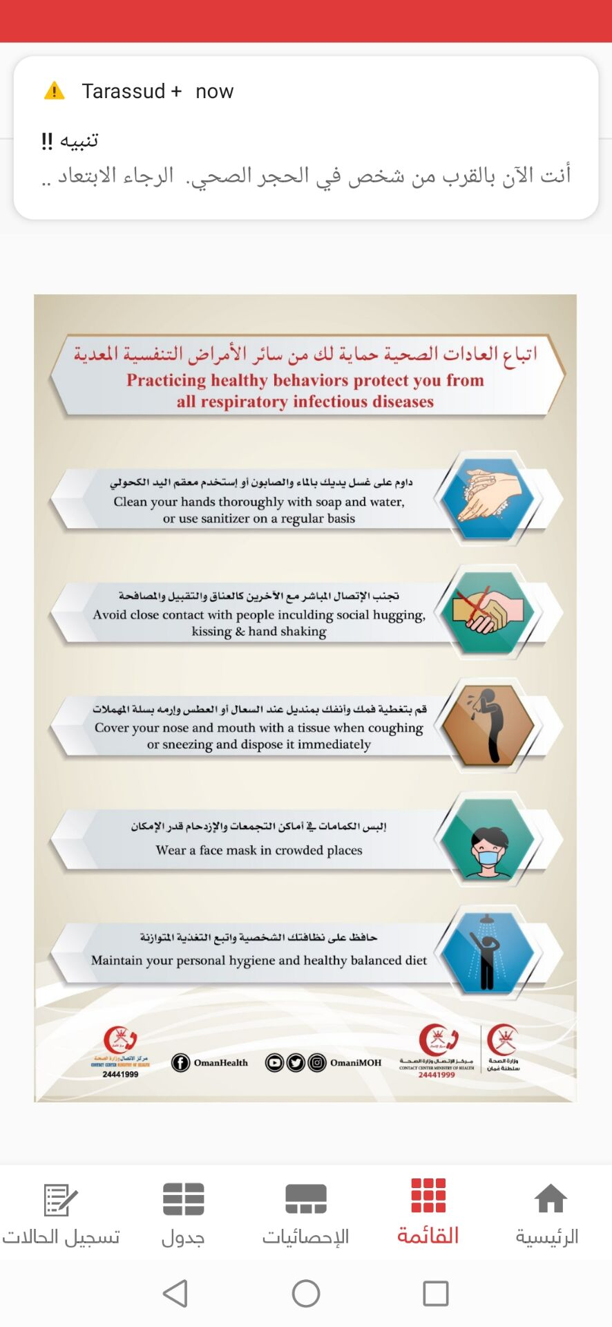
PDO Second Alert
Date:24.04.2021 Incident title: NAD#06
What happened?
On 12 April 2021 Laundry Staff went to the clinic with symptoms of throat pain, Diarrhea and body pain, mild cough. Rig medic examined him and his vital were normal. Discussed with PDO and advised to Quarantine him for 10 days. Next day on 13th he was shifted to Draieh Catering Accommodation, On 16th he admitted to a hospital, PCR test done on 17th & result was positive. On 24th, Draieh Catering reported that he passed away in hospital due to health complications related to the covid-19 infection.
Your learning from this incident..
1. Always ensure to report the health condition to rig medic immediately.
2. Always ensure all site team following with COVID 19 protocols
3. Watch for the COVID-19 symptoms of your colleagues/room mates and escalate it for timely treatment and precautions
Always ensure to follow with COVID 19 protocols and report any health issues immediately
Notes:
No names or detail of company to link this to any recent specific incident

