Slide 1
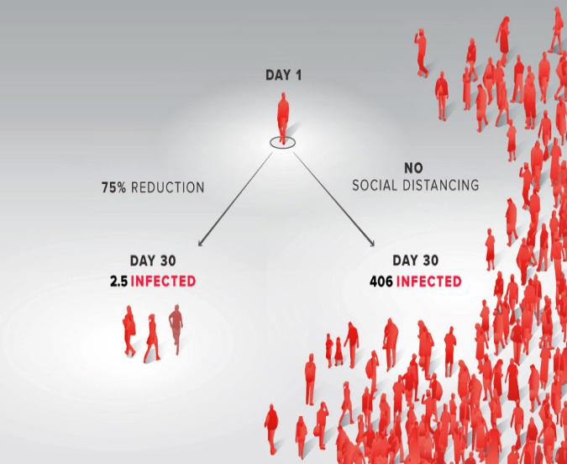
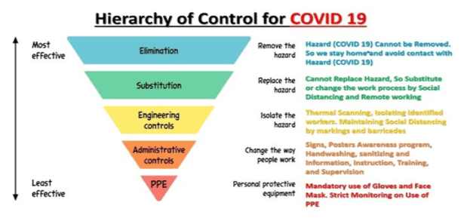
PDO Second Alert
Date: 29.04.2021 Incident title: NAD#08
What happened?
On 17.04.2021 rig Mud Engineer reported to rig medic with COVID-19 symptoms. he taken for test and result was positive. he was taken and admitted in a private hospital. On 22.04.2021 his condition took a turn to the worse. Patient then shifted to Khaula Government hospital where he was on ventilation support in the ICU. His health conditions did not improve. The deceased remained in this critical medical condition until he died on 29.04.2021 at around 11 PM.
Your learning from this incident..
Report any COVID19 symptoms for medical attention and to avoid infection of others
Comply to the COVID-19 controls and mitigation to protect your self and others.
Report any violations against COVID-19 control measures
Adopt implementation of e-self-declaration form 24hrs ahead of any service call-out.
Emphasize on PCR / rapid testing requirement for all rig and non rig based personnel as part of pre-mobilization process
Enforce the BUBBLE CONCEPT and work, act inside your allowed boundaries within required Covid-19 controls.
All should seriously take the lesson from the similar cases whereby complying to rules and best practices we will stop losing colleagues.
Always Follow precautions to avoid the consequence of C-19
Notes:
No names or detail of company to link this to any recent specific incident

