Slide 1
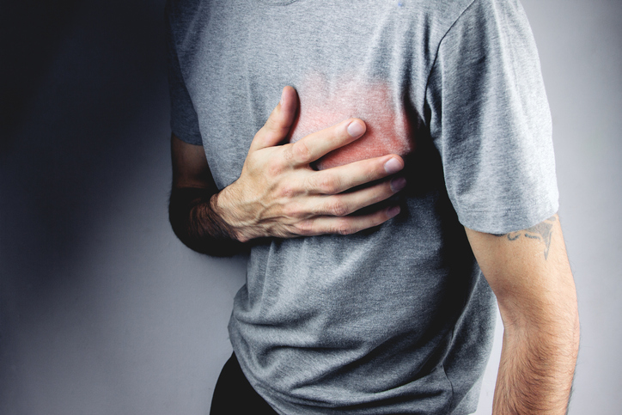
PDO Second Alert
Date: 08 June 2021 Incident title: NAD#12
What happened?
On 08 June 2021 at about 05:15 hrs., an Anwaar Sadad employee of age 59 years, (Bangladesh national) found unresponsive at his room. Immediately the Site In-charge informed to Sahara PAC Rima Male Nurse / PDO Rima HSE. Male Nurse rushed to his room and administered AED but no shock advised. Started CPR for half an hour but no sign of life. Despite of all medical efforts he was declared dead.
Your learning from this incident..
Disclose any illness to your doctor if you are unwell.
If anyone feels discomfort, it shall be informed to your colleagues / supervisor with out delay.
In case of Emergency, EMR system need to be followed and call 5555 for seeking help
Stay fit and maintain healthy life
Notes:
No names or detail of company to link this to any recent specific incident

