Slide 1
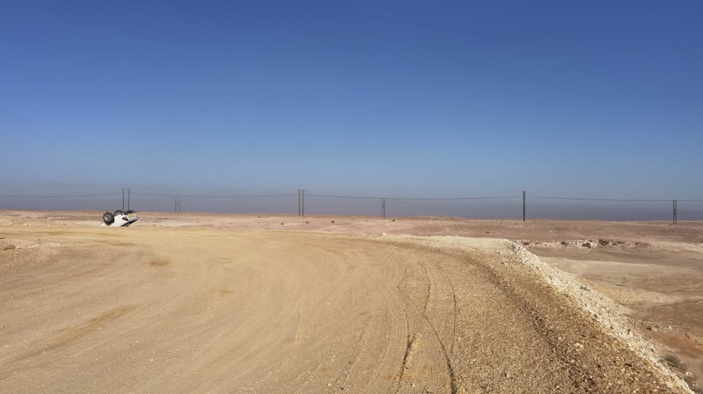
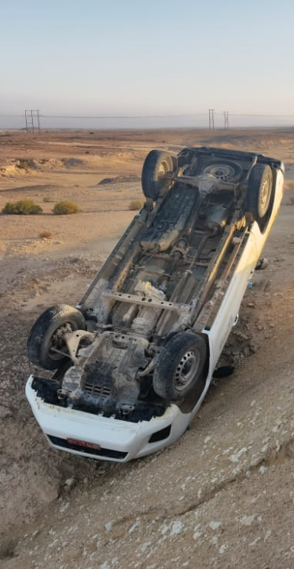
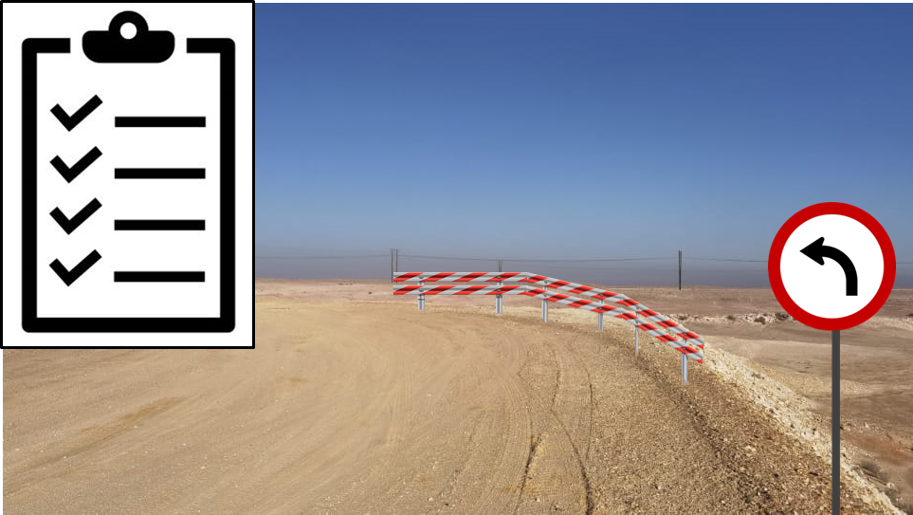
PDO Second Alert
Date:18/10/2021 Incident title: HiPo#58 Pattern: MVI. Potential severity: D4P
What happened?
Schlumberger Artificial Lift crew was heading to Rig-82 after receiving a call out at 5 am. Driving started at 5:38 am and on the way missed the correct turn to the rig. The driver encountered an incline followed by left turn and responded by applying break and turning steering to the left side. The vehicle came to a complete stop on the edge (both right tires were off the edge of the embankment). As the driver was trying to manoeuvre the vehicle off the edge, he turned the wheels to the right and the vehicle lost balance and toppled off the side, landing upside down
Why it happened/Finding :
Absence of road signal indicating immediate sharp left turn after inclined road.
The Driver didn't anticipate the sharp curve after the inclined road. No traffic barrier installed at the sharp turning session of an elevated road.
Vehicles RAS inspection was not valid.
Vehicle's tire was in bad condition.
Your learning from this incident..
Always stay alert, keep your eyes on the driving environment and practice defensive driving techniques.
Always adjust your driving speed according to road condition.
Always STOP and assess when normal conditions change
Maintain safe distances from the edge of the roads.
Report any hazards on the route and bad road conditions to the authorities immediately.
Ensure vehicles are checked on daily basis and rectify the defects before trips.
Ensure vehicles are having valid RAS inspections all the time.
Photo explaining what was done wrong
Target Audience: Drilling, Logistics, Operation & Construction
Notes:
Ensure all dates and titles are input
A short description should be provided without mentioning names of contractors or individuals. You should include, what happened, to who (by job title) and what injuries this resulted in. Nothing more!
Four to five bullet points highlighting the main findings from the investigation. Remember the target audience is the front line staff so this should be written in simple terms in a way that everyone can understand.
The strap line should be the main point you want to get across
The images should be self explanatory, what went wrong (if you create a reconstruction please ensure you do not put people at risk) and below how it should be done.

Slide 2
Management self audit
Date:18/10/2021 Incident title: HiPo#58 Pattern: MVI. Potential severity: D4P
As a learning from this incident and ensure continual improvement all contract managers must review their HSE risk management against the questions asked below
Confirm the following:
Do you ensure all vehicles compliant, in good condition, inspected before every trip with a valid RAS inspection? Is management following up for compliance?
Do you ensure roads inspected and approved for use in operations? Are all non-completed roads closed?
3. Do you ensure to conduct an RHA and installed all appropriate sign boards to define the route to the location?
4. Do you ensure are exercising empowerment to STOP if road conditions change or vehicle is not compliant?
* If the answer is NO to any of the above questions please ensure you take action to correct this finding
Notes:
Ensure all dates and titles are input
Make a list of closed questions (only ‘yes’ or ‘no’ as an answer) to ask others if they have the same issues based on the management or HSE-MS failings or shortfalls identified in the investigation.
Imagine you have to audit other companies to see if they could have the same issues.
These questions should start with: Do you ensure…………………?

