Slide 1
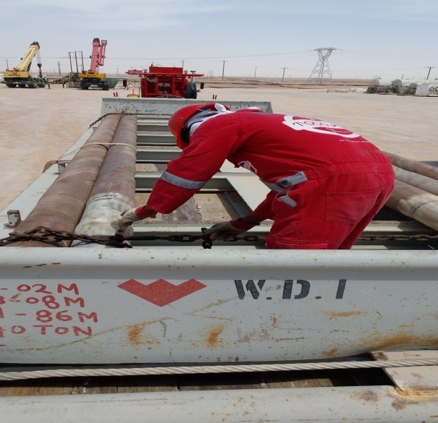
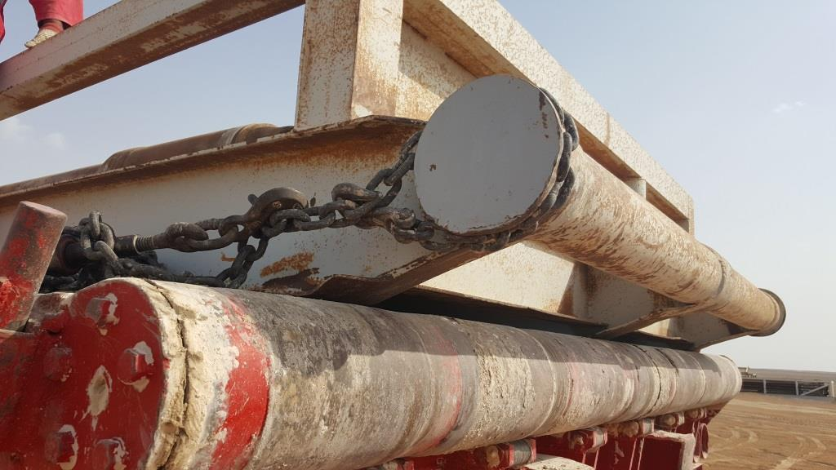
PDO Second Alert
Date: 09.07.2016 Incident title: LTI
What happened?
A Truck Helper and 2 Rig Move helpers (RMH) were in the process of removing the security web belts and chain binders from an open drill collar skid. The RMH’s loosened the chain binder at rear of skid and released tension to the web belt holding 2 of the drill collars. As the tension was released, the inner collar started to roll and crushed the RMH left foot.
Your learning from this incident..
A supervisor must always be present during each securing, releasing , loading/unloading activity.
Do not change load security processes without authority.
Do not stand inside pipe skid bins – in “line of fire”.
Load restraint should be accessible from ground level wherever possible.
Loose loads in skids must be secured to the skid.
Load restraint for skids must pass over the skid pad eyes; to secure the skid to the truck.
Never use the same load restraint to secure the load to the skid and the skid to the truck.
Do not use chains to secure pipes.
Picture of correct process still being sought
Chain lashed to outside of skid over the pad eyes
Do not stand in the LINE OF FIRE

Slide 2
Management self audit
Date: 09.07.2016 Incident title: LTI
As a learning from this incident and to ensure continual improvement all contract managers must review their HSE HEMP against the questions asked below.
Confirm the following:
Are Management visits included e.g. in your HSE Action Plan?
Have management conducted site visits to assure/confirm compliance to procedures/processes on a regular basis?
Do you have procedures/processes for all tasks?
Are your procedures/processes reviewed, up to date, and briefed to relevant staff?
Are procedures readily available to supervisors?
Do supervisors understand the Management of Change (MOC) process and the requirement to seek management approval as and when a MOC is required?
Notes:
Make a list of closed questions (only ‘yes’ or ‘no’ as an answer) to ask other contractors if they have the same issues based on the management or HSE-MS failings or shortfalls identified in the investigation. Pretend you have to audit other companies to see if they could have the same issues.

