Slide 1
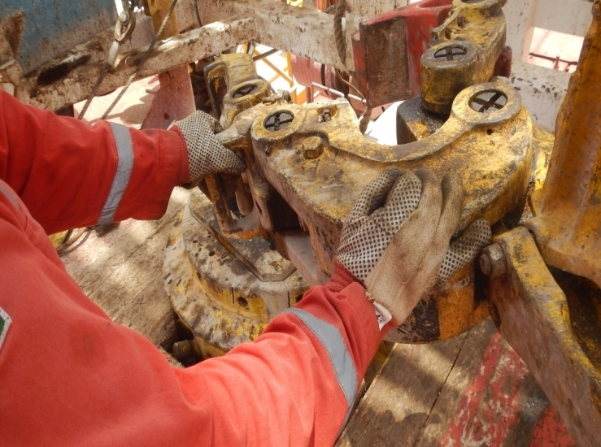
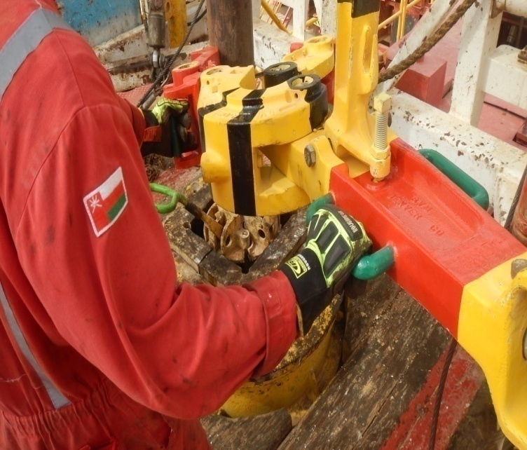
PDO Second Alert
Date: 22.07.2016 Incident title: LTI
What happened?
While making a drill pipe connection, the Derrickman picked up the Break out tong ready to make connection. Along with floorman, he raised the break out tong off the floor. He had his left hand in the correct position on the front tong Jaw, and he placed his right hand further out on the back jaw. As they went to open the jaw to go around the 5” DP, his right little finger was caught between the back jaw and the tong 3 foot arm resulting in crushing his right hand little finger.
Your learning from this incident..
Ensure adequate communication between crew involved in the activity.
Do not place hands at the pinch points.
If possible, do the task hands off.
Ensure there is adequate supervision.
Do not be afraid to use your empowerment to stop.
Always ensure the correct PPE is issued and used
Wrong hand placement
Ensure correct position of hand placement
Safe hand placement

Slide 2
Management self audit
Date: 22.07.2016 Incident title: LTI
As a learning from this incident and to ensure continual improvement all contract managers must review their HSE HEMP against the questions asked below.
Confirm the following:
Does your crew ensure adequate communication ?
Do you ensure proper supervision?
Do you ensure all pinch points are identified and highlighted?
Do you wear high impact gloves?
Notes:
Make a list of closed questions (only ‘yes’ or ‘no’ as an answer) to ask other contractors if they have the same issues based on the management or HSE-MS failings or shortfalls identified in the investigation. Pretend you have to audit other companies to see if they could have the same issues.

