Slide 1
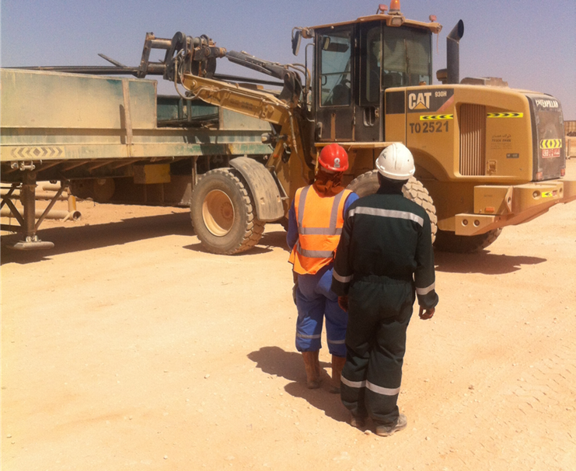
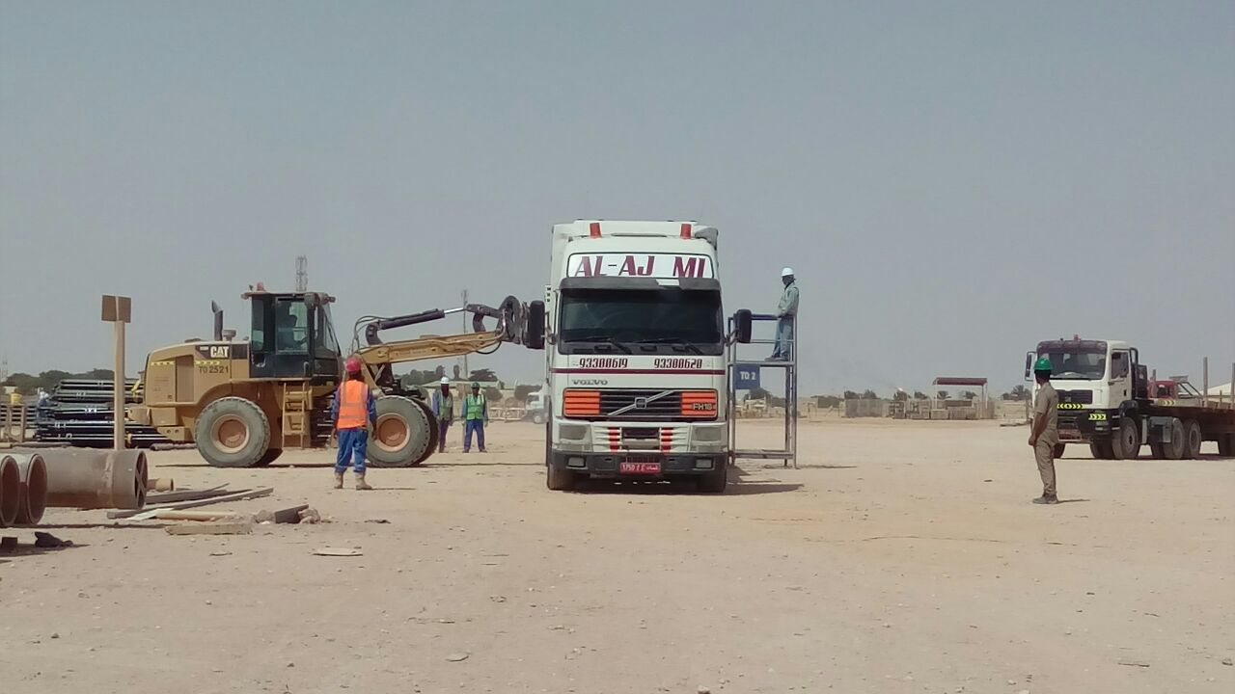
PDO Second Alert
Date:07.08.2016 Incident title: LTI
What happened?
A Forklift was involved in the loading of Sucker Rods into a skid bin that was mounted on the rear of a hoist vehicle and trailer. During the loading operation, the vehicle Truck Helper climbed onto the side of the trailer bed on the opposite side to the forklift. The load was in the process of being tipped from the forks at the time. On seeing the Truck Helper, the forklift operator tipped his forks up in an attempt to stop the pipes from being unloaded; in doing so, the Sucker Rods were rolled off the forks onto the side of the skid bin and struck the vehicle Truck Helper on both legs. Resulting in fractures to both legs.
Your learning from this incident..
All persons must ensure they stay in the safe zone during loading operations.
Loading operations must be supervised.
Ensure the use of Banksman when required.
Ensure you have authorisation to start the job before commencing work.
Do visitors receive a safety briefing when entering operational areas?
Photo explaining what was done wrong
Photo explaining how it should be done right
Stay Clear of Loading Operations

Slide 2
Management self audit
Date:07.08.2016 Incident title: LTI
As a learning from this incident and to ensure continual improvement all contract managers must review their HSE HEMP against the questions asked below.
Confirm the following:
Do you have a safe zone which is away from operations for personnel not involved in lifting operations?
Do you carry out regular management checks to identify shortfalls?
Do your supervisors brief out the whole task to the crew before commencement of the task?
Do your supervisors control the operations from where they have full control of the activity?
Do you ensure you have suitable supervision to manage multiple tasks?
Notes:
Make a list of closed questions (only ‘yes’ or ‘no’ as an answer) to ask other contractors if they have the same issues based on the management or HSE-MS failings or shortfalls identified in the investigation. Pretend you have to audit other companies to see if they could have the same issues.

