Slide 1
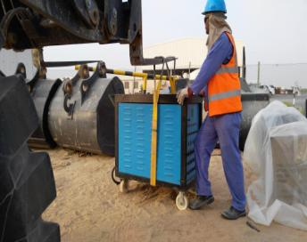
PDO Second Alert
Date: 01.08.2016 Incident title: LTI
What happened ?
Whilst off-loading a Post Weld Heat Treatment machine from a pickup with a Load all, the rigger used a single sling belt to lift up the machine and offload it on to uneven ground. He attempted to adjust it on the ground, however the machine swung to its right landing on his foot resulting in multiple fractures to his right foot.
Learning from this Incident:
Always comply with the standard lifting procedures and never take a shortcut.
All the lifting activities should be carried out under proper supervision.
Stay out of the line of fire.
Comply with Safe Operating Procedures

Slide 2
Management self audit
Date: 01.08.2016 Incident title: LTI
As a learning from this incident and to ensure continual improvement all contract managers must review their HSE HEMP against the questions asked below
Confirm the following:
Does the crew make use of 10 point checklist for lifting ?
Do the supervisors verify available resources before assigning the task?
Does the supervisor monitor the proper use of equipment as per SOP?
Does the crew discuss among themselves the hazards identified in the HEMP?
Does the crew leader ensure required control measures are in place?
Do the supervisors encourage intervention culture among the workforce?
Are the workers aware of consequence Management in case of non-compliance to LSR?
Notes:
Make a list of closed questions (only ‘yes’ or ‘no’ as an answer) to ask other contractors if they have the same issues based on the management or HSE-MS failings or shortfalls identified in the investigation. Pretend you have to audit other companies to see if they could have the same issues.

