Slide 1
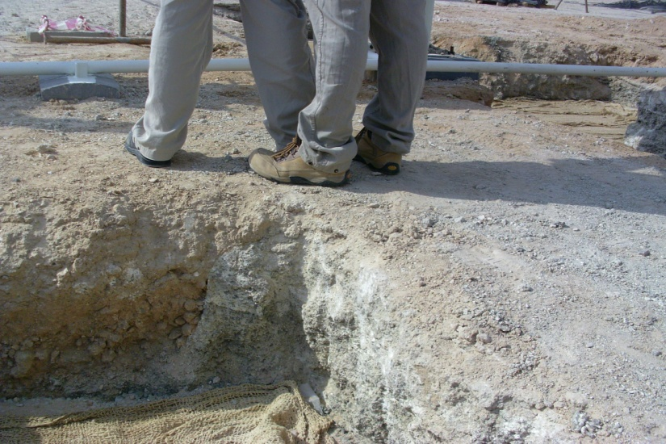
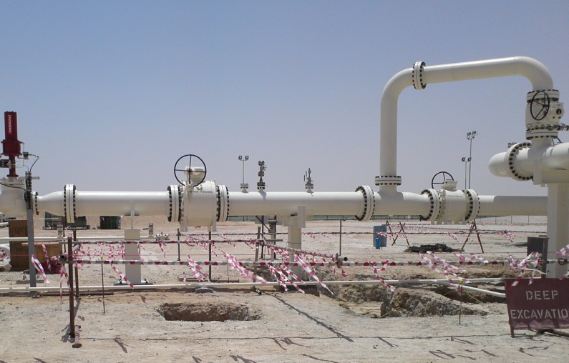
PDO Second Alert
Date : 17.08.2016 Incident title: LTI
What happened?
A contractor Piping Engineer and his colleague were carrying out red line mark-up of engineering drawings for as built purpose at Musallam Oil Station. A pit of depth 54cm was located behind both employees within barricaded construction area. While doing this activity, the Piping Engineer walked backward and accidently stepped over the edge of the pit and twisted his left ankle.
Your learning from this incident.
Observe warning signs.
Check your work position (for your own safety).
Prior to any job at site, conduct a formal TBT/TRIC discussion
Review and challenge the need for Red Line Mark-Up before completion of construction.
Challenge the need for performing non-construction activities within a restricted construction area.
Beware of hazards around you

Slide 2
Management self audit
Date: 17.08.16 Incident title: LTI
As a learning from this incident and to ensure continual improvement all contract managers must review their HSE HEMP against the questions asked below
Confirm the following:
Do you challenge the need to perform engineering activities such as RLMU of PEFS before site readiness (before completing construction activities)?
Do your engineering team, carrying out design verification activities at construction site, conduct formal TBT/TRIC before starting the activities?
Do you regularly monitor and update HSE Training Matrix of your staff?
Do your construction staff challenge the need for performing non-construction activities within a restricted construction area.
Notes:
Make a list of closed questions (only ‘yes’ or ‘no’ as an answer) to ask other contractors if they have the same issues based on the management or HSE-MS failings or shortfalls identified in the investigation. Pretend you have to audit other companies to see if they could have the same issues.

