Slide 1
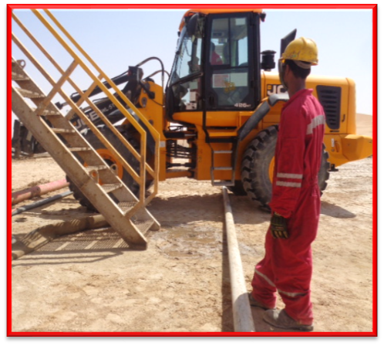
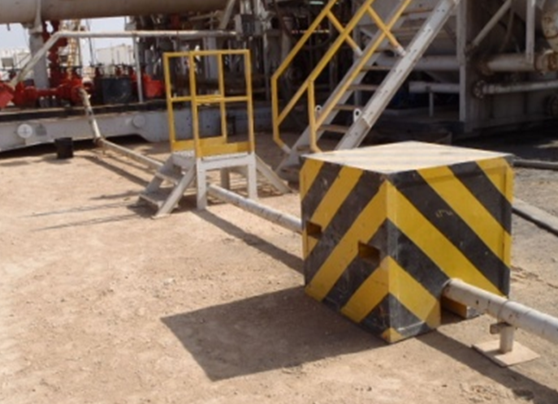
PDO Second Alert
Date: 19.08.2016 Incident title: LTI
What happened?
The fork lift was crossing the flare line guided by two banksmen to reposition the OBM cutting box. The forklift rear tyres while moving over the flare line, pressed the line to make a contact with the ground. At that time the roustabout, waiting for the fork lift to cross the flare line, kept his right foot underneath the line by mistake. He lost his balance and fell backwards when his right foot got caught between the flare line and the ground, resulting in fractures to his right foot ankle.
Your learning from this incident..
Always use the correct lifting equipment for the task.
Always perform the task as per procedure and avoid shortcuts.
Assign authorized banksman with adequate training for the task.
Banksmen must ensure a clear view of the surroundings of the machinery movement path.
Always use the correct lifting equipment

Slide 2
Management self audit
Date: 19.08.2016 Incident title: LTI
As a learning from this incident and to ensure continual improvement all contract managers must review their HSE HEMP against the questions asked below:
Confirm the following:
Do you ensure the correct lifting equipment is available on site?
Do you have an effective TBT with TRIC and JSP to cover all the hazards/risks and controls for the task?
Does your crew understand the meaning of “Line of Fire” and its related hazards and risks?
Do you have an effective audit/assurance process to identify your installations are free from trip/fall hazards or the hazards related to moving machinery over any installed pipelines?
Do you have a system to effectively cascade the HSE flashes & recommended actions of all LTIs and high potential incidents in your work sites?
Notes:
Make a list of closed questions (only ‘yes’ or ‘no’ as an answer) to ask other contractors if they have the same issues based on the management or HSE-MS failings or shortfalls identified in the investigation. Pretend you have to audit other companies to see if they could have the same issues.

