Slide 1
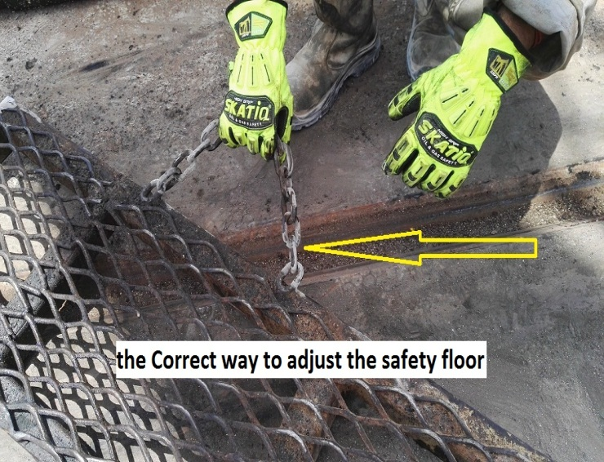
PDO Second Alert
Date: 24.08.2016 Incident title: LTI
What happened?
At 09:30hr and while pull out ESP Pump, ESP Crew were in the process of preparing their handling tool & lifting equipment on the hoist floor. The technician decided to adjust the safety cover of hoist floor to enable him to properly position the ESP table, in the process of doing so he trapped his left hand middle finger between main hoist floor & safety cover of the hoist floor (weighing approx. 25 kg).
Your learning from this incident..
Always ensure the correct lifting procedures are followed.
Make sure all individuals involved in the work have attended the TBT and signed the TRIC.
Ensure not place your hand in a pinch point.
Exercise STOP work authority if the conditions are not safe to work.
Work planning to be discussed amongst all crew involved in the activity.
Do not engage in an activity which you are not trained for.
Beware of pinch points

Slide 2
Management self audit
Date: 24.08.2016 Incident title: LTI
As a learning from this incident and to ensure continual improvement all contract managers must review their HSE HEMP against the questions asked below.
Confirm the following:
Do you ask the “4 Hands and Fingers Golden Questions” in the TBT?
How can the job be done Hands Free?
Do you think about stored energy release that can injure your Hands & Fingers?
Do you identify pinch points & discuss them during your TBT?
Are the hand tools we use fit for the job and used correctly?
Do you provide adequate supervision for third party contractors?
Do you enforce your safety systems on third party contractors?
Does the third party contractor evaluate the risk prior to the commencement of their task?
Notes:
Make a list of closed questions (only ‘yes’ or ‘no’ as an answer) to ask other contractors if they have the same issues based on the management or HSE-MS failings or shortfalls identified in the investigation. Pretend you have to audit other companies to see if they could have the same issues.

