Slide 1
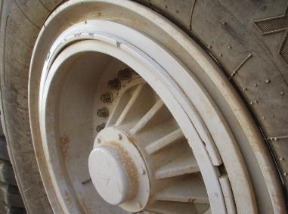
PDO Second Alert
Date: 30.08.16 Incident title: Fatality
What happened:
After completing a rig move, the Rig Maintenance crew noticed the wheel rim locking ring protruding. After numerous attempts to rectify the fault, the Chief Mechanic decided to re-inflate the tyre. Whilst standing in-front of the wheel the locking ring exploded out of its fitting due to the increased pressure in the tyre resulting in the locking ring striking him. The pressure release from the tyre blew him backwards off his feet into the BOP skid. He was pronounced dead soon after.
Your learning from this incident..
Always obtain permission and approval prior to start of any service or maintenance on site, if non routine raise a PTW.
Always consider the risk of “stored energy” while carrying out the task.
Stay away from the “Line of Fire” and from any potential stored energy sources.
Ensure the air hose has an in-line air pressure gauge and sufficient hose length (minimum 3 m) between the clip-on chuck and the in-line gauge.
Any service or maintenance related to tyres should be performed by a competent person in an authorized workshop.
Tyre with pressure reduced to below 80% of the recommended operating pressure, should be removed and sent to authorized work shop for repair.
Locking ring incorrectly seated in rim
Any repairs on tyres shall be done by trained/ competent personnel at approved workshop
Tyre maintenance using tyre cage

Slide 2
Management self audit
Date: 30.08.2016 Incident Title: Fatality
As a learning from this incident and to ensure continual improvement all contract managers must review their HSE HEMP against the questions asked below
Confirm the following:
Do you and your subcontractors have a procedure for Inflation, deflation, change out and performing repairs on tyre / wheel rim assembly including all hazards their risks / consequences and mitigations?
Do you and your subcontractors have a training program developed from the requirements of the above procedure to train employees that perform work of inflation / deflation / replacement or repairs on tyre and wheel rim assembly?
Do you and your subcontractors have a system to manage tyre and wheel rim assembly inspection and maintenance?
Do you or your approved tyre repair workshops have a safety cage to inflate/repair tyre / wheel rim assembly if repairs are carried out at your site or company approved workshops?
Do you and your subcontractors have posters / stickers to warn site staff of the hazards / consequences and controls?
Do you have a system to effectively cascade the HSE Flashes & recommended actions to all staff?
Notes:
Make a list of closed questions (only ‘yes’ or ‘no’ as an answer) to ask other contractors if they have the same issues based on the management or HSE-MS failings or shortfalls identified in the investigation. Pretend you have to audit other companies to see if they could have the same issues.

