Slide 1
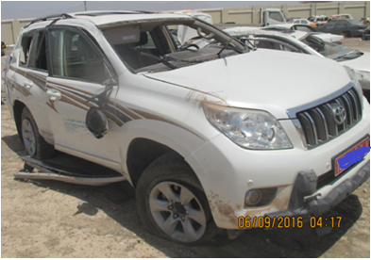
PDO Second Alert
Date: 02.09. 2016 Incident title : LTI - MVI
What happened?
Whilst driving a vehicle from Fahud to Muscat, the driver lost control over the vehicle resulting in multiple rollovers. The driver received a fracture to his left hand.
Your learning from this incident..
Always drive with a valid Journey Management Plan.
Never use a GSM whilst driving.
Comply to speed limits designated for the road.
All company vehicles must be monitored by IVMS Tracking.
Utilize approved means of commuting to and from worksites.
Always intervene if you know (or you think) rules are being broken.
Always follow Life Saving Rules !!

Slide 2
Management self audit
Date: 02.09. 2016 Incident title : LTI - MVI
As a learning from this incident and to ensure continual improvement all contract managers must review their HSE HEMP against the questions asked below
Confirm the following:
Do you ensure all company vehicles meet SP-2000 requirements?
Do you ensure all drivers have appropriate licenses and training?
Do you have an effective Journey Management system in place?
Is the policy on use of a GSM whilst driving communicated and understood by all?
Does the Consequence Management policy provide a deterrent against violations?
Does the Senior Management demonstrate commitment to the company safety policies?
Notes:
Make a list of closed questions (only ‘yes’ or ‘no’ as an answer) to ask other contractors if they have the same issues based on the management or HSE-MS failings or shortfalls identified in the investigation. Pretend you have to audit other companies to see if they could have the same issues.

