Slide 1
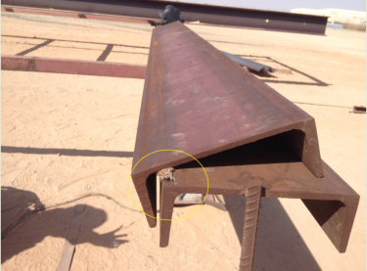
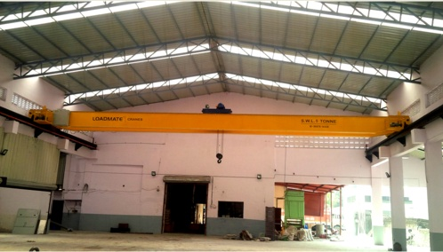
PDO Second Alert
Date: 10.9.2016 Incident title: LTI
What happened?
Two 3rd party Welders were welding a component of ROTAFLEX Gravel Pan frame. The Welders finished welding one side of the c-channel (work piece) of 3.45m length, weighing approximately 159kgs. While they were manually turning the work piece to weld the other side,. the work piece slipped trapping their fingers between the c-channel and the work bench resulting in a lacerated finger of one welder and a fracture to the right thumb of the 2nd Welder.
Your learning from this incident..
Always utilize hands off tools where pinch points could occur.
Always use impact gloves to minimize the severity of hands and fingers injuries.
Ensure sufficient crew are available to complete the work safely.
Ensure adequate supervision is available.
Ensure your hands and fingers are out of the “line of fire”.
Ensure mechanical handling tools are available and utilised.
Pinch points where fingers were trapped.
Wrong manual handling for the work piece
Always use mechanical handling aids when carrying out a heavy lift
Proper mechanical handling for the work piece

Slide 2
Management self audit
Date: 10.9.2016 Incident title: LTI
As a learning from this incident and to ensure continual improvement all contract managers must review their HSE HEMP against the questions asked below.
Confirm the following:
Do you have adequate surveillance protocol and HSE standards to manage your sub-contractors?
Does your sub-contractors management invest sufficient time and energy in their HSE management system?
Does your HEMP / SOP’s contain all hazards, risks and controls associated with the tasks?
Are your procedures reviewed on a regular basis and followed?
Do you have appropriate competency standards for your workforce and supervisors?
Do you Discuss “Hands & Fingers 4 golden” questions in the TBT ?
  How can the job be done Hands Free?
  Do you think about stored energy release that can injure your Hands & Fingers?
  Do you identify pinch points & discuss them during your TBT?
  Are the hand tools we use fit for the job and used correctly?
Notes:
Make a list of closed questions (only ‘yes’ or ‘no’ as an answer) to ask other contractors if they have the same issues based on the management or HSE-MS failings or shortfalls identified in the investigation. Pretend you have to audit other companies to see if they could have the same issues.

