Slide 1
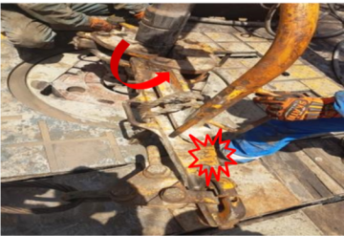
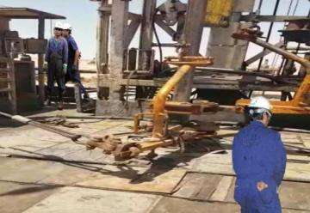
PDO Second Alert
Date: 11.09.2016 Incident title: LTI
What happened?
At approximately 11:50 hrs, the Rig was in process of pulling out of hole, 8 ½” section. Two floor-men were engaged to latch the manual tongs and a third floor-men (FM), injured person was to reposition the back-up tong at the center.
During breaking out of 5” drill pipe joint, after the joint got released, due to the reaction torque in the drill string, the backup tong swung back and hit the FM on his left leg below the knee, resulting in fracture of both bones (Tibia and Fibula ).
Your learning from this incident.
Ensure all hazards are identified and discussed with team members.
Ensure communication between supervisor and team members.
Ensure you are out of the line of fire / red zone.
If in doubt, stop the job and discuss abnormal conditions.
Ensure you are out of the danger zone
Stand clear of maximum swing radius

Slide 2
Management self audit
Date: 11.09.2016 Incident title: LTI
As a learning from this incident and to ensure continual improvement all contract managers must review their HSE HEMP against the questions asked below
Confirm the following:
Are Dynamic risks effectively assessed and communicated?
Does your HEMP covers operational abnormalities (operating outside normal parameters?
Do you ensure adequate HSE performance monitoring for your sub-contractors?
Does your team understand the rules around “red zone” / “No Go Zone”?
Notes:
Make a list of closed questions (only ‘yes’ or ‘no’ as an answer) to ask other contractors if they have the same issues based on the management or HSE-MS failings or shortfalls identified in the investigation. Pretend you have to audit other companies to see if they could have the same issues.

