Slide 1
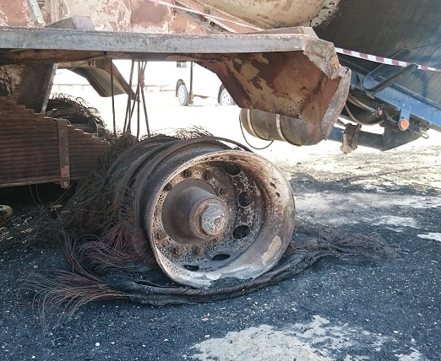
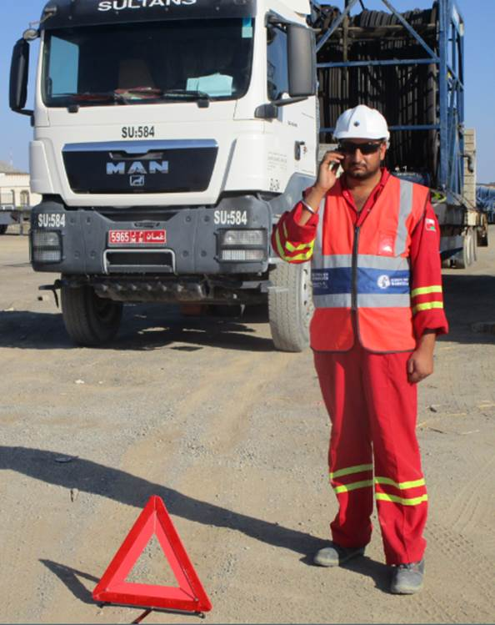
PDO Second Alert
Date: 16.09.2016 Incident title: LTI
What happened?
Banana Truck was moving from the Rig camp to the Rig 99. While on the graded road, the driver felt the truck is resisting movement. He stopped about 2 km before the Rig site and saw fire starting on the back tyres of the banana. He tried to extinguish the fire with vehicle fire extinguisher. During his attempt, one of the tyres burst and a piece of rubber hit him on the right side of his face.
Your learning from this incident..
Ensure you stop and report immediately if you observe a vehicle fault.
Ensure you call PDO emergency services on 5555 for any emergency.
Always ensure you avoid putting yourself in the “line of fire”.
Only fight a fire if it is safe to do so and you are competent.
Photo explaining what was done wrong
Photo explaining how it should be done right
Immediately stop and report in event of vehicle failure or emergency

Slide 2
Management self audit
Date: 16.09.2016 Incident title: LTI
As a learning from this incident and to ensure continual improvement all contract managers must review their HSE HEMP against the questions asked below
Confirm the following:
1. Are all your drivers trained in basic fire safety?
2. Do all your drivers understand what to do in a vehicle fault or in emergency situation? 3. Do you monitor quality of TBT’s and ensure they cover fire and other emergencies?
4. Do you ensure vehicles maintenance is proper and up to date?
5. Do you ensure your drivers having the required competence?
6. Do you ensure 24 hr IVMS monitoring of your vehicles?
Notes:
Make a list of closed questions (only ‘yes’ or ‘no’ as an answer) to ask other contractors if they have the same issues based on the management or HSE-MS failings or shortfalls identified in the investigation. Pretend you have to audit other companies to see if they could have the same issues.

