Slide 1
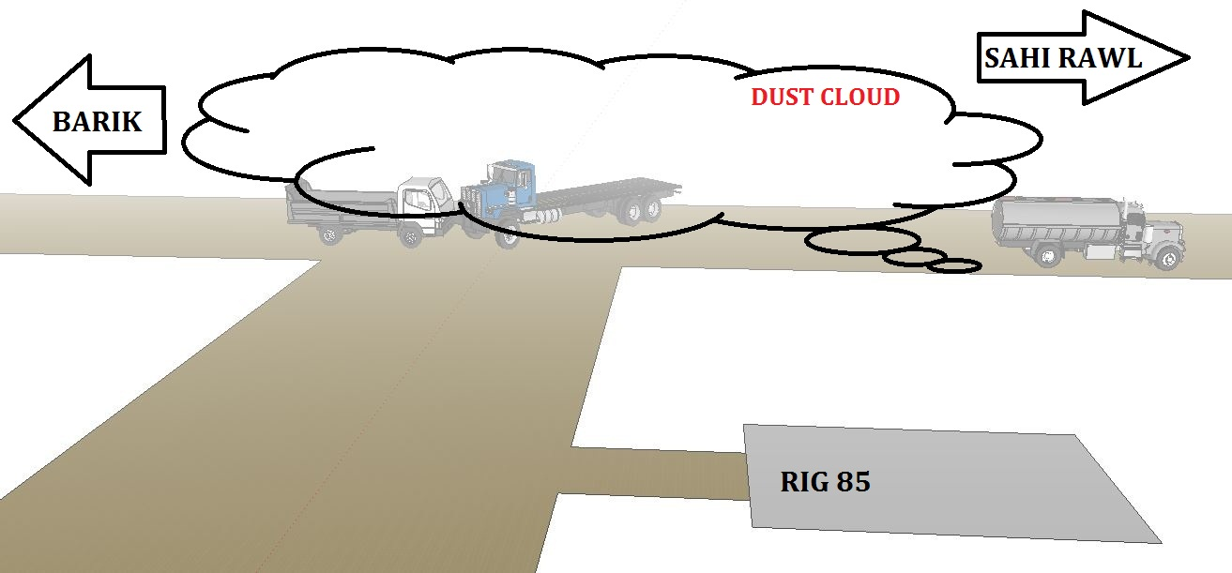
PDO Safety Advice
Use this Alert: Discuss in Tool Box Talks and HSE Meetings ➔ Distribute to contractors ➔ Post on HSE Notice Boards ➔ Include in site HSE Induction
Date: 26.03.2014
Injury: Multiple fracture, Motor Vehicle Incident (MVI)
What happened?
The driver of an oilfield truck on a graded road decided to turn left at a junction but not to wait for a dust cloud from a passing vehicle to settle. Another canter lorry was approaching from the opposite direction and they did not see each other in the dust cloud. The two vehicles collided resulting in severe leg injuries to the canter driver and damage to both vehicles.
Your learning from this incident..
Never turn across a carriageway in a dust cloud.
Never drive in a dust cloud.
Never drive closer than 4 seconds behind a dust cloud.
Driving in a dust cloud is like driving
at night with no lights on
Contact: MSE54 for further information or visit the HSE Website Learning No 19 26/03/2014

Slide 2
Management learning's
Use this Alert: Distribute to contractors ➔ Discuss in Meetings
Date: 26.03.2014
Injury: Multiple fracture, Motor Vehicle Incident (MVI)
As a learning from this incident and ensure continual improvement all contract
managers are to review their HSE HEMP against the questions asked below
Confirm the following:
Do you effectively engage with your drivers with interesting tool box talks?
Do you communicate learnings from incidents effectively?
Do you have a system to ensure actions from lateral Learnings are implemented?
Is the alert/learning advice understood by the crew members?
Contact: MSE54 for further information or visit the HSE Website Learning No 19 26/03/2014

