Slide 1
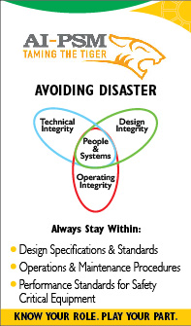
PROCESS SAFETY DAY OCTOBER 28th 2014
KNOW YOUR ROLE – PLAY YOUR PART

Slide 2
Agenda
Welcome, HSE Induction and Set the Stage – 15 minutes
Watch MD’s message – 5 minutes
What did you learn from MD’s message – 5 minutes?
Watch the AI-PSM and Refinery Explosion Video – 15 minutes
Engagement – “What’s Your Role” – 30 minutes
Reflection and Commitment – 10 minutes
Resources : Process Safety Day Website

Slide 3
Why Process Safety Day?
Objective
Asset Integrity and Process Safety Management (AI-PSM) is a crucial matter for our survival and future success
The 2014 Process Safety Day focus is to raise and maintain awareness of the AI-PSM program throughout the organization.
Outcome
Each one of us better understands his/her role in improving AI-PSM performance
Raise the profile of AI-PSM and make it a top priority.

Slide 4
Process Safety Incidents at PDO (2009 – 2014*)
There is a fundamental need to review our safety controls (barriers) for major accident hazards
* Till 28th Oct 2014
Notes:
1. Bahja GS Export line leak – 14th December 2013
During a routine station check a leak was observed from the 12” station discharge header from an existing clamp location. The station was stopped at 08:00 hrs as per normal sequence including all incoming wells. The discharge line was isolated and depressurized. A civil crew o started the clean up prior to attempts to arrest the leak. Re-clamping included using a new rubber sheet and tightening of the clamp. The line was re-pressurized however the clamp failed again. The plant was shutdown , Decision was taken to shutdown the station , the line was depressurized, drained and flushed, then the area was made safe for hot work and patch welding. The station was re-started at 00:05 hrs, no more leaks were observed.
Loss: 14.73m³ crude lost from primary containment
3. SARMAD-1 Oil Spill- 09.12.2013
Around 16:00 hrs the day shift field operator went to fit a pressure gauge on a standalone old plugged well with no flow line. Whilst checking the annulus he noted a pressure of 320 barg. He informed his supervisor who told him to return and bleed it off. Wearing BA he entered the cellar and opened the A annulus valves first by opening the needle valve and then the gate valve #2. After a few seconds a jet of fluid came out of the vent into the cellar creating a gas and dust cloud which set off his personal H2S monitor. They exited the well pad and waited for 15mins to see if the gas flow would stop. Now dark they left the well and asked the night shift to monitor it, but he didn’t and the next morning the day shift field operator found oil all over the well pad and in the cellar pit. He closed the gate valve#2 wearing a chemical suit and rubber boots.
4. Wafra Header leak - 19th September 2013

Slide 5
Process Safety – what is it all about?
Petroleum’s biggest benefit – is its ability to burn
which is also its most significant risk.
Ensuring the safety and integrity of our assets is of paramount importance to you and PDO.
For us, process safety means making sure our facilities are:
well designed, safely operated, and properly inspected and maintained
able to prevent process safety incidents that could place our people, our neighbors, the environment and our facilities at risk.
We aim to ensure that……..
Our Assets Are Safe and We Know It.

Slide 6
The Golden Rules
The Golden Rules of Health, Safety and Environment are:
Comply with the law, standards and procedures
Intervene in unsafe or non-compliant situations
Respect our neighbours.
This year our focus is on compliance which can further be extended to the theme of the Process Safety Day:
“KNOW YOUR ROLE – PLAY YOUR PART”
Process safety management: a commitment by PDO, a role and
responsibility for everyone.

Slide 7
MD’s Message
Please watch the video message from Managing Director Raoul Restucci (5 Minutes)
MD's Message
(Link will work for PDO staff only for contactors please download from the PS webpage)

Slide 8
What did you learn ?
After watching the MD’s message, what have you learned so far?

Slide 9
Process Safety Day Video
Watch the introductory 15 minutes video
Process Safety Day
(Link will work for PDO staff only for contactors pls. download from the PS webpage)

Slide 10
Process Safety Barriers
Multiple barriers prevent us from a process safety incident. These barriers could be hardware barriers (e.g. shutdown system) and human barriers (following a procedure)
Every incident investigation shows that a series of barriers have failed over a period of time. The first barriers may have failed months or even years earlier
Each person who works at PDO has a role in keeping the barriers intact. You may be:
An employee or contractor
At the site or in the office
From a technical or non-technical discipline.
In some small or large way you create, maintain, support or defend
critical hardware or human barriers.

Slide 11
Process Safety Barriers – In your role where do you fit in?
What critical activities do you perform?
Applying appropriate engineering standards for projects
Maintaining safe operating conditions
Monitoring Instruments and following procedures
Inspecting and repairing critical equipment barriers
Identifying hazards and designing barriers
Conducting hazards analysis
Keeping documents such as procedures or drawings up to date
Training employees and managing competencies
Updating / making new procedures / standards
Assigning adequate resources
Clearly defining expectations, responsibilities and authority
Funding of process safety-critical projects
Performance monitoring, audits, reviews etc
Contractor HSE management and supervision
Spare parts availability
Emergency management
Turnarounds
Construction, commissioning, start-ups
HSE compliance management
Security management / access control
Learning from incidents
External stakeholder management
And there could be much more…

Slide 12
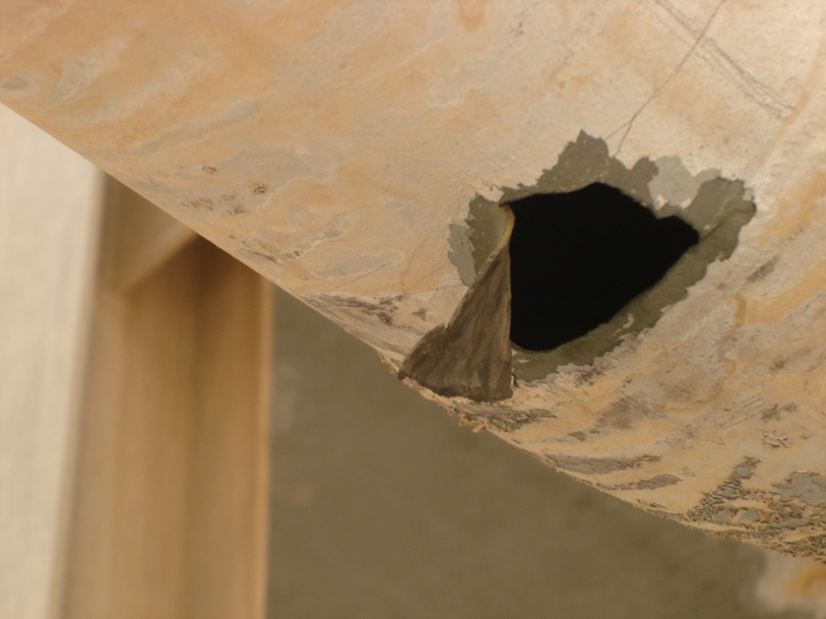
Actual Footage Of A Process Safety Incident
This is a CCTV footage of an explosion which happened in a refinery at Mexico in 2012.This explosion resulted in 26 fatalities
Watch the Actual Video Footage of the Refinery Explosion in Mexico (1 minute)
(Link will work for PDO staff only for contactors please download from the PS webpage)
We at PDO had process safety incidents which could had the potential of
similar explosion
34 kg/s leak, 73 bar
Lekhwair Gas Release
(2011)

Slide 13
GROUP DISCUSSION - Ask yourself !
What are the risks that could exist in my area of the plant?
What are the barriers that we rely on to manage these risks?
What is my role in creating and maintaining these barriers?
Are there any problems with the barriers? Are the barriers effective?
After the discussion each group leader will present their group answers.

Slide 14
Today’s learning
Acting safely means we comply with the procedures and systems
Each of our actions is a part of a bigger picture. Together we can reduce the
probability of a major accident.
What do we do from here
Agree on tangible actions which will improve the process safety performance
Highlight genuine process safety concerns for escalation to the management
Review and reaffirm commitment to comply with agreed policies and procedures.

Slide 15
For Technical Staff Only Ask yourself: In your role, do you need more knowledge on
HSE cases
Design and engineering standards
Safety-critical elements (SCEs)
Process safeguarding memorandums
Updated plant operating manuals
HAZOP reports
Asset register
IPF reports
Permit To Work
Emergency response plans
Corrosion management philosophy- inspection plans and records
Competency requirements
Management of change
Operating envelope, AI-PS critical registers, shift handovers
Incident investigation and reporting
PSBR compliance
Audits and reviews

Slide 16
GIVE FEEDBACK ON THE WEBSITE ON ?
What is the general understanding and awareness of Process Safety within your department?
Do you really think that there is a case for effective process safety management and are you personally committed?
Which operations give you a feeling of unease and why? What are your concerns ?
Is enough support and facilities available for managing Process Safety issues?
Do you feel that certain activities affecting process safety get too little attention?
Are you empowered to raise process safety concerns and take right actions including stopping operations when not safe?
How can we further improve on our performance?
Please participate in the “quiz” and “find the problem” contest available at the link
Interesting prizes await for 20 winners

