Slide 1
PDO Incident First Alert 2020 Summary
LTI No | Date | Injury | LTI No | Date | Injury
LTI#01 | 01.01.2020 | Hands and Fingers | LTI#17 | 28.08.2020 | Hands & Fingers
LTI#02 | 18.01.2020 | Head Injury | LTI#18 | 29.07.2020 | Slip & Fall
LTI#03 | 29.01.2020 | Hands and Fingers | LTI#19 | 20.08.2020 | Rollover
LTI#04 | 04.02.2020 | Fall from Height | LTI#20 | 16.09.2020 | MVI
LTI#05 | 01.04.2020 | Struck by | LTI#22 | 14.09.2020 | Hands & Fingers
LTI#06 | 13.04.2020 | Slip & Fall | LTI#23 | 17.09.2020 | Slip, Trip & Fall
LTI#07 | 24.4.2020 | Hands and Fingers | LTI#24 | 20.09.2020 | Hands & fingers
LTI#08 | 07.05.2020 | Slip & Fall | LTI#25 | 04.10.2020 | Drops
LTI#09 | 07.05.2020 | Slip & Fall | LTI#26 | 06.10.2020 | Hands & Fingers
LTI#10 | 17.5.2020 | Hands and Fingers | LTI#27 | 14.10.2020 | Drops
LTI#11 | 13.6.2020 | Struck by | LTI#28 | 15.10.2020 | Fire & Explosion
LTI#12 | 30.6.2020 | Slip & Fall | LTI#29 | 24.10.2020 | Struck by
LTI#13 | 27.6.2020 | Struck by | LTI#31 | 15.12.2020 | Hands & Fingers
LTI#14 | 03.07.2020 | Struck by | LTI#32 | 16.12.2020 | Slip, Trip & Fall
LTI#15 | 15.7.2020 | Fall from Height | LTI#33 | 19.12.2020 | Released Energy
LTI#16 | 21.8.2020 | Released Energy | LTI#34 | 22.12.2020 | Hands & Fingers
For enquiries or comments on these slides, please Contact; MSE3 TEAM

Slide 2
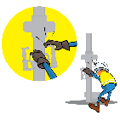
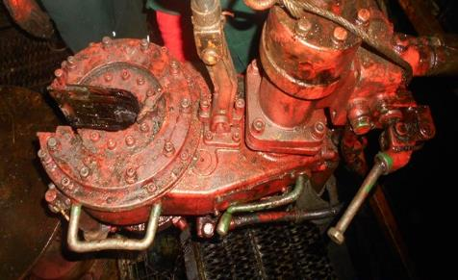
PDO Incident First Alert
Incident Type | LTI#01 | Pattern
Date / Time | 01.01.2020@19:15hrs | Directorate
Location | Qaharir | Dept
Target Audience
Drilling, Operations, Engineering & Construction
What happened
While the Floorman was pushing the Sucker Rod power tong toward the Mast, the power tong operated pinching his finger in the jaws.
Mr. Musleh asks the questions of can it happen to you?
Do you always use the handles provided?
Do you ensure you keep your hands and fingers away from pinch points?
Do you ensure you identify all hazards before starting a task?
Please disseminate this LTI notification to your teams and use it in your tool box talks and HSE meetings and notice boards.

Slide 3
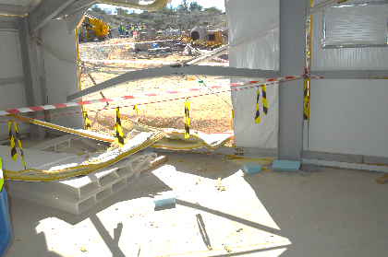
PDO Incident First Alert
Incident Type | LTI#02 | Pattern | Struck By
Date / Time | 18.01.2020@13:00hrs | Directorate
Location | RAH Project | Dept
Target Audience
Drilling, Operations, Engineering & Construction
What happened
A telehandler moved backwards striking the wall of the rest area, leading to the collapse of the wall which fell onto a mason who was resting inside the rest area.
Mr. Musleh asks the questions of can it happen to you?
Do you ensure Plant & Equipment is parked on level ground?
Do you ensure vehicle hand brake is applied and chocks in place?
Are you are aware of the site emergency plan when an incident occurs?
Please disseminate this LTI notification to your teams and use it in your tool box talks and HSE meetings and notice boards.

Slide 4
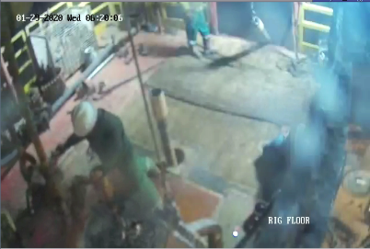
PDO Incident First Alert
Incident Type | LTI#03 | Pattern
Date / Time | 29.01.2020@06:20hrs | Directorate
Location | Bahja | Dept
Target Audience
Drilling, Operations, Logistics, Engineering & Construction
What happened
While the Floorman was attempting to latch the elevator, he crushed his left thumb between the elevator and the drill pipe.
Mr. Musleh asks the questions of can it happen to you?
Do you stop and ask for help when needed?
Do you ensure you keep your hands and fingers away from pinch points?
Do you ensure you identify all hazards before starting a task?
Please disseminate this LTI notification to your teams and use it in your tool box talks and HSE meetings and notice boards.

Slide 5
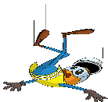
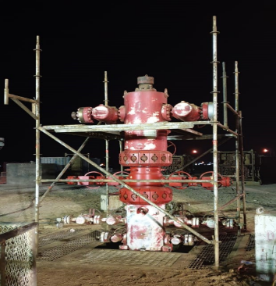
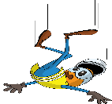
PDO Incident First Alert
Incident Type | LTI#04 | Pattern | Fall from height
Date / Time | 04.02.2020@22:30hrs | Directorate
Location | Saih Rawl | Dept
Target Audience
Drilling, Operations, Logistics, Engineering & Construction
What happened
While the Equipment Operator was climbing on the scaffold’s lower crossbeam, he slipped and fell onto the cellar grating fracturing his right ankle.
Mr. Musleh asks the questions of can it happen to you?
Do you consider if you can fall from height?
Do you check that your boots are not slippery ?
Do you ensure you have safe access and egress?
Do you always ensure you keep 3 points of contact when climbing down?
Please disseminate this LTI notification to your teams and use it in your tool box talks and HSE meetings and notice boards.

Slide 6
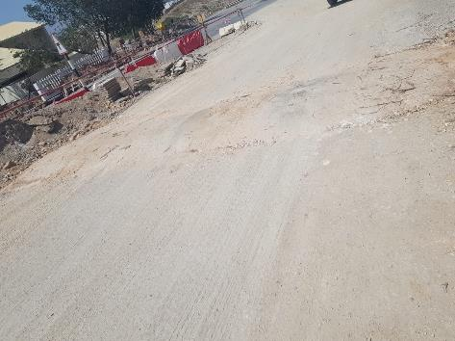
PDO Incident First Alert
Incident Type | LTI#05 | Pattern | Struck By
Date / Time | 01.04.2020@06:00hrs | Directorate
Location | RAH Project | Dept
Target Audience
Construction, Operations, Logistics, Engineering & Drilling
What happened
While travelling to site by bus, when the bus crossed a speed hump, the civil foreman was thrown upwards striking his head on the roof suffering a neck injury.
Mr. Musleh asks the questions of can it happen to you?
Do you ensure all vehicle occupants are wearing seat belts?
Do you intervene with the driver when you feel unsafe?
Do you reduce your speed while crossing speed humps?
Please disseminate this LTI notification to your teams and use it in your tool box talks and HSE meetings and notice boards.

Slide 7
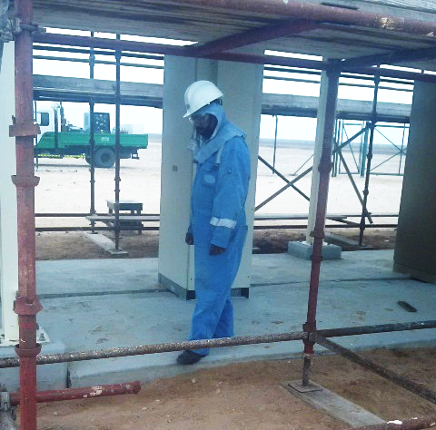
PDO Incident First Alert
Incident Type | LTI#06 | Pattern | Slip & Fall
Date / Time | 13.04.2020@12:15hrs | Directorate
Location | Qarn Alam | Dept
Target Audience
Construction, Operations, Logistics, Engineering , Exploration & Drilling
What happened
While stepping down from a concreate floor, the Rigger slipped twisting his left ankle resulting in a fracture.
Mr. Musleh asks the questions of can it happen to you?
How do you ensure where you are stepping is free from Hazards?
How do you ensure you have safe access and egress at your work and camp site?
How do you identify Slip, Trips and fall points at work and camp site?
Please disseminate this LTI notification to your teams and use it in your tool box talks and HSE meetings and notice boards.

Slide 8
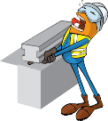
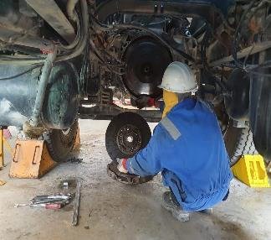
PDO Incident First Alert
Incident Type | LTI#07 | Pattern | Hands & fingers
Date / Time | 22.04.2020@13:45hrs | Directorate
Location | Fahud | Dept
Target Audience
Construction, Operations, Logistics, Engineering , Exploration & Drilling
What happened
While the Mechanic was removing the clutch from a tanker, the clutch disc slipped and fell on his left hand crushing his middle finger.
Mr. Musleh asks the questions of can it happen to you?
How do you ensure you identify all hazards before starting a task?
Do you consider “what could go wrong?”
How do you ensure you handle equipment properly?
How do you ensure your Hands & Fingers are away from ‘Line of Fire’?
Please disseminate this LTI notification to your teams and use it in your tool box talks and HSE meetings and notice boards.

Slide 9
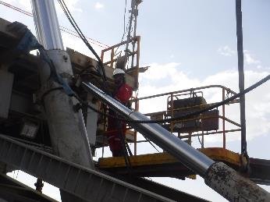
PDO Incident First Alert
Incident Type | LTI#08 | Pattern | Slip , Trip & Fall
Date / Time | 07.05.2020 at 01: 30:00hrs | Directorate
Location | Yibal | Dept
Target Audience
Construction, Operations, Logistics, Engineering , Exploration & Drilling
What happened
Whilst removing a pin between the mast cylinder and support cylinder, the AD was attempting to hammer the pin out, to gain a better position he came out of the cherry picker and fell striking his body on the cross beam fracturing his left rib.
Mr. Musleh asks the questions of can it happen to you?
How do you ensure you identify all hazards before starting a task?
Do you consider “what could go wrong?”
Do you consider if you can fall from height?
Do supervisors ensure staff wear safety harnesses when working at height?
Please disseminate this LTI notification to your teams and use it in your tool box talks and HSE meetings and notice boards.

Slide 10
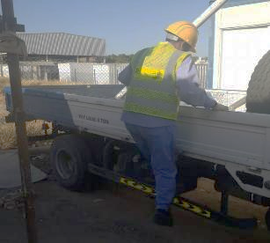
PDO Incident First Alert
Incident Type | LTI#09 | Pattern | Slip , Trip & Fall
Date / Time | 09.05.2020 at 08: 30:00hrs | Directorate
Location | Min Al Fahal | Dept
Target Audience
Construction, Operations, Logistics, Engineering , Exploration & Drilling
What happened
While the Mason was climbing over the side of a 3t truck, he lost his balance falling backwards fracturing his wrist.
Mr. Musleh asks the questions of can it happen to you?
How do you ensure you identify all hazards before starting a task?
Do you consider “what could go wrong?”
Do you consider if you can fall from height?
Do you consider safe access and egress?
AD fell into the cross beam
Please disseminate this LTI notification to your teams and use it in your tool box talks and HSE meetings and notice boards.

Slide 11
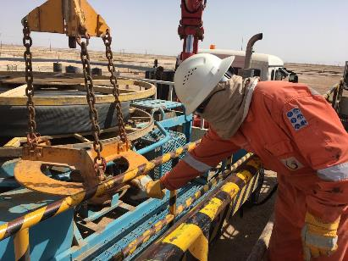
PDO Incident First Alert
Incident Type | LTI#10 | Pattern | Hands and Fingers
Date / Time | 17.05.2020@11:00hrs | Directorate
Location | Qarn Alam | Dept
Target Audience
Drilling, Operations, Engineering, Construction & Logistics
What happened
While the Assistant Technician was trying to free the stuck hose reel lifter, his right hand index finger was crushed between the hose reel lifter plate and the handrails of the HIAB truck.
Mr. Musleh asks the questions of can it happen to you?
How do you always ensure to use handoff methods ?
How do you ensure your hands and fingers are away from pinch points?
How do you ensure you identify all hazards before starting a task?
How do you effectively communicate the hazards and risk before the task?
Please disseminate this LTI notification to your teams and use it in your tool box talks and HSE meetings and notice boards.

Slide 12
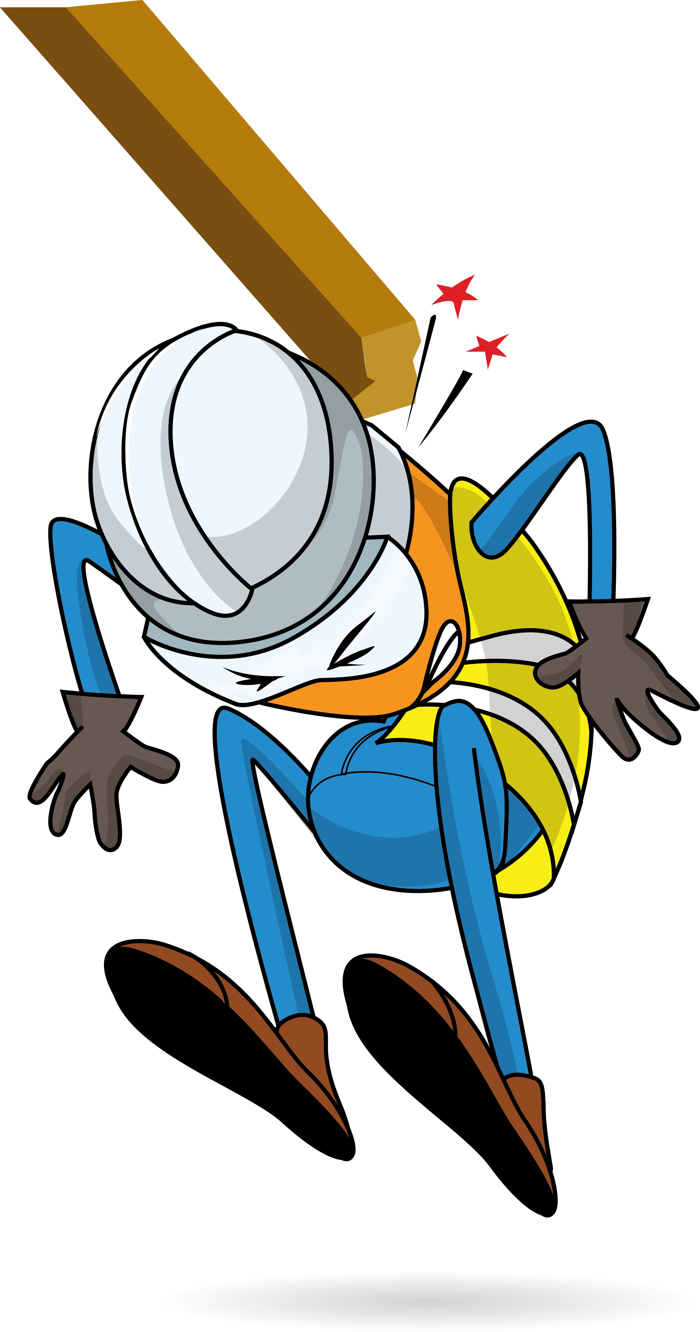
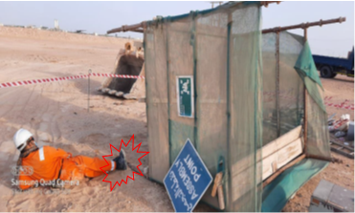
PDO Incident First Alert
Incident Type | LTI#11 | Pattern | Struck by
Date / Time | 13.6.2020@16:40hrs | Directorate
Location | Qarn Alam | Dept
Target Audience
Construction, Operations, Logistics, Engineering , Exploration & Drilling
What happened
A civil crew were about to leave site, the scaffold rest shelter toppled over striking the Civil Technician’s on his right leg.
Mr. Musleh asks the questions of can it happen to you?
How do you ensure you identify all hazards before starting a task?
Do you consider “what could go wrong?”
Do you consider if you are away from ‘line of fire’ released energy?
Please disseminate this LTI notification to your teams and use it in your tool box talks and HSE meetings and notice boards.

Slide 13
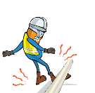
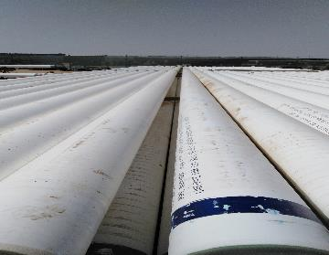
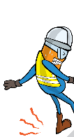
PDO Incident First Alert
Incident Type | LTI#12 | Pattern | Slip, trip & fall
Date / Time | 30.06.2020@06:30hrs | Directorate
Location | Qarn Alam | Dept
Target Audience
Construction, Operations, Logistics, Engineering , Exploration & Drilling
What happened
A Technician was aligning pipes in the yard when a pipe slid, trapping his leg resulted in a fracture to his right ankle.
Mr. Musleh asks the questions of can it happen to you?
How do you ensure you identify all hazards before starting a task?
Do you consider “what could go wrong?”
Do you ensure you follow the correct method to perform the job?
Please disseminate this LTI notification to your teams and use it in your tool box talks and HSE meetings and notice boards.

Slide 14
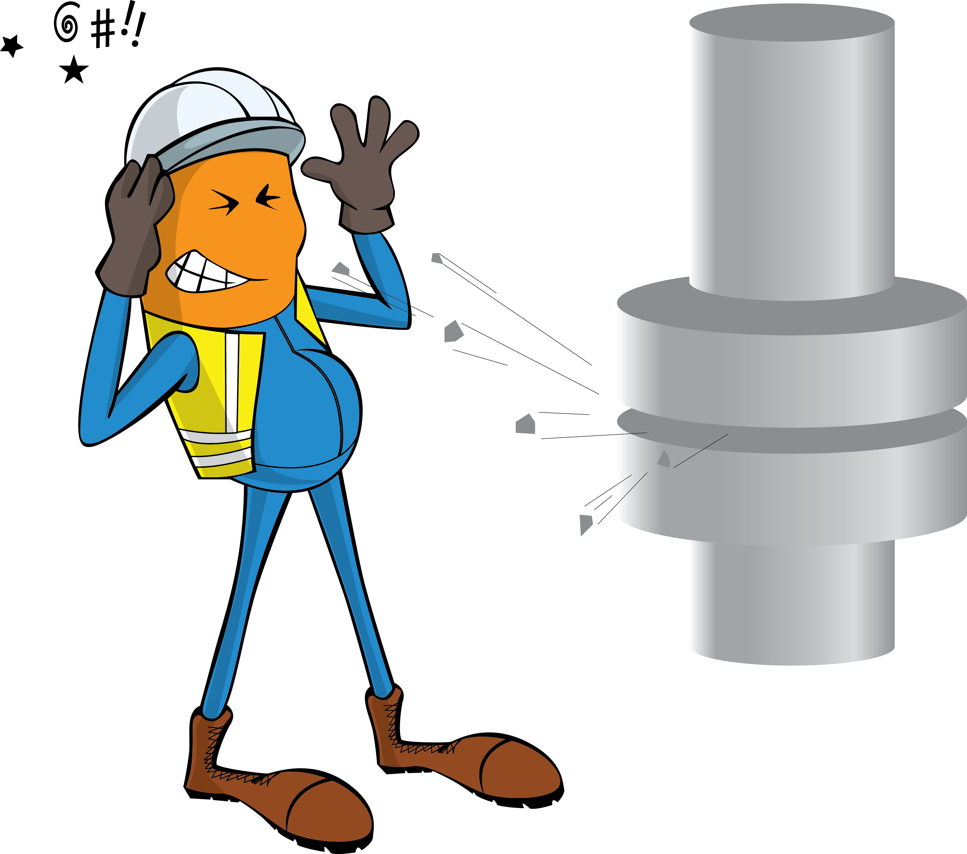
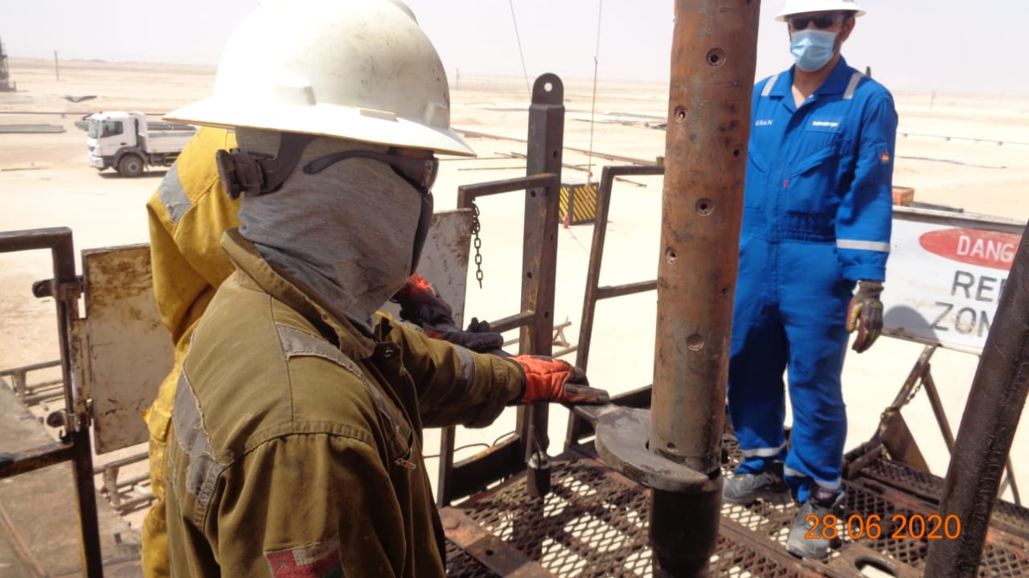
PDO Incident First Alert
Incident Type | LTI#13 | Pattern | Struck by
Date / Time | 27.06.2020@16:30hrs | Directorate
Location | Amal | Dept
Target Audience
Construction, Operations, Engineering, Drilling and Explorations
What happened
During POOH (Pulling out of hole), trapped pressure released from the perforation gun striking a Roustabout on the right side of his face resulting in a burn to his face.
Mr. Musleh asks the questions of can it happen to you?
How do you ensure you identify all hazards before starting a task?
Are you aware of the risk of stored energy?
Do you consider “what could go wrong?”
Are you in the ‘line of fire’?
Trapped pressure release point
Please disseminate this LTI notification to your teams and use it in your tool box talks and HSE meetings and notice boards.

Slide 15
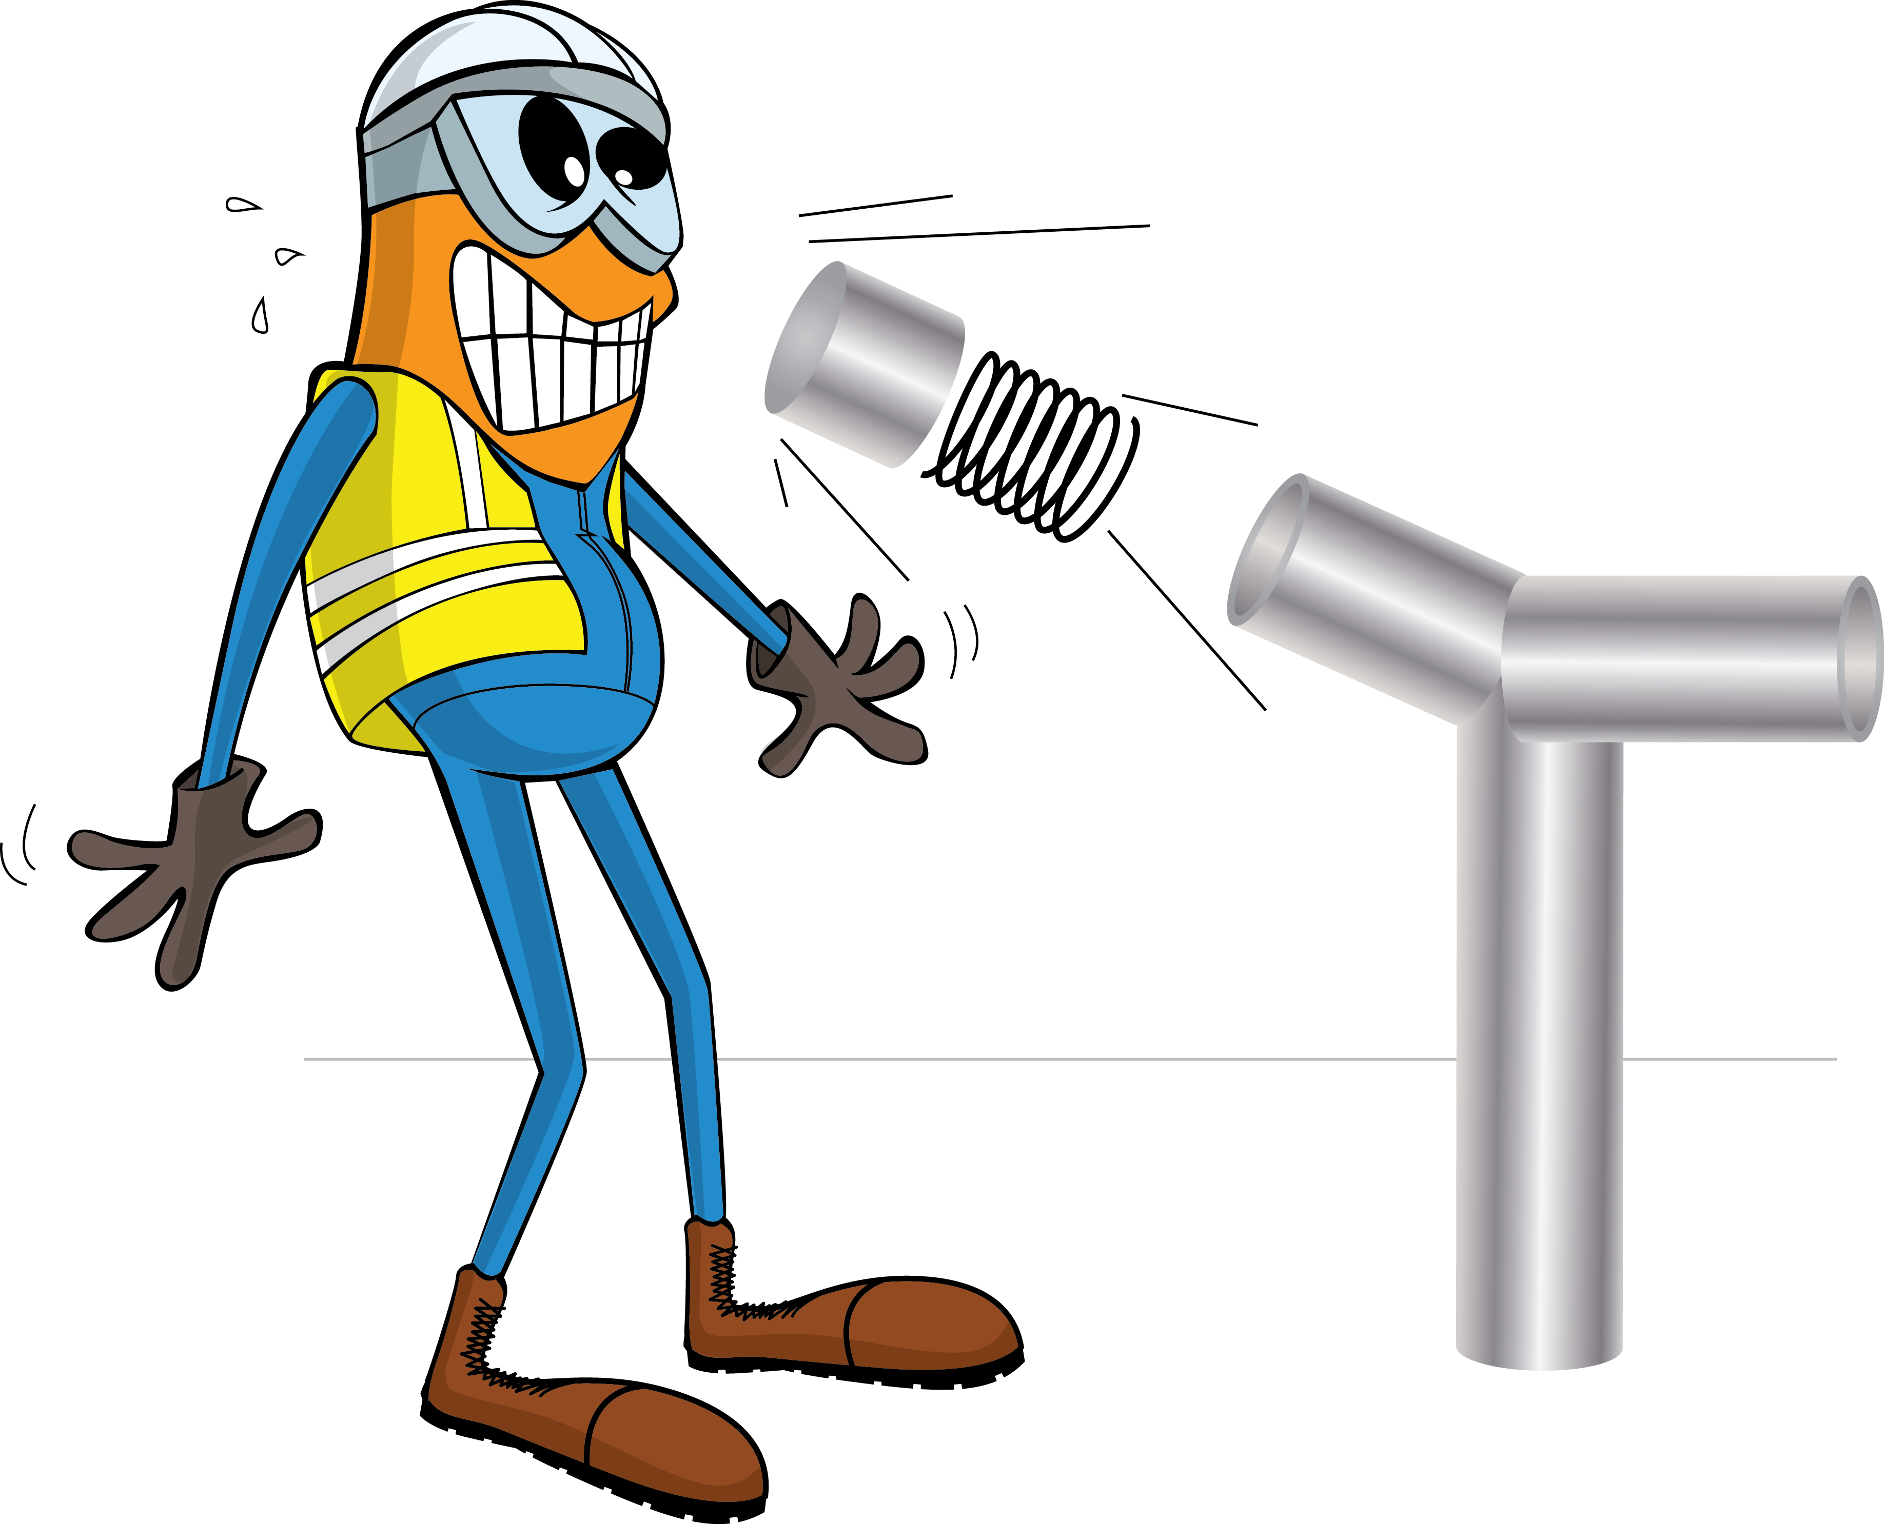
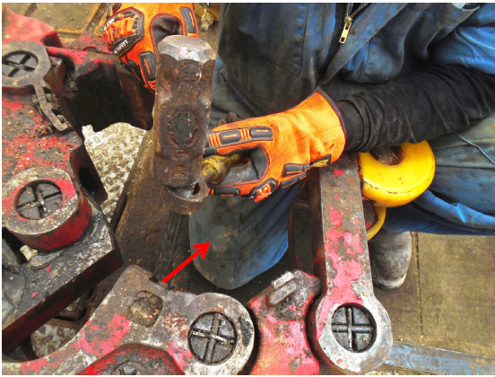
PDO Incident First Alert
Incident Type | LTI#14 | Pattern | Struck by
Date / Time | 03.07.2020@11:30hrs | Directorate
Location | Marmul | Dept
Target Audience
Drilling, Operations, Engineering, Construction & Logistics
What happened
While removing stuck dies from manual tong, a broken chip ejected striking and piercing through Floorman’s coverall and penetrating his right thigh.
Mr. Musleh asks the questions of can it happen to you?
How do you ensure you identify all hazards before starting a task?
Do you consider if you are away from ‘line of fire’ Projectiles?
Do you verify if you have the right tool for the task?
Splintered chip came from the dies
Please disseminate this LTI notification to your teams and use it in your tool box talks and HSE meetings and notice boards.

Slide 16
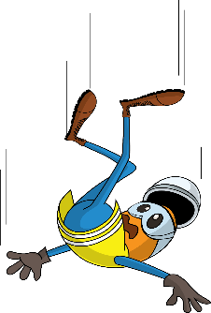
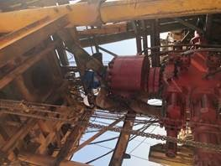
PDO Incident First Alert
Incident Type | LTI#15 | Pattern | Fall
Date / Time | 15.07.2020@16:00hrs | Directorate
Location | Qarn Alam | Dept
Target Audience
Drilling, Operations, Engineering, Construction & Logistics
What happened
While the Roustabout was attempting to remove the vent line, the flowline swung causing him to fall striking his left hand on the BOP. The Roustabout was attached with the fall arrestor.
Mr. Musleh asks the questions of can it happen to you?
Do you ensure you identify all hazards before starting a task?
Do you ensure you are in a safe position while performing a task?
Do you consider the risk of fall from height?
Do you consider any stored energy which can release at any time?
Where RA his hit hand
Please disseminate this LTI notification to your teams and use it in your tool box talks and HSE meetings and notice boards.

Slide 17
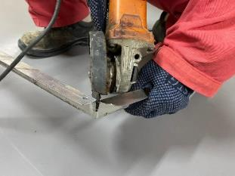
PDO Incident First Alert
Incident Type | LTI#16 | Pattern | Release energy
Date / Time | 21.08.2020@10:30hrs | Directorate
Location | Bahja | Dept
Target Audience
Drilling, Operations, Engineering, Construction & Logistics
What happened
While the Carpenter was trying to cut the frame using angle grinder in a sitting position, the grinder slipped and moved towards him causing a serious injury in his groin area.
Mr. Musleh asks the questions of can it happen to you?
Do you ensure you identify all hazards before starting a task?
Do you ensure you are in a safe position while performing a task?
Do you consider your body is out of line of fire while using hand powered tool?
How do you ensure hand powered tool operators are competent?
Carpenter using grinder
Please disseminate this LTI notification to your teams and use it in your tool box talks and HSE meetings and notice boards.

Slide 18
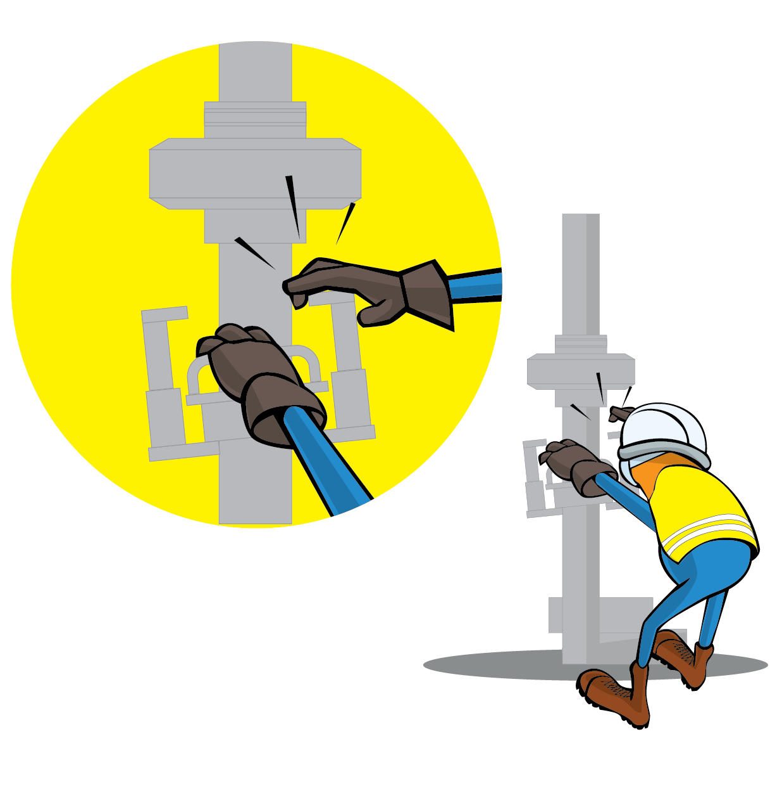
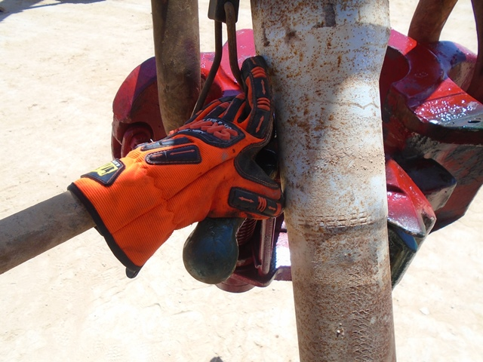
PDO Incident First Alert
Incident Type | LTI#17 | Pattern | Hands & Finger
Date / Time | 29.08.2020@03:24hrs | Directorate
Location | Rima | Dept
Target Audience
Drilling, Operations, Engineering, Construction & Logistics
What happened
While Derrickman was latching the pipe to the elevator, his right hand got trapped between the drill pipe and the elevator caused crush injury to his right little finger.
Mr. Musleh asks the questions of can it happen to you?
Do you ensure you identify all hazards before starting a task?
Do you always use the handles provided?
Do you ensure you keep your hands away of crush points “Line of Fire”?
Crush point
Please disseminate this LTI notification to your teams and use it in your tool box talks and HSE meetings and notice boards.

Slide 19
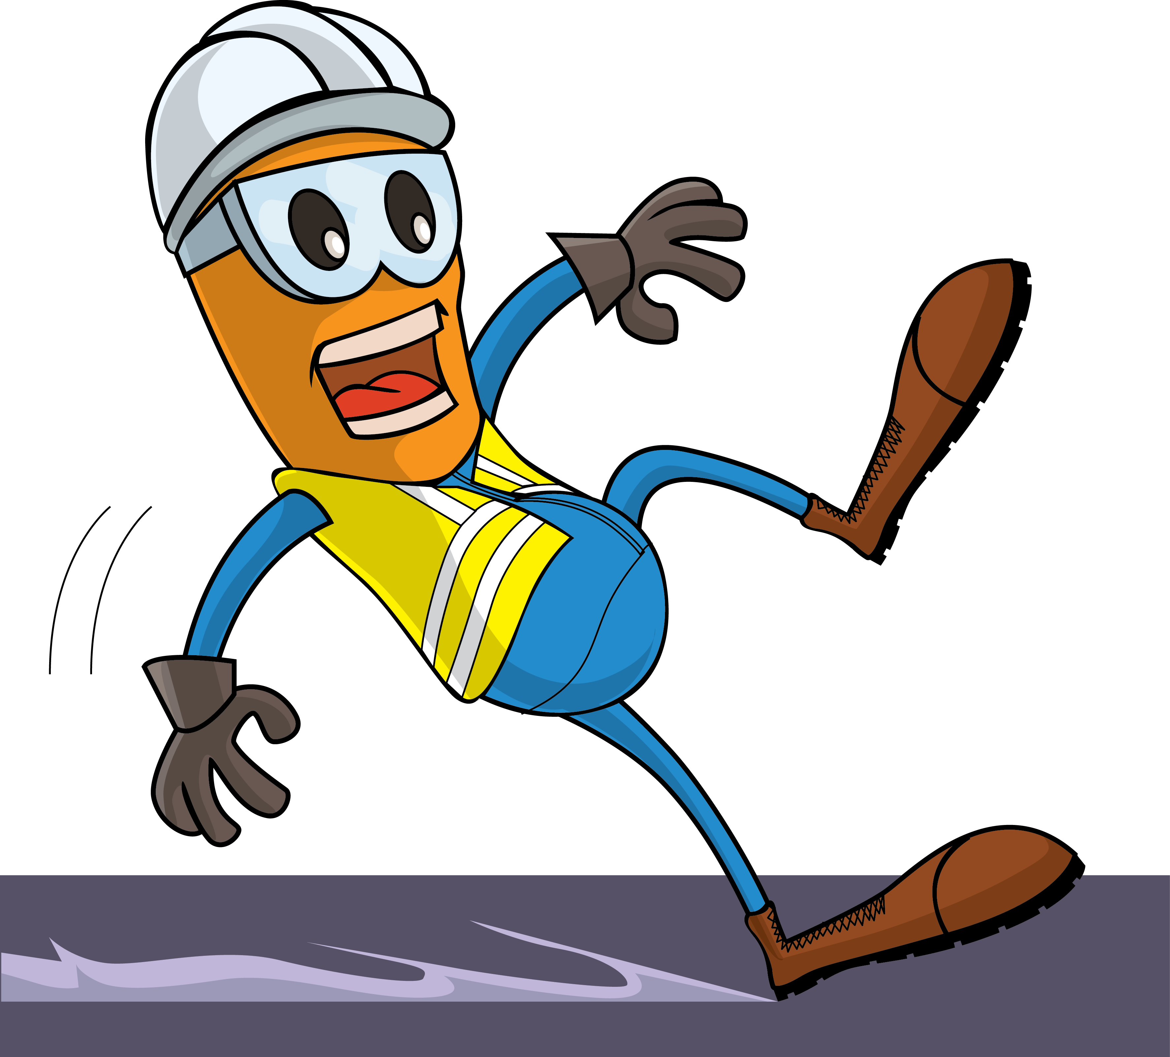
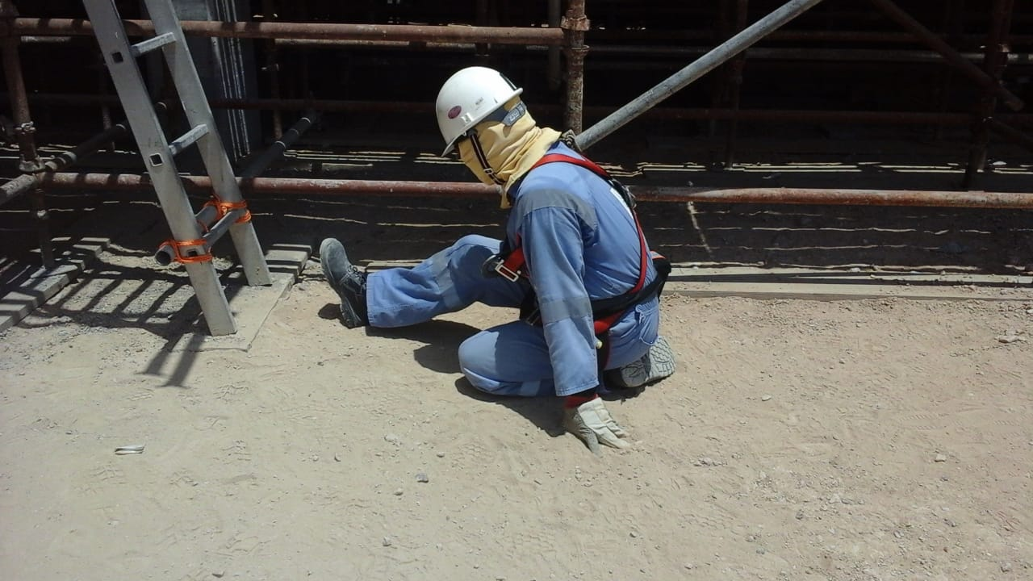
PDO Incident First Alert
Incident Type | LTI#18 | Pattern | Slip & Fall
Date / Time | 29.07.2020@10:30hrs | Directorate
Location | Qarn Alam | Dept
Target Audience
Construction, Operations, Logistics, Engineering , Exploration & Drilling
What happened
While the Carpenter was coming down from scaffolding, he lost his balance, slipped and fell fracturing his left leg.
Mr. Musleh asks the questions of can it happen to you?
How do you ensure where you are stepping is free from Hazards?
How do you ensure you have safe access and egress?
How do you identify Slip, Trips and fall hazards around your working location?
Do you ensure to use three points of contact while ascending/descending ladder?
Please disseminate this LTI notification to your teams and use it in your tool box talks and HSE meetings and notice boards.

Slide 20
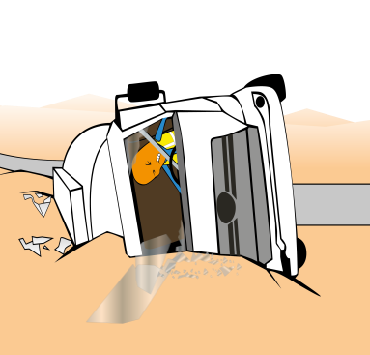
PDO Incident First Alert
Incident Type | LTI#19 | Pattern | MVI
Date / Time | 20.08.2020@14:05hrs | Directorate
Location | Adam | Dept
Target Audience
Logistics , Drilling, Operations, Engineering & Construction
What happened
While driving a load of chemical to Nimr, the driver lost control of the vehicle resulted in the vehicle rolled over and catching fire. The driver suffered multiple burn injuries.
Mr. Musleh asks the questions of can it happen to you?
Do you always apply defensive driving techniques?
Do you ensure you check your vehicle prior to starting your journey?
Do you ensure you drive according to the road conditions?
Do you drive if you are fatigue?
Please disseminate this LTI notification to your teams and use it in your tool box talks and HSE meetings and notice boards.

Slide 21
PDO Incident First Alert
Incident Type | LTI#20 | Pattern | MVI
Date / Time | 10.09.2020 at 11: 50:00hrs | Directorate
Location | Qarn Alam | Dept
Target Audience
Construction, Operations, Logistics, Engineering , Exploration & Drilling
What happened
While traveling on a graded road from Qarn Alam to Ghubar Station the house keeping supervisor (driver) and the cleaner passed over a sand dune and due to jerk movement of the vehicle the driver experienced a back pain.
Mr. Musleh asks the questions of can it happen to you?
Do you ensure you follow graded road defensive driving techniques?
Do you ensure you receive adequate information about the road conditions from the Journey Manager prior to starting your journey?
Do you ensure to follow the speed limits on graded roads?
Do you pay attention to road hazards and drive accordingly?
Please disseminate this LTI notification to your teams and use it in your tool box talks and HSE meetings and notice boards.

Slide 22
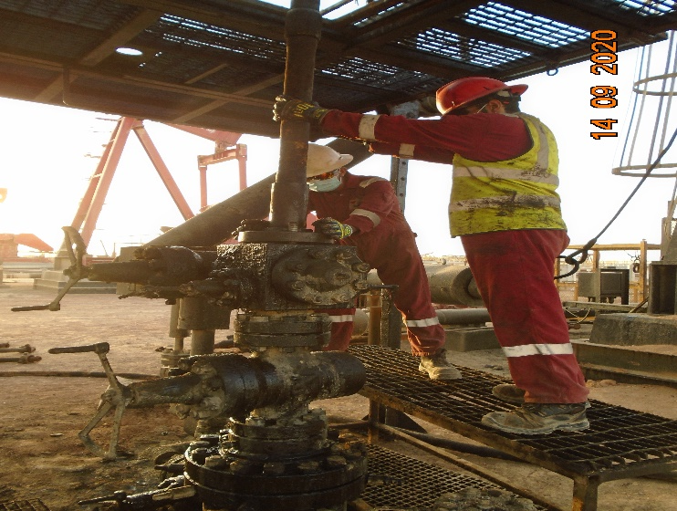
PDO Incident First Alert
Incident Type | LTI#22 | Pattern | Hands and Fingers
Date / Time | 14.09.2020@04:30hrs | Directorate
Location | Marmul | Dept
Target Audience
Drilling, Operations, Engineering & Construction
What happened
While the Floor man was installing Sucker Rod Bop flange into the Xmas tree, his right ring finger got crushed between the flange and Xmas tree.
Mr. Musleh asks the questions of can it happen to you?
How do you ensure your Hands & Fingers are away from ‘Line of Fire’?
How do you ensure you identify all hazards before starting a task?
Do you consider “what could go wrong?”
Do you observes your colleague’s action during task and intervene if required?
Do you ensure adequate Supervision during task?
Please disseminate this LTI notification to your teams and use it in your tool box talks and HSE meetings and notice boards.

Slide 23
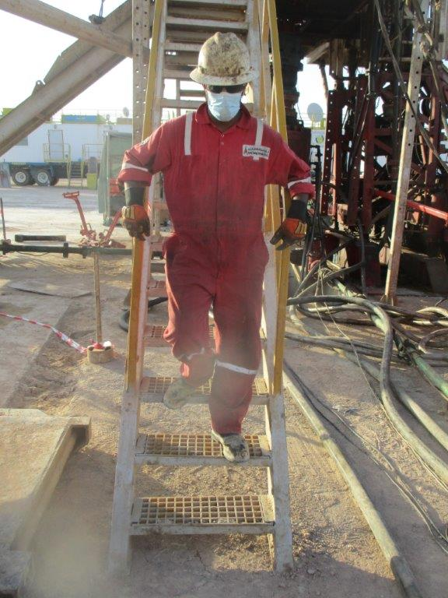
PDO Incident First Alert
Incident Type | LTI#23 | Pattern | Slip & Fall
Date / Time | 17.09.2020@04:20hrs | Directorate
Location | Fahud | Dept
Target Audience
Construction, Operations, Logistics, Engineering , Exploration & Drilling
What happened
While the Derrick man was coming down from hoist floor stairs , he lost balanced & and fell down injuring his right foot.
Mr. Musleh asks the questions of can it happen to you?
How do you ensure where you are stepping is free from Hazards?
How do you ensure you have safe access and egress?
How do you identify Slip, Trips and fall hazards around your working location?
Do you ensure to use three points of contact while ascending/descending ladder?
Please disseminate this LTI notification to your teams and use it in your tool box talks and HSE meetings and notice boards.

Slide 24
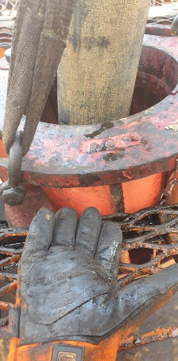
PDO Incident First Alert
Incident Type | LTI#24 | Pattern | Hands and Fingers
Date / Time | 20.09.2020@08:20hrs | Directorate
Location | Marmul | Dept
Target Audience
Construction, Drilling, Operations & Engineering
What happened
While the Engineer was attempting to balance the winch line, his left fourth finger got trapped between the safety floor and bowl housing of manual slips.
Mr. Musleh asks the questions of can it happen to you?
How do you ensure your Hands & Fingers are away from ‘Line of Fire’?
How do you ensure you identify all hazards before starting a task?
Do you consider “what could go wrong?”
Supervisor, do you ensure adequate supervision and avoid participate in the job?
Do you intervene whenever necessary?
Please disseminate this LTI notification to your teams and use it in your tool box talks and HSE meetings and notice boards.

Slide 25
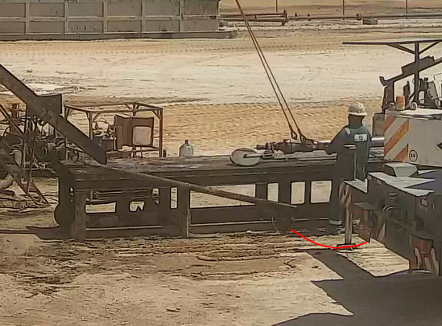
PDO Incident First Alert
Incident Type | LTI#25 | Pattern | Drops
Date / Time | 04.10.2020 at 12: 30:00hrs | Directorate
Location | Qarn Alam | Dept
Target Audience
Exploration & Drilling, Construction, Operations, Logistics, Engineering
What happened
The Slick Line Assistant was guiding the lubricator on the catwalk when the test joint rolled off the catwalk and fell striking his right foot causing fractured in his toe.
Mr. Musleh asks the questions of can it happen to you?
Do you ensure you identify all hazards before starting a task?
Do you consider if you are in the ‘line of fire’?
Do you use tagline to guide the load?
Do you intervene whenever required to stop unsafe Acts?
Please disseminate this LTI notification to your teams and use it in your tool box talks and HSE meetings and notice boards.

Slide 26
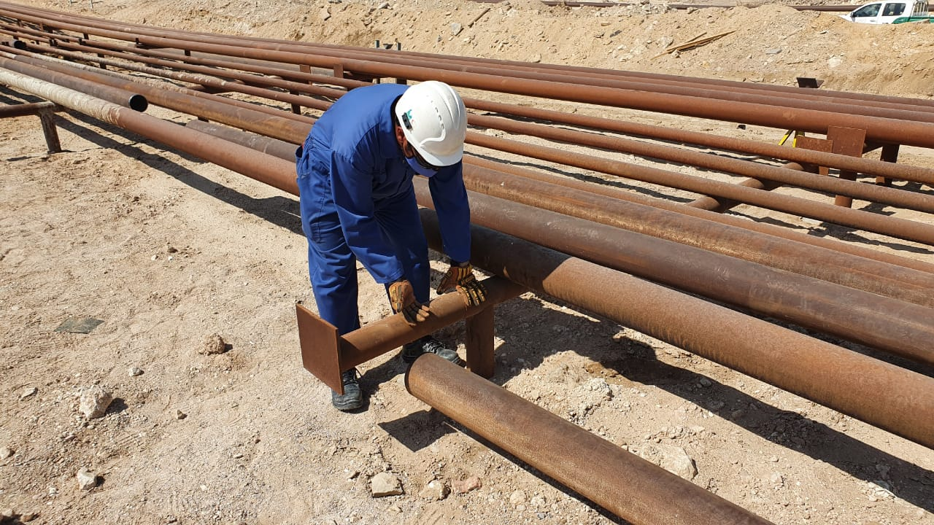
PDO Incident First Alert
Incident Type | LTI#26 | Pattern | Hands & fingers
Date / Time | 06.10.2020@9:00hrs | Directorate
Location | Fahud | Dept
Target Audience
Construction, Operations, Logistics, Engineering , Exploration & Drilling
What happened
While Mechanical Rigger was supporting the pipe end for welding, it slipped trapping the rigger’s right hand middle & ring finger between the pipe and the support.
Mr. Musleh asks the questions of can it happen to you?
How do you ensure you identify all hazards before starting a task?
Do you observes your colleague’s action during task and intervene if required?
Do you ensure adequate supervision during the task?
How do you ensure your Hands & Fingers are away from ‘Line of Fire’?
Pinch point
Please disseminate this LTI notification to your teams and use it in your tool box talks and HSE meetings and notice boards.

Slide 27
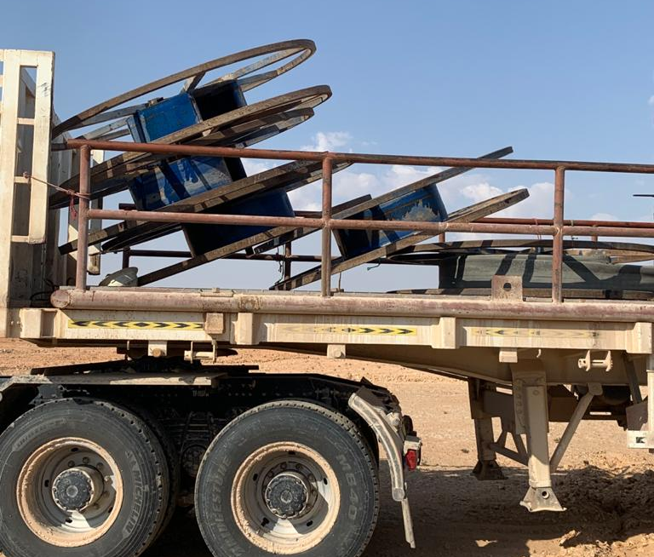
PDO Incident First Alert
Incident Type | LTI#27 | Pattern | DROPs
Date / Time | 14.10.2020@14:00hrs | Directorate
Location | Marmul | Dept
Target Audience
Construction, Operations, Logistics, Engineering , Exploration & Drilling
What happened
During laying down of water hose, while the Rigger and other crew member were standing on the trailer to align the hose, an empty hose reel fell on the Rigger causing an injury to his forehead and neck.
Mr. Musleh asks the questions of can it happen to you?
How do you ensure you identify all hazards before starting a task?
How do you ensure that you are away from ‘Line of Fire’?
Do you ensure you are following procedure and avoid taking shortcut?
Do you ensure adequate supervision during the task?
Please disseminate this LTI notification to your teams and use it in your tool box talks and HSE meetings and notice boards.

Slide 28
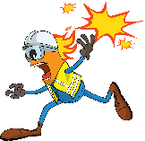
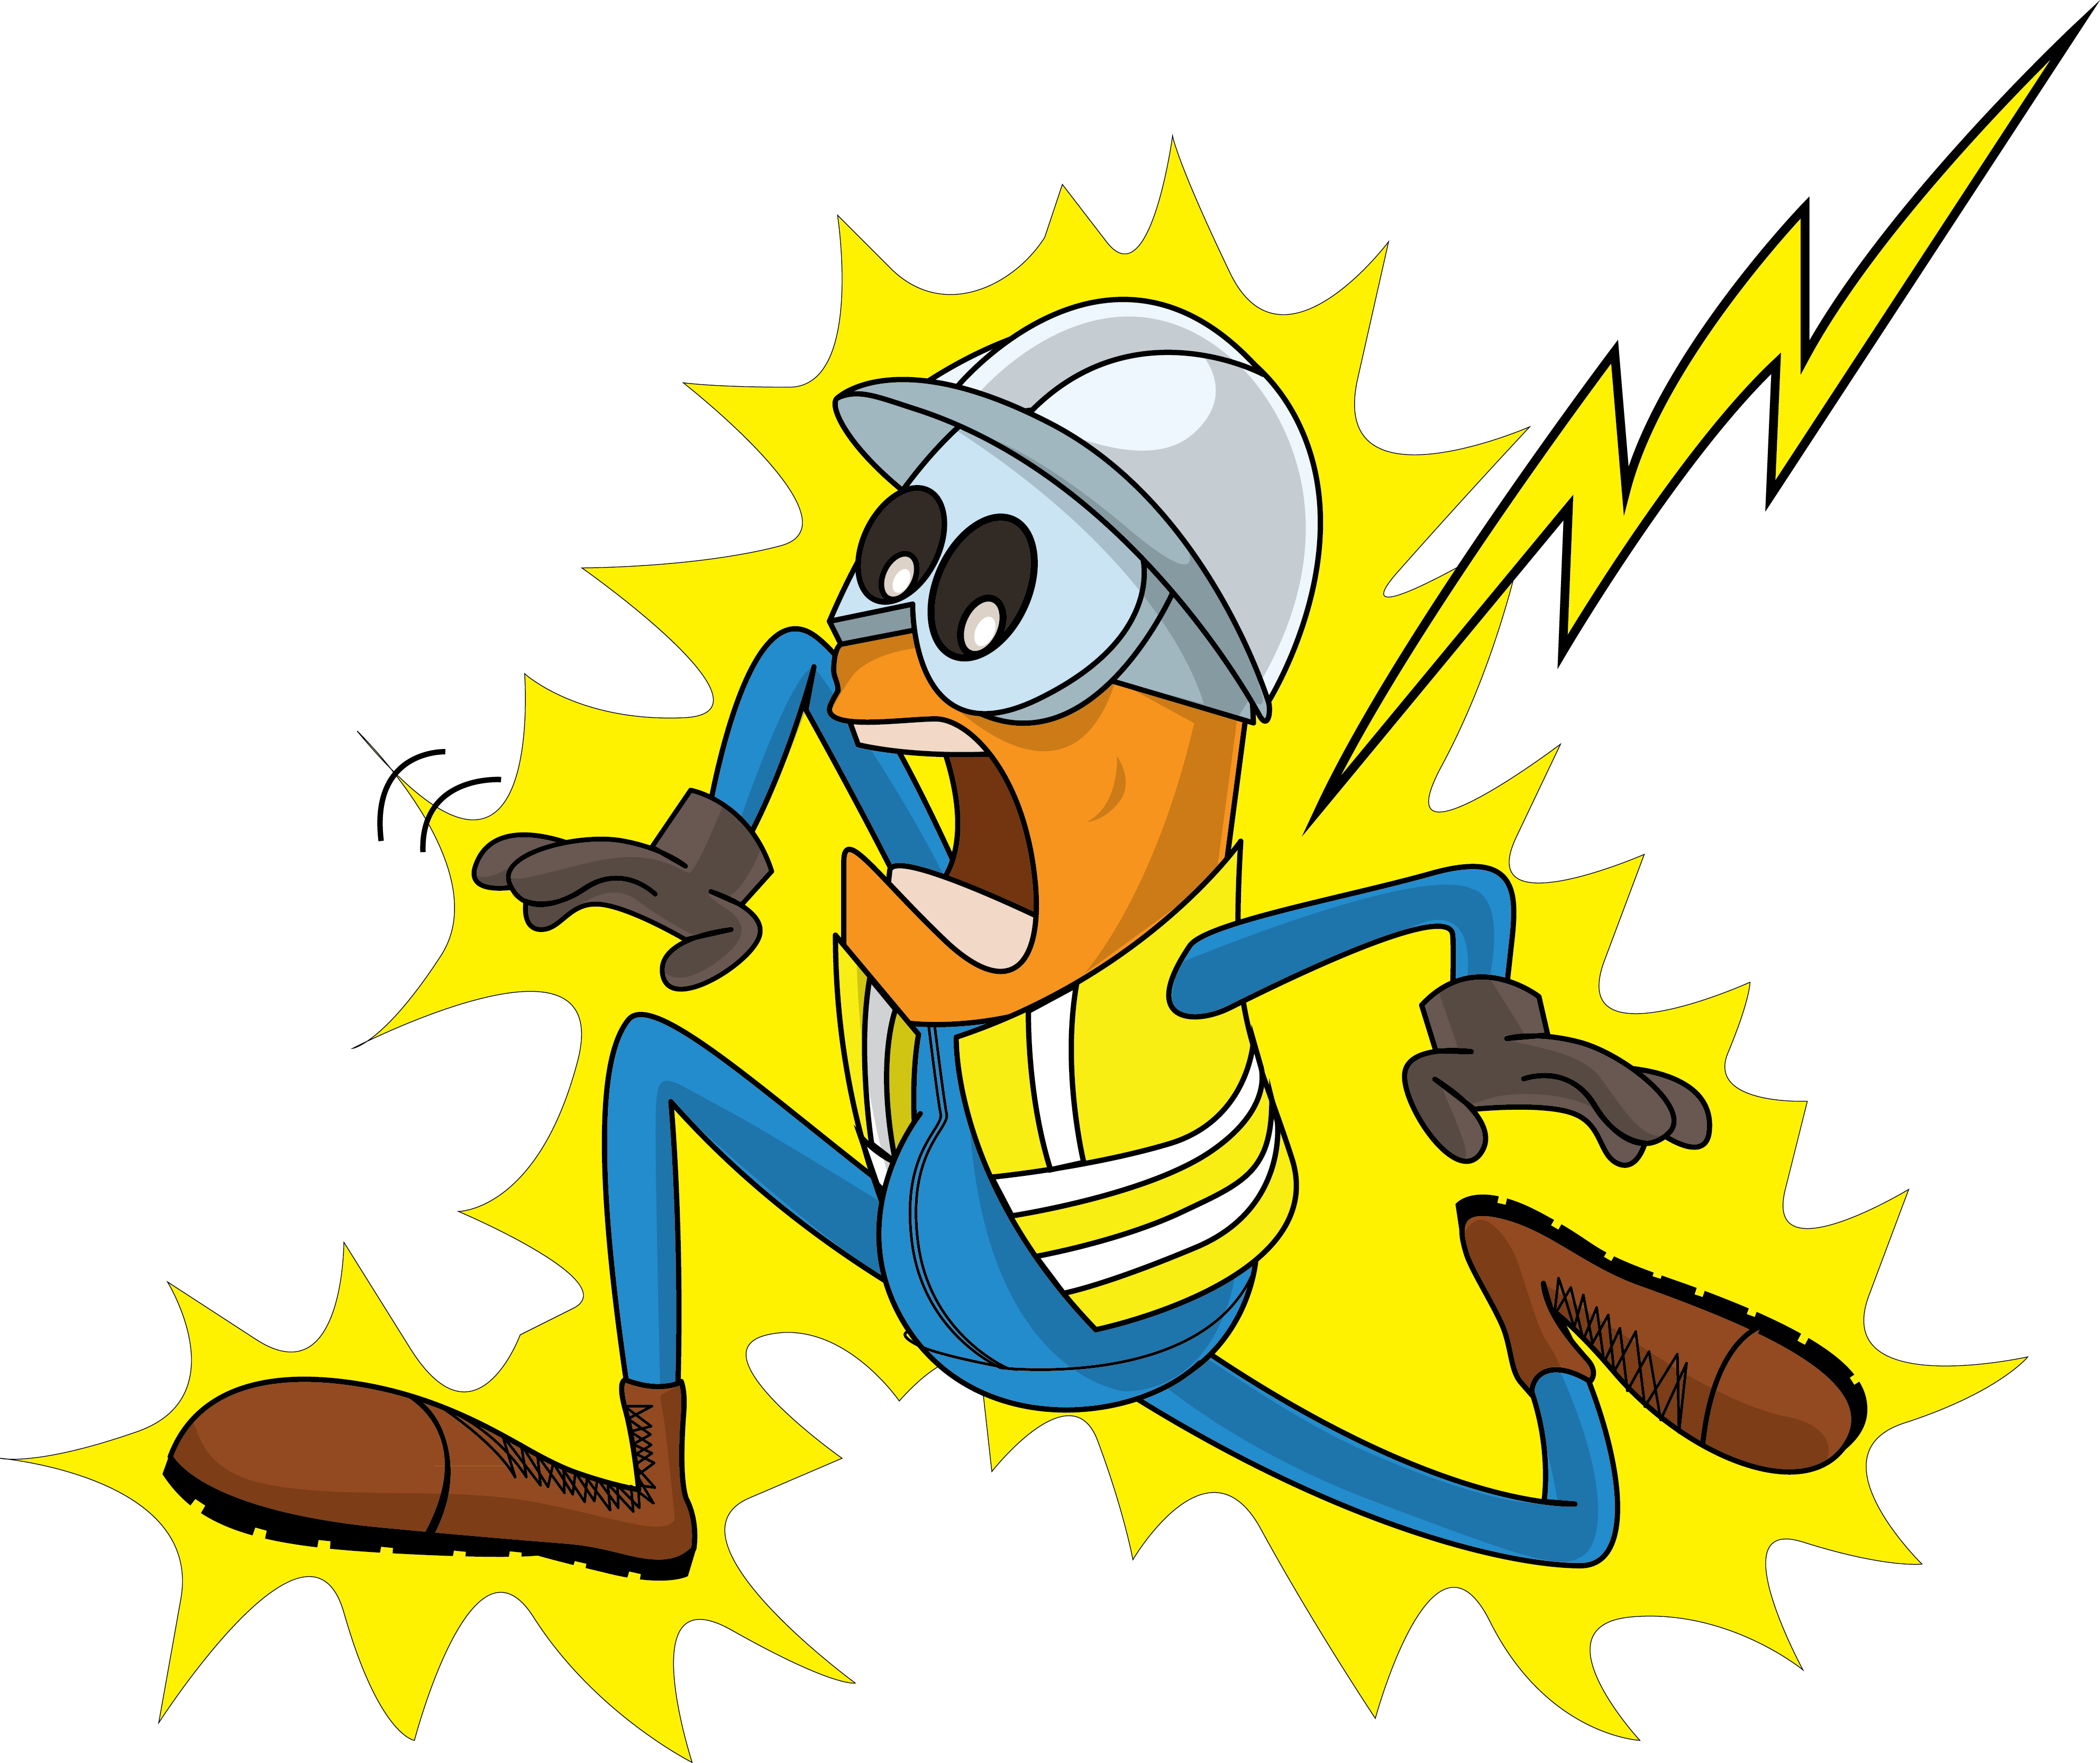
PDO Incident First Alert
Incident Type | LTI#28 | Pattern | Fire & Explosion
Date / Time | 15.10.2020@11:10hrs | Directorate
Location | Fahud | Dept
Target Audience
Construction, Operations, Logistics, Engineering , Exploration, Infrastructure & Drilling
What happened
While the technician was checking the power supply, the fuse fell onto the Busbar creating a short circuit with an electrical explosion resulting in burns to his left side.
Mr. Musleh asks the questions of can it happen to you?
Do you ensure the power is adequately isolated?
Do you ensure you have a valid Permit to Work (PTW) for the task?
How do you ensure you identify all hazards before starting a task?
How do you ensure that you are away from ‘Line of Fire’?
Please disseminate this LTI notification to your teams and use it in your tool box talks and HSE meetings and notice boards.

Slide 29
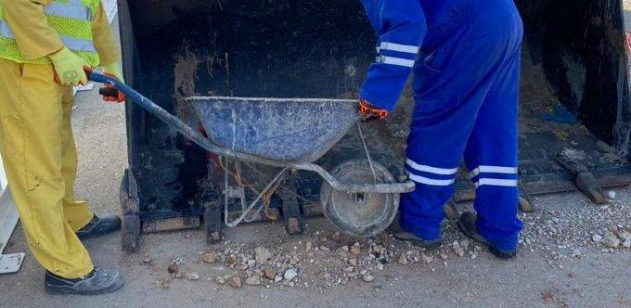
PDO Incident First Alert
Incident Type | LTI#29 | Pattern | Struck by
Date / Time | 24.10.2020@09:50hrs | Directorate
Location | Fahud | Dept
Target Audience
Construction, Operations, Logistics, Engineering , Exploration, Infrastructure & Drilling
What happened
While the Mason was assisting with moving excavated soil, his left foot got trapped between the wheel loaders front bucket teeth.
Mr. Musleh asks the questions of can it happen to you?
Do you ensure you are stood in a safe place?
How do you ensure that you are away from ‘Line of Fire’
How do you ensure you identify all hazards before starting a task?
Please disseminate this LTI notification to your teams and use it in your tool box talks and HSE meetings and notice boards.

Slide 30
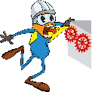
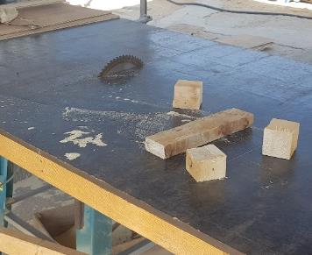
PDO Incident First Alert
Incident Type | LTI#31 | Pattern | Hands & fingers
Date / Time | 15.12.2020 @ 09:50hrs | Directorate
Location | Marmul | Dept
Target Audience
Construction, Operations, Logistics, Engineering , Exploration & Drilling
What happened
While cutting wooden pieces for wedge supports, the carpenters left hand struck the machine blade resulting a deep cut of the left palm, extending to the 3rd finger and fracturing 2 others.
Mr. Musleh asks the questions of can it happen to you?
Do you ensure your Hands & Fingers are away from ‘Line of Fire’?
Do you ensure you identify all hazards before starting a task?
Do you always use hands free tools/ push stick to push material into the cutting area?
Cutting point
Please disseminate this LTI notification to your teams and use it in your tool box talks and HSE meetings and notice boards.

Slide 31
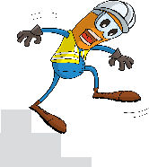
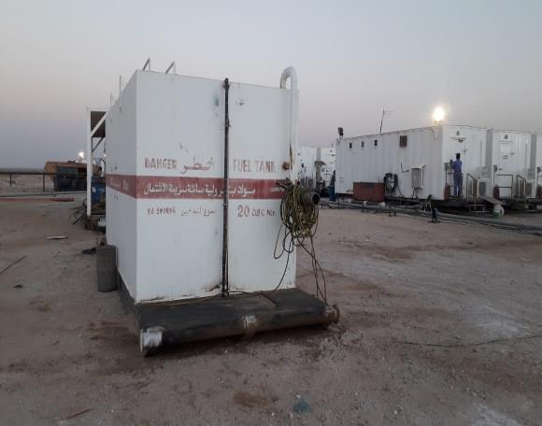
PDO Incident First Alert
Incident Type | LTI#32 | Pattern | Slip, Trip & Fall
Date / Time | 16.12.2020 @ 17:45hrs | Directorate
Location | Yibal | Dept
Target Audience
Construction, Operations, Logistics, Engineering , Exploration & Drilling
What happened
While checking the fuel level on the generator, as the mechanic stepped down from the skid he twisted his ankle resulting in a fracture to his right foot.
Mr. Musleh asks the questions of can it happen to you?
Do always pay attention to where you are stepping?
Do you take care when stepping up or down?
Do you identify Slip, Trips and fall hazards around your working location?
Please disseminate this LTI notification to your teams and use it in your tool box talks and HSE meetings and notice boards.

Slide 32
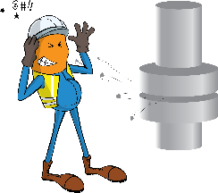
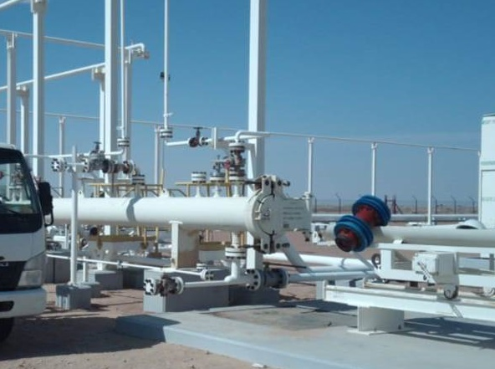
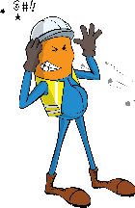
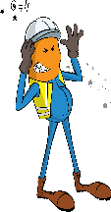
PDO Incident First Alert
Incident Type | LTI#33 | Pattern | Released Energy
Date / Time | 19.12.2020 @ 10:30 hrs | Directorate
Location | Qarn Alam | Dept
Target Audience
Operations, Engineering, Drilling
What happened
While three crew members were manipulating a pig launcher for the 16” SRS – CPP Gas line, a release of gas pressure occurred resulting in the Pig coming out of the launcher door striking and injuring two crew members.
Mr. Musleh asks the questions of can it happen to you?
Are you aware of all hazards that are identified for the task you performing?
Do you follow established procedures when breaking into or pressurizing hydrocarbon systems?
Do you follow process safety fundamentals?
Do you always keep away from line of fire?
Please disseminate this LTI notification to your teams and use it in your tool box talks and HSE meetings and notice boards.

Slide 33
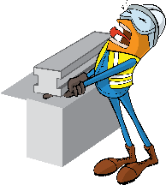
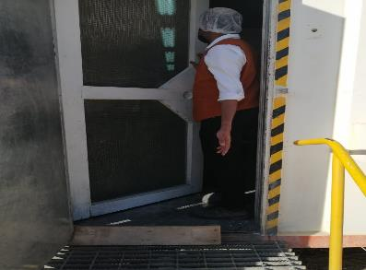
PDO Incident First Alert
Incident Type | LTI#34 | Pattern | Hands & Fingers
Date / Time | 22.12.2020 @ 16:00 hrs | Directorate
Location | Amal | Dept
Target Audience
Operations, Engineering, Drilling, Construction and Logistics
What happened
While entering the kitchen, the waiter has caught his finger in the door resulting in an amputated tip of his left hand index finger.
Mr. Musleh asks the questions of can it happen to you?
Do you consider what could go wrong?
Do you ensure you keep your hands and fingers away from pinch points?
Do you always pay attention while performing a routine activity?
Please disseminate this LTI notification to your teams and use it in your tool box talks and HSE meetings and notice boards.

