Slide 1
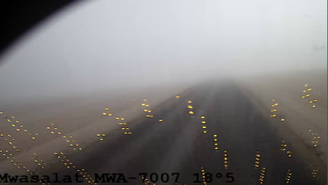
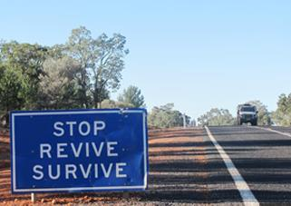
Learning From Incident Awareness Alert
Alert NO: PIM# | PDO LFI_200320231520 HiPo#10 1150927 | Pattern: | MVI
Date: | 01/03/2023 | Target Audience: | Drilling, Logistics, Operations & Construction
MVI incident between HGV and 3rd party bus-Investigation in progress
Description of the incident:
On 1st March at 8.15am, a Heavy Goods Vehicle (HGV) driver was enroute to Marmul to deliver High Density Polyethylene Duct. Three kilometers before Rima roundabout on a straight blacktop road, the HGV driver moved from his lane directly into the path of an oncoming 3rd party bus. Due to heavy fog in the area and reduced visibility, both drivers were unable to avoid the collision. The 2 vehicles impacted at an angle with the right side of the prime mover striking the right front corner of the bus in a glancing blow before the bus collided with the trailer headboard and both vehicles came to a stop at the right-hand side of the road in the northern direction lane. Consequently, 5 passengers in the bus sustained injuries.
Why it happened/Finding :
Overtaking a long vehicle on a single carriageway in low visibility condition (fog).
Driver fatigue.
Notes:
Target audience for this alert
List the position names or roles that are the target audience for this alert. Wherever possible, the target audience should be limited to those in positions or roles or locations for which the lesson learnt are relevant, or who are required to take action upon receiving this Alert.
Position or role name
Position or role name
Description of the incident:
This should be free text writing and include the relevant facts explaining. what happened to all the relevant parties in a short sharp factual paragraph that describes the incident.
Without mentioning names of contractors or individuals. You should include, what happened, to who (by job title) and what injuries this resulted in. Nothing more
The description should be in sufficient detail to allow a person who does not know anything about the incident to imagine it.
It should only be about what happened and not why it happened.
DO NOT include investigation findings here, simply describe the incident as the investigation has shown it happened.
DO NOT give us a sequence of events here.

Slide 2
Learning From Incident Awareness Alert
Lessons learned:
Drivers:
Always assess the road condition prior to commencement of the journey and re-assess when conditions change.
Always ensure you have enough rest prior to driving – if your feeling fatigued, STOP and contact the Journey Manager.
Always avoid driving in low visibility conditions.
Always avoid overtaking if the road is not clear.
Always inform your Journey Manager of road hazards.
When travelling as a passenger on a bus:
Always ensure yourself and others travelling with you, wear seatbelts in order to minimize the risk of injury in the event of an MVI.
As a learning from this incident and ensure continual improvement, all contract managers must review their HSE risk management against the questions asked below.
Management/journey managers Confirm the following:
How do you ensure your Journey Planners are taking mitigating actions during adverse weather?
How do you ensure your fatigue monitoring system alerts are being actioned upon?
How do you ensure your Drivers are having sufficient rest?
How do you ensure your Drivers are using the rest facilities?
How do you ensure Drivers are learning from previous incidents?
* If the answer is NO , or you are unsure, to any of the above questions please ensure you take action to correct this finding.
**As a learning from this incident and ensure continual improvement review risk management ( HEMP) against the questions
Notes:
Why it happened
Describe here the:
Immediate causes of the incident; and
Underlying causes of the incident
Lessons Learned: Four to five bullet points highlighting the main findings from the investigation. Remember the target audience is the front line staff so this should be written in simple terms in a way that everyone can understand.
Contract managers: Must review their risk assessment for this task capturing all points raised as a minimum and provide assurance to Contract Holders

Slide 3
Ramadhan
Road Safety Tips
Ramadhan Kareem
رمضان
إرشادات والسلامة على الطرق
@thedabdoob
Mohammed Al Ameen Mosque

Slide 4
Driving While Fasting Advice:
نصيحة القيادة أثناء الصيام:
If you feel tired or unwell, stop the vehicle in a safe location and rest until you feel better
Avoid driving during sunset
Avoid retaliation from other drivers who are driving poorly; remember that they may be feeling unwell
Avoid any unnecessary driving.
إذا شعرت بالتعب أو التوعك ، أوقف السيارة في مكان آمن واسترح حتى تشعر بتحسن
تجنب القيادة أثناء غروب الشمس
تجنب الانتقام من السائقين الآخرين الذين يقودون بشكل سيء ؛ تذكر أنهم قد يكونون على غير ما يرام
تجنب أي قيادة غير ضرورية.

Slide 5
Symptoms of Fatigue:
أعراض التعب:
Poor concentration, drowsiness, daydreaming
Constant yawning, stretching
Feeling tired, sore, blurry vision
Not remembering the last few miles driven and missing road signs
Drifting from your lane, variations in driving speed
Head nodding, eyes start flickering.
ضعف التركيز والنعاس وأحلام اليقظة
التثاؤب المستمر والتمدد
الشعور بالتعب ، والتقرح ، وتشوش الرؤية
لا تتذكر الأميال القليلة الماضية المقطوعة وإشارات الطرق المفقودة
الانحراف عن مسارك ، اختلافات في سرعة القيادة
إيماءة الرأس ، تبدأ العيون بالرمش.

Slide 6
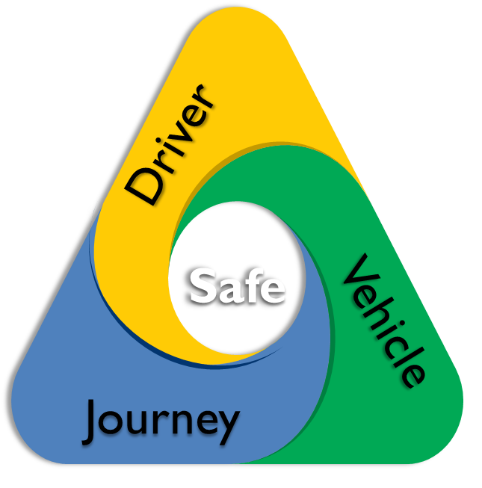
Safe Driver
Fasten your seatbelt
Keep to the speed limit
Be conscious and vigilant
Have enough rest before and during the trip
Safe Vehicle (FLOWER check)
Safe Journey
Have enough Fuel
Headlights, break lights and indicators
Check the Oil level when the engine is cold
Coolant water and washer fluid
Electric: ensure battery is secured
Rubber (tyre pressure and conditions)
Plan and manage your trip
Keep in touch
Study your route

Slide 7
السائق
السائق الآمن
السلامة
أربط حزام مقعدك
التزم بحدود السرعة
كن واعيًا ويقظًا
احصل على قسط كافٍ من الراحة قبل وأثناء الرحلة
المركبة
الرحلة
مركبة آمنة (افحص المركبة)
رحلة آمنة
احصل على وقود كافٍ
المصابيح الأمامية وكشافات الأضواء والمؤشرات
افحص مستوى الزيت عندما يكون المحرك باردًا
ماء المبرد وسوائل الغسيل
كهربائي: تأكد من تأمين البطارية
المطاط (ضغط الإطارات وشروطها)
تخطيط وإدارة رحلتك
أبق على اتصال
ادرس مسارك

