Slide 1
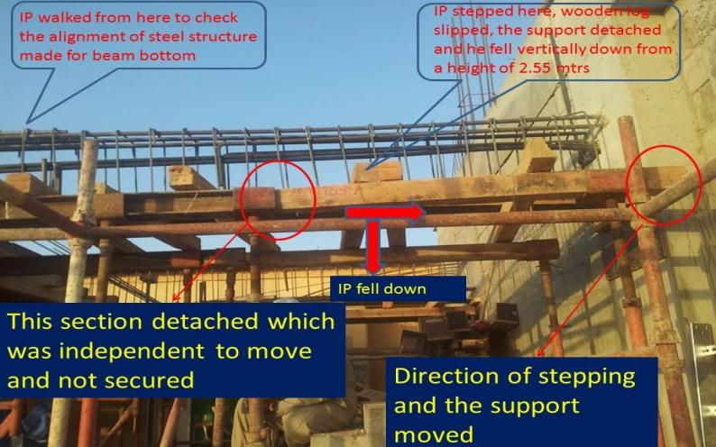
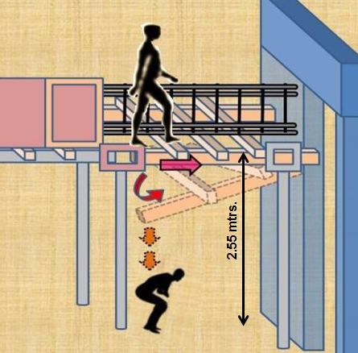
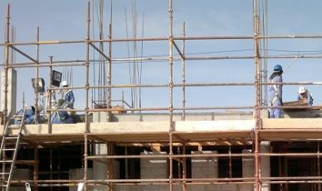
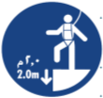
PDO safety advice
Use this Alert: Discuss in Tool Box Talks and HSE Meetings ➔ Distribute to contractors ➔ Post on HSE Notice Boards ➔ Include in site HSE Induction
Date : 17.04.2013 Fractured spine
Carpenter falls from 2.5 metres and fractured his spine
What happened?
A carpenter decided to breach the life saving rules by working at a height of 2.5 metres without fall protection. He wanted to check the alignment of a steel mesh above the ground and as he walked across a wooden framework of beams supporting the mesh his movement dislodged the wooden frame out of one of its supports. The whole frame he was standing on collapsed and he fell down to the ground fracturing his spine.
Your learning from this incident…
Use access platform or fall arrest for working at height.
Never breach a life saving rules, they are there to save lives
If in doubt, use your right to STOP and question safety.
Ensure scaffolding has been certified before accessing it.
Shortcuts which are unsafe often result in lengthy delays and injury.
Use proper platform and safety harness for working at height
1
Contact: MSE54 for further information or visit the HSE Website Learning No 13 22/07/2013

Slide 2
Management learnings
Date : 17.04.2013 Fractured spine
Carpenter falls from 2.5 metres and fractured his spine
Does “safe working at height” procedure in place and adhered to ?
Does all at height activates properly planned & organised ?
Are all those involved in working at height trained and competent ?
Are your scaffold platforms certified by competent scaffold person and safe to use ?
Have Risk Assessment been done for working at height activates?
Do you implement TRIC effectively ?
Is the risk of falling objects from height properly controlled ?

