Slide 1
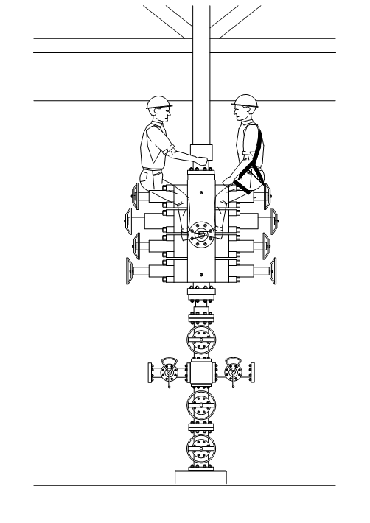
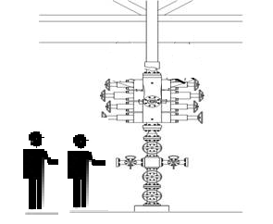
PDO Safety Advice
Use this Alert: Discuss in Tool Box Talks and HSE Meetings ➔ Distribute to contractors ➔ Post on HSE Notice Boards ➔ Include in site HSE Induction
Date: 19/04/2013
Fractured finger by swinging pipe
What happened?
Two operators were sitting on top of a blow out preventer (BOP) at a height of 2.4 m. They had finished unscrewing the lubricator from the top of BOP and remained there after authorising instructing the field assistant to lift the lubricator. As it was raised it swung and struck one of the operators on his hand fracturing his finger.
Your learning from this incident…
Never remain in the danger area during any lifting operation.
Never work at height unless you have a safety harness or are working from a platform.
If no procedure is available to advise how to complete the task, always use a TRIC card and list the steps to complete the job. For each step identify the hazards, put sufficient controls in place and identify who is responsible.
Remember to obey lifting rules and stay away from loads being lifted
Contact: MSE54 for further information or visit the HSE Website Learning No 14 22/07/2013

Slide 2
Management Learnings
Date: 19/04/2013
Fractured finger by swinging pipe
As a learning from this incident and ensure continual improvement all contract
managers are to review their HSE HEMP against the questions asked below
  Do you have rules to control all lifting operations in your operation?
  Do you employ trained riggers and banks men in your operation?
  Do your management supervise lifting operations to ensure rules are being followed?
  Do you prohibit staff working when supervision is not available?
  Do you enforce the life saving rules for working at height?
  Do you conduct TRIC assessments where jobs have no procedure to follow?
  Do you have processes to ensure safe working at height and safe access to height?
  Have you trained your staff in how to assess the risk of work in the operations?

