Slide 1
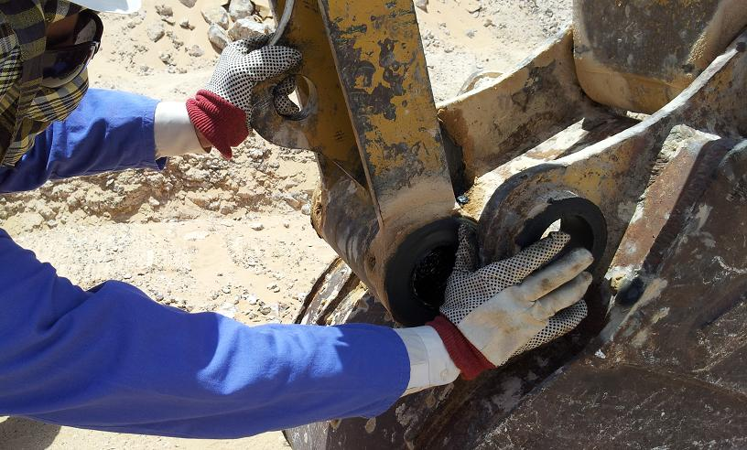
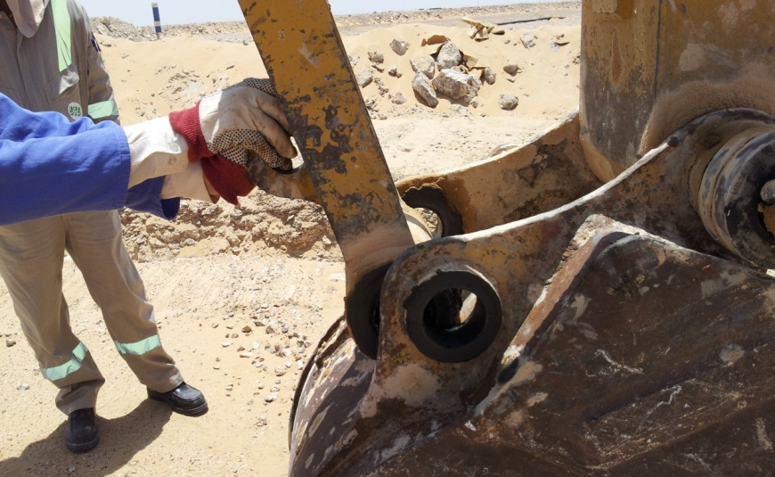
PDO safety advice
Use this Alert: Discuss in Tool Box Talks and HSE Meetings ➔ Distribute to contractors ➔ Post on HSE Notice Boards ➔ Include in site HSE Induction
Date: 13/05/2013
Rigger fractures finger whilst attaching excavator bucket
What happened?
Whilst attempting to change a bucket on an excavator and whilst attempting to line up the holes to allow the securing pin to slot between the arm and bucket, the rigger placed his thumb in the gap between the arm and the buckets frame. As he moved the excavator arm forward with his other hand it caused the gap to close and crushed his thumb resulting in a painful fracture.
Your learning:
Before you start a task, think how you could be injured.
Avoid putting your hands and fingers where they can become trapped.
If you are not sure how to do a job safely then it is best to stop and ask.
Do not become complacent just because you have done the job before.
Always ask for help if you can not do the job on your own.
Remember you need all your hands and fingers, so look after them
Contact: MSE54 for further information or visit the HSE Website Learning No 17 22/07/2013

Slide 2
Management learnings
Date: 13/05/2013
Rigger fractures finger whilst attaching excavator bucket
  Have you identified safety critical activities in your operation?
  Have you introduced additional controls for managing safety critical activities?
  Do you audit that additional controls are in place and effective?
  Have you ensure staff are competent in conducting safety critical tasks?
  Have supervisors been made aware of their responsibility to supervise safety critical tasks?
  Have you developed, issued and trained work instructions for all activities?
  Have you reviewed your hazard identification and risk assessments to ensure they are comprehensive and adequate?
  Have you visibly highlighted pinch points by placing hazard signs on equipment?
  Have you educated your workforce in the dangers of pinch points and the need to watch out for them?

