Slide 1
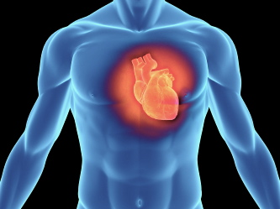
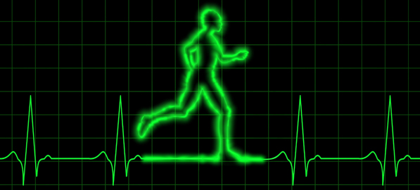
PDO safety advice
Use this Alert: Discuss in Tool Box Talks and HSE Meetings ➔ Distribute to contractors ➔ Post on HSE Notice Boards ➔ Include in site HSE Induction
Date: 24/04/2013
Driver dies from heart attack whilst driving
What happened?
An Indian Al Turki light vehicle driver died of a heart attack whilst driving four passengers in a pickup on the Ras Al Hamra project. The vehicle was thankfully travelling at a slow speed when it lost control and the other passengers were unharmed.
Your learning:
Overweight people are prone to heart attacks.
High blood pressure is a warning from your body.
Smoking and alcohol abuses your body.
Lose weight and feel great.
Change your lifestyle, get fit and lose that weight.
Always consult a doctor when changing your lifestyle or poorly.
Health is your best asset look after your body
Contact: MSE54 for further information or visit the HSE Website Learning No 15 22/07/2013

Slide 2
Management learnings
Date: 24/04/2013
Driver dies from heart attack whilst driving
  Do all your employees undergo fitness to work medical examinations?
  Do you conduct emergency drills to give first aiders experience of CPR and the defibrillator?
  Do you have a robust and well understood medical emergency procedure?
  Do you employ the required number of medical staff at each site?
  Do you run regular health and lifestyle campaigns?
  Do you regularly monitor the health and fitness to work of your employees?
  Do your medical team get together on annual basis to exchange best practices?

