Slide 1
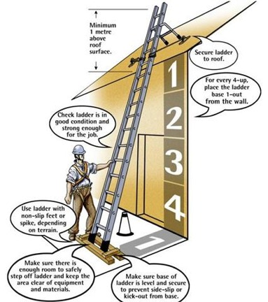
PDO Safety Advice
Use this Alert: Discuss in Tool Box Talks and HSE Meetings ➔ Distribute to contractors ➔ Post on HSE Notice Boards ➔ Include in site HSE Induction
Date: 16/06/2013 Fractured leg
Helper falls from 1.2 metres and fractured leg
What happened?
An Al Turki helper while climbing down from a height of 1.2 meter using an unsecured ladder was severely injured when the base of the ladder slipped and he fell awkwardly to the ground trapping his left leg between the rungs. His leg bones fractured.
Your learning:
Always ensure that a ladder is tied or held by another person when it is being used.
Always pay your full attention when climbing ladders, even for small heights.
Never be complacent or underestimate risk.
Contact: MSE54 for further information or visit the HSE Website Learning No 20 22/07/2013

Slide 2
Management learnings
  Is ladder safety included in your company HEMP and risk assessment?
  Do you have checks to ensure that controls identified from your risk assessments have been introduced into the procedures and people trained?
  Is ladder safety in your induction for people at risk?
  Does your management system include management inspections and do these look out for safety issues including unsecured ladders?
  Do you have competency criteria for you supervision?
  Do you have controls on the storage and use of ladders?

