Slide 1
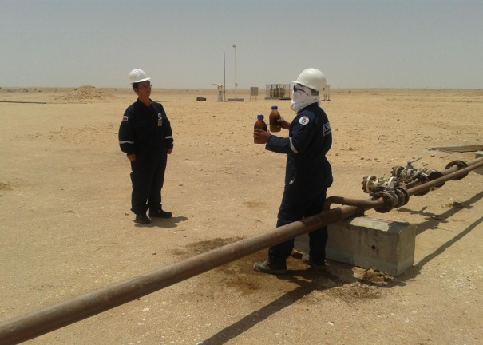
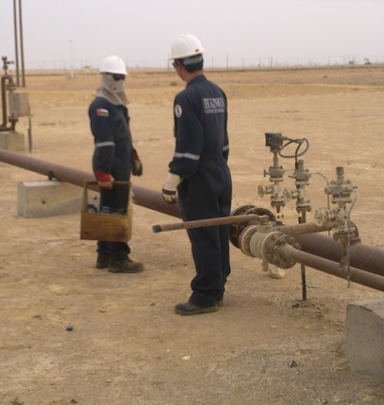
PDO Safety Advice
Use this Alert: Discuss in Tool Box Talks and HSE Meetings ➔ Distribute to contractors ➔ Post on HSE Notice Boards ➔ Include in site HSE Induction
Date : 20/04/2013
Fractured elbow
What happened?
The employee was walking to his vehicle carrying oil filled glass sample bottles from a well test. Just before crossing a flowline he was distracted by a colleague behind him. He turned around whilst walking backward and fell over the flowline on to his back. He held on to the glass bottles to protect them and in doing so he fractured his elbow.
Your learning from this incident…
Always look where you are walking
Always remain aware of your surroundings
Beware of distractions in your work
Warn other people if you see them in danger
Protect yourself first before protecting equipment
Direction he faces
Direction of travel
Always pay attention to what you are doing
1
Contact: MSE54 for further information or visit the HSE Website Learning No 19 22/07/2013

Slide 2
Management actions
Date : 20/04/2013
Fractured elbow
As a learning from this incident and ensure continual improvement all contract
managers are to review their HSE HEMP against the questions asked below
Does your management system include the requirement for TRIC?
Do you ensure your supervision are competent in TRIC and risk assessment?
Does your HEMP require you to minimise walking distances and avoid crossing flow-lines?
Do you have a working STOP system which is effective in warning people of hazards?
Do you have a system to ensure your management are competent in the emergency escalation procedure?
Do you regularly test your emergency escalation procedure to ensure it is known and used?
2

