Slide 1
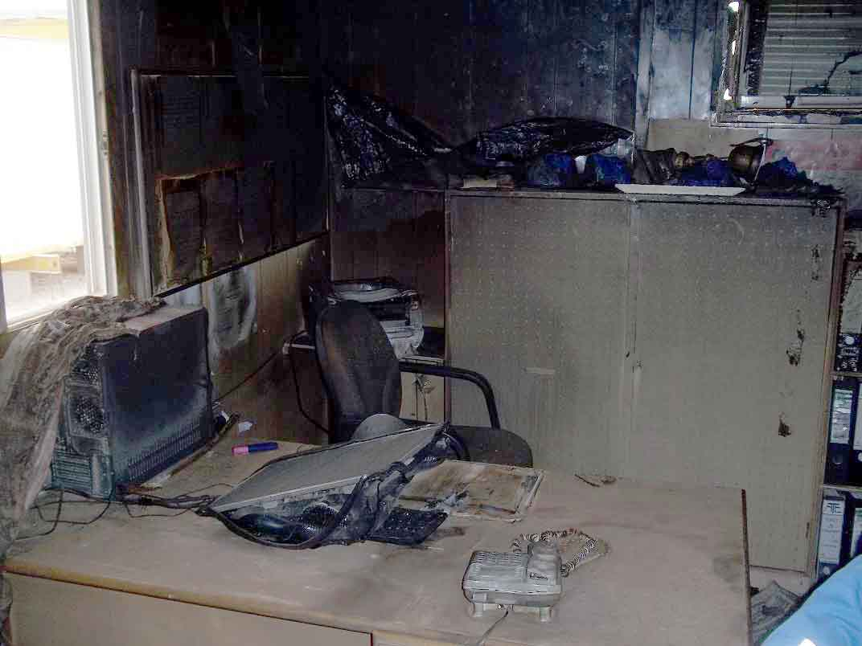
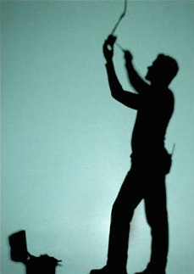
PDO safety advice
Use this Alert: Discuss in Tool Box Talks and HSE Meetings ➔ Distribute to contractors ➔ Post on HSE Notice Boards ➔ Include in site HSE Induction
Date: 15/06/2013 - Fire breaks out in Journey Manager’s office (portacabin)
What happened?
In the early hours of the morning smoke was seen coming out of the Journey manager’s office. The alarm was raised, the emergency response procedure initiated, site evacuated and the fire extinguished by portable fire extinguishers. The interior of the office was burnt including all office equipment. No one was injured. The fire had started in a short circuit in the air conditioning unit.
Your learning from this incident…
Know the date when your electrical equipment should be serviced.
Challenge management if the electrical/air-con servicing is late.
Always turn off your air-conditioning over night when not in use.
Always lock your offices at night to avoid unauthorised access.
Challenge management if your electrical/air-con servicing is late
Contact: MSE54 for further information or visit the HSE Website Learning No 21 02/09/2013

Slide 2
Management actions
Date: 15/06/2013
Fire outbreak in the Journey Manager’s office (portacabin) at night
As a learning from this incident and ensure continual improvement all contract
managers are to review their HSE HEMP against the questions asked below:
  Do you have systems to ensure all your electrical equipment is fit for purpose?
  Do your assurance processes ensure electrical equipment fuse/circuit breaker ratings are as per manufacturers recommendations
  Do you have planned preventative maintenance/servicing schedules for electrical equipment?
  Do you have systems to check the planned preventative maintenance is taking place?
  Do you employ sufficiently qualified technicians to service/maintain electrical equipment?
  Do you have a formal process for employees to report electrical faults or over-due servicing?
  Do you educate your workforce to switch off electrical equipment when not in use ?
  Do you educate your workforce to lock rooms after working hours to avoid unauthorized entry?

