Slide 1
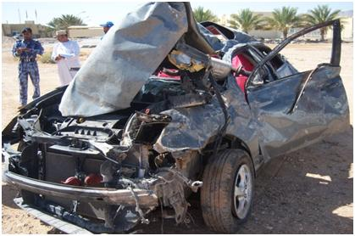

PDO safety advice
Use this Alert: Discuss in Tool Box Talks and HSE Meetings ➔ Distribute to contractors ➔ Post on HSE Notice Boards ➔ Include in site HSE Induction
Date : 11.03.2013 Fatality
Driver dies from rollover whilst commuting in his private vehicle
What happened?
An employee working for BGP decided to breach commuting policy and commuted home at the end of his rotation at around 21hrs using his private vehicle.
While approaching a smooth bend on the black top road on high speed, he lost control of the car due to a loss of concentration when using his GSM. He veered sharply to the left and the vehicle hit a 30cm high windrow and rolled over 3 times. He died of severe head injuries.
Your learning from this incident…
You are far more likely to be killed if you are driving:
At high speed;
Whilst using a mobile phone;
Whilst driving at night;
Using your private car.
✓
It’s proven it safer to use PDO approved bus
1
Contact: MSE54 for further information or visit the HSE Website Learning No 12 22/07/2013

Slide 2
Management learnings
Date : 11.03.2013 Fatality
Driver dies from rollover whilst commuting in his private vehicle
Does commuting policy exist in your organization?
Have you communicated the commuting policy effectively to your staff?
Do you monitor your staff commuting compliances?
Have you facilitated a safe and comfort means of commuting?
Is commuting departure timing suitable for the operation and optimized for staff?
Did you initiate controls and mitigation to discourage the use of private vehicles for commuting
Do you have transportation in case of an emergency?
Do you sufficiently communicate and engage with staff for learnings from commuting fatalities?
Do you effectively communicate the risks and consequences of using a mobile phone while driving?
Do you sufficiently communicate the increased risk of night driving?
Do you sufficiently communicate the risk of driving when you are tired?

