Slide 1
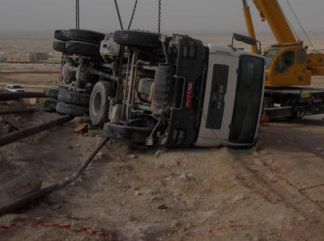
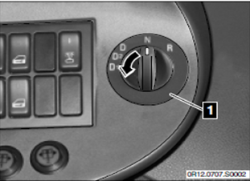
PDO safety advice
Use this Alert: Discuss in Tool Box Talks and HSE Meetings ➔ Distribute to contractors ➔ Post on HSE Notice Boards ➔ Include in site HSE Induction
Being translated
Never become complacent when driving – it might kill
Contact: MSE54 for further information or visit the HSE Website Learning No 22 08/09/2013

