Slide 1
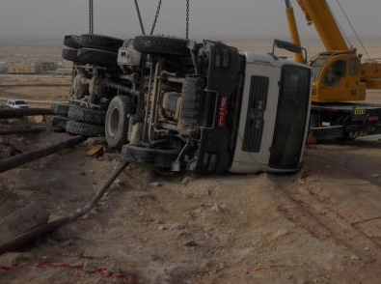
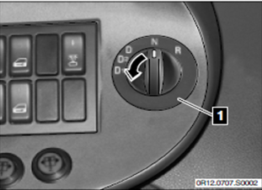
PDO safety advice
Use this Alert: Discuss in Tool Box Talks and HSE Meetings ➔ Distribute to contractors ➔ Post on HSE Notice Boards ➔ Include in site HSE Induction
Date: 22/07/2013 - Tipper truck loses power on jebal, overturns and crushes flowlines
What happened?
While driving a loaded tipper truck uphill, the engine stalled and eventually lost all power on the steep incline. The driver had failed to change his gears to the correct setting for the climb on his approach to the jebel. The truck rolled back and after 78 metres the driver steered into the side of the jebel to avoid going off the edge. The truck overturned and crushed four flowlines carrying Oil and Gas. No one was injured and there was no loss of containment.
Your learning from this incident…
Always select the correct gear before driving a HGV up a Jebel.
Never become complacent when driving – it might kill
Contact: MSE54 for further information or visit the HSE Website Learning No 22 08/09/2013

Slide 2
Management actions
Date: 22/07/2013
Tipper truck loses power on Jebel overturns and and crushes flowlines
As a learning from this incident and ensure continual improvement all contract
managers are to review their HSE HEMP against the questions asked below:
Do you have systems to provide drivers vehicle specific training to impart knowledge on the vehicle specific controls?
Do you have systems to assess your drivers competency on the vehicle specific controls and on different terrains/slopes?
Do you have systems which require route surveys for repeat journeys/hazardous routes?
Do you have a safe journey management system which reminds HGV drivers of the risks and the need for lower gears on slopes when required from the route survey.

