Slide 1


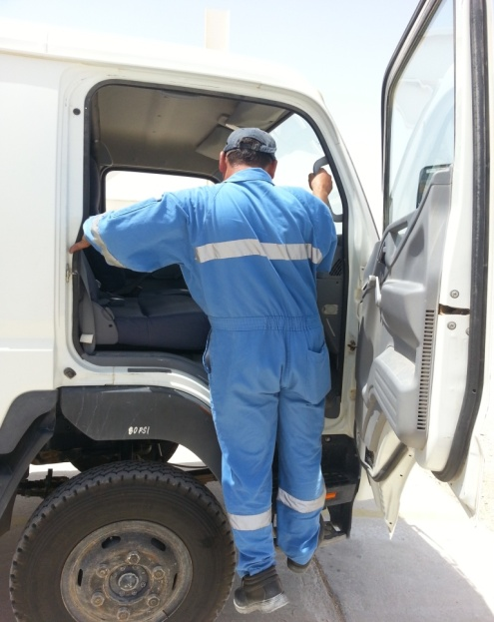
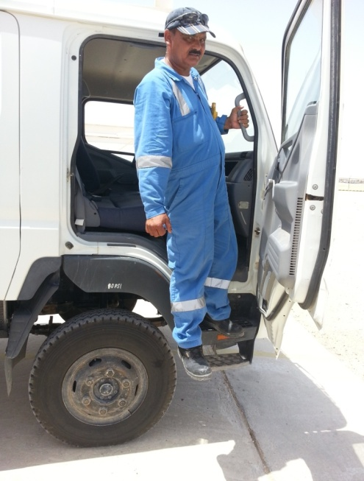

HSE LEARNING
INCIDENT:
While coming out of the 3ton Mitsubishi Canter cabin the IP lost balance, twisted his right ankle & fell down
CAUSES:
The IP did not maintain the 3point contact while descending from the vehicle.
IP did not pay attention while descending from the elevated vehicle
LEARNINGS:
Pay attention while going in and coming out of elevated vehicles.
Maintain the 3 point contact.
Key Learning:
Mind your steps, it is an ELEVATED VEHICLE
Fall While Descending
Use this Alert: Discuss in Tool Box Talks and HSE Meetings ➔ Distribute to contractors ➔ Post on HSE Notice Boards ➔ Include in site HSE Induction
Contact: MSE511 for further information or visit the HSE Website Alert No 000 October, 2013

