Slide 1
Safety work-stoppage
13TH February 2014

Slide 2
Safety work-stoppage
A VERY SAD start to the year
Following our best ever annual safety performance in 2013 PDO & its contractors have suffered two horrific fatalities and five LTIs in 2014
NOW IS NOT THE TIME
FOR COMPLACENCY

Slide 3
The fatal injuries
1
A sub contractor's heavy truck rolled over and killed the driver
(24th January, 2014)
2
A contract employee was crushed under the tracks of a side boom crane and killed instantly.
(1st February, 2014)

Slide 4
1
A sub contractor's lorry rolled over after a tyre burst
Learning from Incidents
For PDO staff and contractors
A sub contractor's heavy truck rolled over and killed the driver
(24th January, 2014)

Slide 5
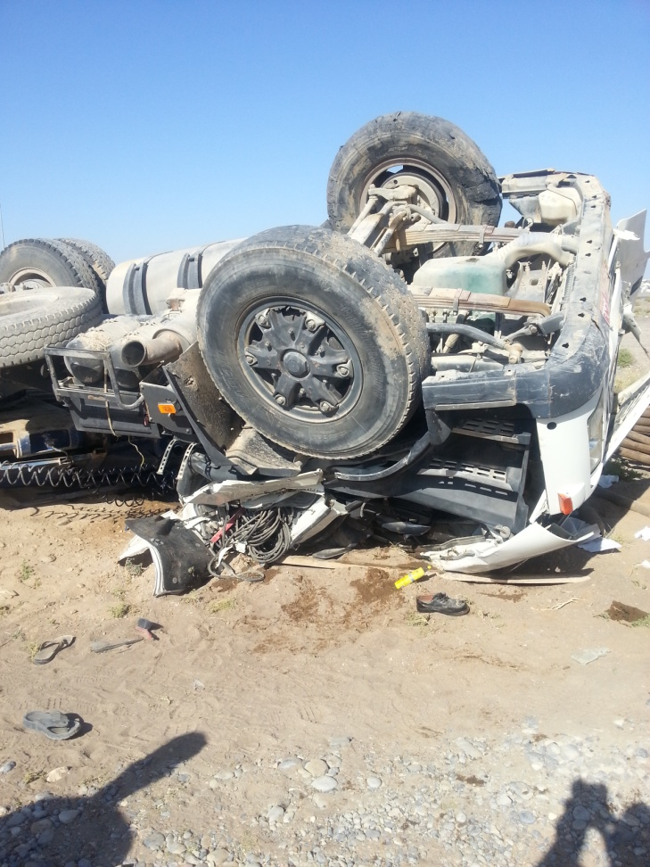
1
A sub contractor's lorry rolled over after a tyre burst
What happened :
At 4 o’clock in the afternoon on the 24th January 2014 a heavy goods articulated truck was transporting 31 tonne of drill pipe from a hoist back to the suppliers base. Whilst adhering to the speedlimit on a black top road, the prime movers passenger side tyre on the steering axle blew out and shredded. The lorry swerved to the right and left the road down an embankment where it rolled over and the cabs roof was smashed into the ground, killing the driver
instantly.

Slide 6
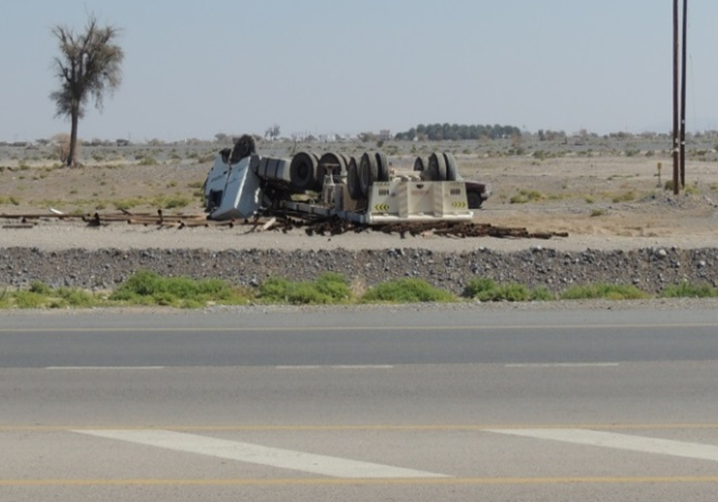
1
A sub contractor's lorry rolled over after a tyre burst
Why do we think it may have happened?
The tyre was pierced by a sharp object in the road works.
The lorry was travelling too fast in road works to allow the driver to regain and keep control.
After leaving the road, the prime mover drove off a raised section of land causing further loss of traction to the steering axle which helped further destabilized the trailer
The tyre, which had originally been a spare, lost its integrity causing an instant loss of control on the steering axle as it had exceeded the 4 year expiry date.

Slide 7
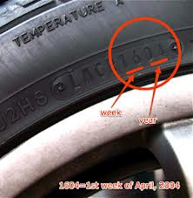
A sub contractor's lorry rolled over after a tyre burst
1
Discussion….. Do you know…. :
your spare tyre may be dangerous after 4 years even though it still looks brand new?
your tyres date of manufacture is stamped as a four digit number, the two digits is the week of the year and the second two is the year of manufacture?
to check your tyre dates monthly, even on your private car?
how old your spare tyre is?
you should change both tyres on the same axle at the same time and ensure they are same size & brand?
you should replace the spare tyre back again when you have had the puncture repaired?
road works are high risk areas of debris on the road? It is best to slow down
The IVMS driver performance feedback process saves lives?

Slide 8
1
A sub contractor's lorry rolled over after a tyre burst
Underlying causes:
The sub contractor did not have a management process ensuring tyres were discarded after four years from manufacturer date.
The sub contractor did not have a process to ensure spare tyres were returned to the spare tyre holder after the original punctured tyre had been repaired.
The sub contractor had invested in a non compliant IVMS system which did not effectively manage the risk.
The sub contractor had not implemented a robust IVMS feedback and notification system to effectively manage driver behaviour.
The PDO contractor was not effectively assuring safety standards in its sub contractors
The PDO Contract Holder was not effectively ensuring the contractor was managing its sub contractor management.

Slide 9
1
A subcontractor's lorry rolled over after a tyre burst
Our lessons to be learnt:
Contract Holders should understand the importance of managing road safety risks in (sub) contractors.
Contractors need a process to ensure all tyres are discarded when they reach 4 years old.
Contractors must manage their sub contractors.
Contractors should only use IVMS systems from suppliers which have provided written evidence that they comply with PDO standards.
Drivers need to insist spare tyres after being used are returned back to the spare tyre cradle.
Drivers should slow down when driving through road works. The speed limit is the maximum not the target.
IMMEDIATE ACTION
Contract holders should request contractors to conduct an immediate check on their fleet and remove all tyres which are above the 4 year expiry date.

Slide 10
2
A contractor's side boom crane crushed its operator
Learning from Incidents
For PDO staff and contractors
A contractor's side boom crane crushed its operator
(1st February, 2014)

Slide 11
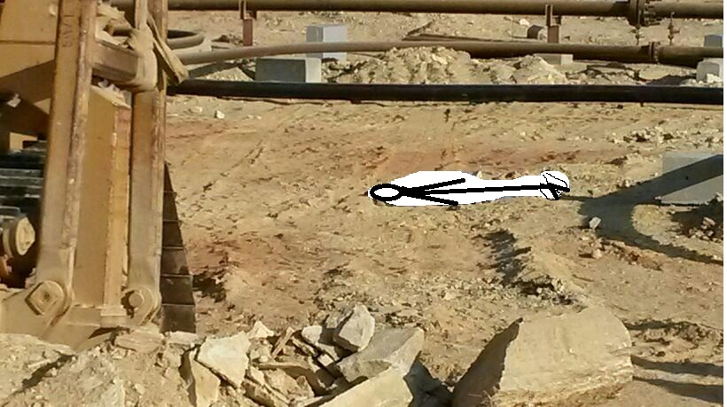
2
A contractor's side boom crane crushed its operator
What happened :
The contractor mechanical crew finished their days work laying a flowline and the operator proceeded to park the side boom crane. The majority of the crew strolled towards the commuting vehicles parked by the road, 32 m away. Two others were stowing equipment on the back of a hiab parked ahead of the commuting vehicles, just off the road. A short time later the side boom crane collided with the rear passenger side of the hiab causing the two employees to jump to safety. The crew rushed back to investigate the collision and found the operator lying dead on the ground 8m behind the crane in the marks left by its caterpillar tracks.

Slide 12
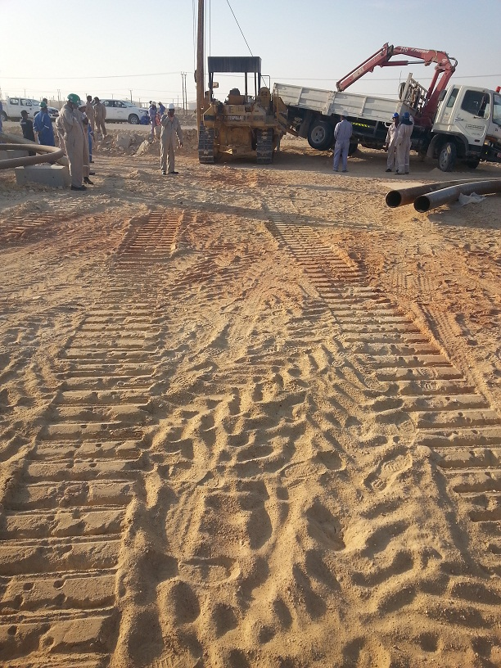
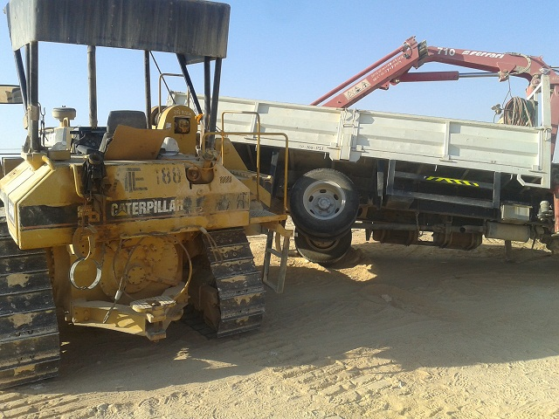
2
A contractor's side boom crane crushed its operator
Why do we think it may have happened?
On the balance of evidence, it is probable that the operator took his own life.
The operator chose not to share his personal problems or seek counseling.
The side boom crane was able to be driven without an operator.
The supervision was preoccupied at the end of the shift and hence could not have prevented the opportunity for the operator to put himself in harms way.

Slide 13
2
A contractor's side boom crane crushed its operator
Discussion….. Do you know…. :
it is best to seek help and share a problem than to keep it to yourself.
stress is not what happens to us, it is more about our response to what happens . We are in control as our response is something we can choose
when you find yourself stressed, ask yourself one question: Will this matter in 5 years from now? If the answer is ‘yes’, then do something about it; if the answer is ‘no’, then let it go.
your company will try and help you if you have personal problems so share them and seek help?
nothing can be so bad so as to take your own life
to look out for your work colleagues especially if you notice a change in their behaviour?

Slide 14
2
A contractor's side boom crane crushed its operator
Underlying causes:
Personal matters and pressures led to stress.
The banksman did not monitor the movement of the Side Boom Crane until its conclusion.
The Permit Holder left the Side Boom Crane activity unsupervised even though it remained in motion.
The design of the Side Boom Crane allows it to be driven when unmanned.
Management did not intervene when they noticed he was not eating properly for 3 days before the incident.

Slide 15
2
A contractor's side boom crane crushed its operator
Lessons learnt:
Look out for each other.
Seek support and counseling if you need help.
Supervising is key to control
If you notice a change in behaviour, then act.
IMMEDIATE ACTION
Ensure you have a well publicized but private mechanism for your staff to receive counseling or help for personal or financial issues.

Slide 16
What can I do to help?
Remember to comply, intervene and respect.
Remember the value of the Life Saving Rules, they exist to save lives.
Look after your health and wellbeing and look out for your colleagues, they need you as much as you need them.
If you need help, do not be afraid to ask…

