Slide 1
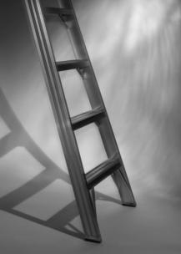
Workplace Safety Engagement Pack Volume 2014 Edition 1
Working at Heights

Slide 2
Working at Heights
PDO’s serious injuries from falls from heights increased by 75% in 2013
Already in 2014 we have suffered an electrician falling over 7 metres onto
a marble floor due to unsecure barriers.
We need to improve our focus and awareness on the dangers of working
at height. Once you fall it is too late.
Before working at height ask yourself is it safe...........?????

Slide 3
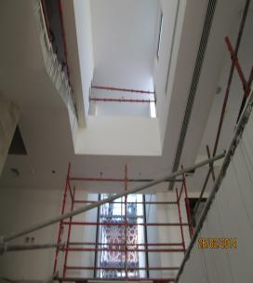
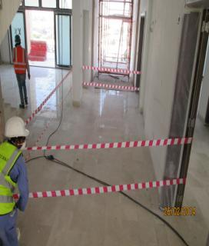
ATE –LTI- 26th February 2014
He fell from 7 metres
He is in intensive care with multiple fractures
Incorrect scaffolding was used

Slide 4
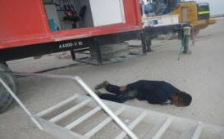
B&C –LTI- 30th August 2013
He fell from 1.3 metres
and broke his left forearm

Slide 5
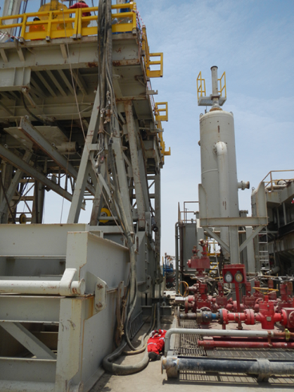
KCA Deutag, LTI - 4th August 2013
He fell from 9 metres
and fractured his pelvic and collar bones

Slide 6
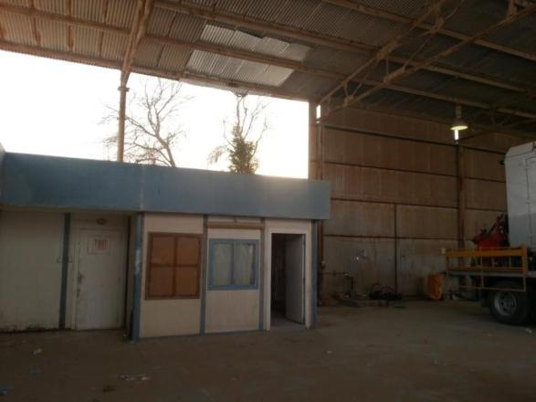
Abraj Energy Services LTI – 4th July 2013
He fell from 3 metres
and fractured his left leg

Slide 7
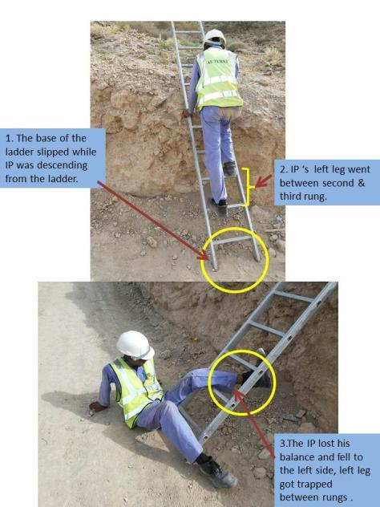
ATE LTI - 16th June 2013
He fell from 0.6 metres
and fractured his leg in two places

Slide 8
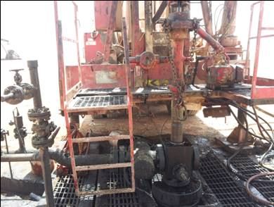
Weatherford LTI - 20th April 2013
He fell from 1 metres
CORRECT
and fractured his left knee

Slide 9
ATE Nimr LTI - 17th April 2013
He fell from 2.6 metres
and suffered a fracture
and spinal injury .

Slide 10
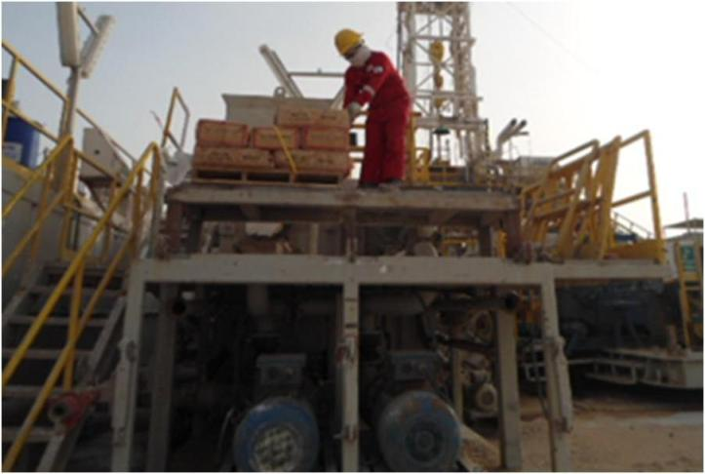
KCA Deutag LTI - 3rd February 2013
He fell from 2 metres
and fractured
his wrist

Slide 11
Top 5 learnings from our fall from height victims last year
Not securing the ladder.
Taking a short cut to be quick.
Not replacing handrails which had been removed.
Not being vigilant and aware of the area.
Not considering the dangers.
All resulted in a fall from height…….

Slide 12
Top 5 tips of how our management controls failed last year
Acceptance of poor design or practices.
Lack of assurance of competency.
Poor risk assessment and inspections.
Inadequate management of change.
Poor subcontractor management.
All resulted in a fall from height…….

Slide 13
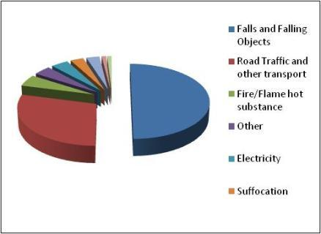
We can use Abu Dhabis’ information as a guide
50% of surgical submissions to the main hospitals in the
Emirate state related to falls and falling objects,
50%, 307 injuries, related to falls and falling objects
The injured were mostly male migrant workers aged between 22 and 44
(2003 to 2005, 614 occupational injuries,)
Cause of FATAL occupational Injuries
Latest data available

Slide 14
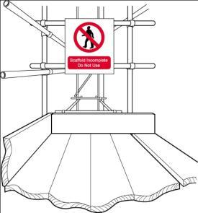
Workers Beware - Checklist
Has your Tool Box Talk today reviewed all the hazards of the work?
Have you reviewed your area for a risk of falling or dropped objects?
Are all fall and dropped object risk areas suitably protected with rails or toe boards?
Are ScaffTags in place to show a competent person has inspected the structure?
Have you checked that nothing has changed which affects your safety from working at height since you were last there?
If you think someone is in danger, STOP and intervene

Slide 15
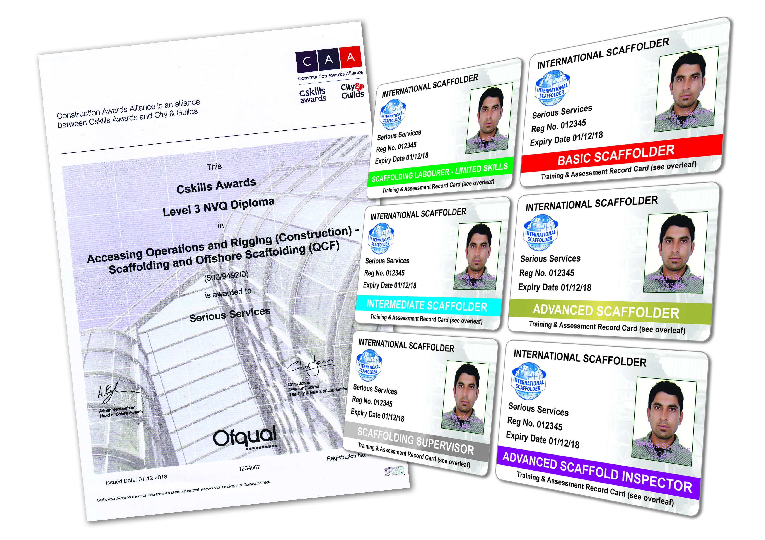
Management Beware - Checklist
Are you assured that the appropriate equipment to prevent or protect against falls from height is in place?
Are you assured that all equipment provided is fit for purpose for its intended use and maintained in good order?
Are you assured that employees have received adequate training to enable them to complete the work safely and method statements are understood?
Are you assured that work is properly supervised , checking what is actually happening on site and STOP bad practice?
Are you assured that your people are competent for working at height, which means having the right knowledge, training, skills and experience for the task?
SP1257 – (Scaffolding, Working at Heights or Over Water, Lifting Operations and Earthworks)
Remember by May 1st 2014 PDO will require all scaffolding personnel to have been assessed and then carry the appropriate competence Card ..…… Don’t delay, competency assess today.
For more information contact MSE12 – Kevin Doyle

Slide 16
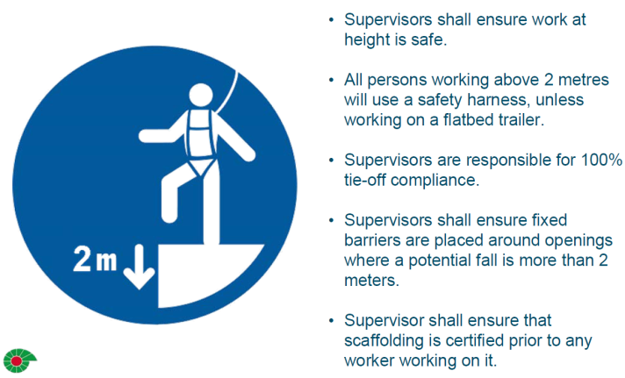
Working at height is a life saving rule
PDO has been lucky so far….
falling from a height can often kill, so pay special attention when
working where you can potentially fall.

