Slide 1
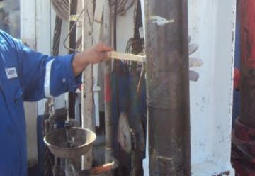
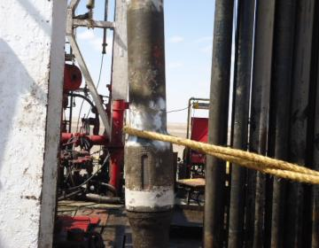
PDO Safety Advice
Use this Alert: Discuss in Tool Box Talks and HSE Meetings ➔ Distribute to contractors ➔ Post on HSE Notice Boards ➔ Include in site HSE Induction
Date: 1 Jan 2014
Injury: Hand Fracture
What happened?
The Floor Man was supporting a lifting sub (78kg) while it was being lifted from its basket by the off driller side air winch. In doing so the lifting sub slipped from his hand and moved towards mast leg. He tried to stop it and his left hand got trapped between lifting sub and mast leg resulting in injury.
Your learning from this incident…
Don’t try to stop any suspension load.
Apply the empowerment to stop when the job is unsafe.
Always assess and use “HANDS OFF APPROACH” where necessary
Contact: MSE54 for further information or visit the HSE Website Learning No 01 01/01/2014

Slide 2
Management learning's
Use this Alert: Discuss in Tool Box Talks and HSE Meetings ➔ Distribute to contractors ➔ Post on HSE Notice Boards ➔ Include in site HSE Induction
Date: 1 Jan 2014
Injury: Hand Fracture
As a learning from this incident and ensure continual improvement all contract
managers are to review their HSE HEMP against the questions asked below
Confirm the following:
Do you have an effective Hands off training program in place?
Do you use the “Hands Off” Questionnaire to prepare for tasks and Toolbox talks
Is the empowerment to stop process used effectively?
Do you have a system to ensure actions from lateral Learnings are implemented.
Is the alert/learning advice understood by the crew members?
Contact: MSE54 for further information or visit the HSE Website Learning No 01 01/01/2014

