Slide 1
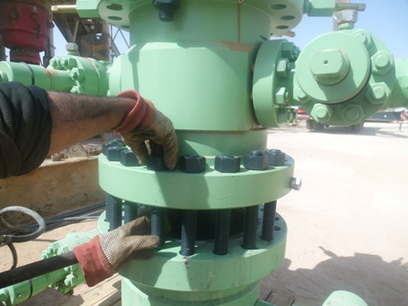
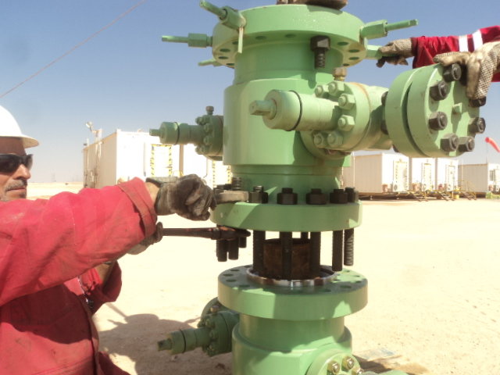
PDO Safety Advice
Use this Alert: Discuss in Tool Box Talks and HSE Meetings ➔ Distribute to contractors ➔ Post on HSE Notice Boards ➔ Include in site HSE Induction
Date : 18 Jan 2014
Injury: Hand laceration
What happened?
While the Floor man was trying to unscrew the nut of a stud, he placed his left hand in- between the Tubing Head Spool (THS) and Casing Head Housing flanges so as to hold and stop the stud from rotating. The THS moved down and trapped his left hand between the two flanges.
Your learning from this incident..
Ensure that the total weight of the hoisted load ( THS) is on the hoisting machinery.
STOP & Re-assess the task to ensure correct controls are in place to manage the change.
Use “HANDS OFF APPROACH”.
Never put your Hands and Fingers in-between flanges
Contact: MSE54 for further information or visit the HSE Website Learning No 03 18/01/2014

Slide 2
Management learning's
Use this Alert: Discuss in Tool Box Talks and HSE Meetings ➔ Distribute to contractors ➔ Post on HSE Notice Boards ➔ Include in site HSE Induction
Date : 18 Jan 2014
Injury: Hand laceration
As a learning from this incident and ensure continual improvement all contract
managers are to review their HSE HEMP against the questions asked below
Do you have an effective Hands off training program in place?
Do you use the “Hands Off” Questionnaire to prepare for tasks and Toolbox talks
Do you have a system to verify the supervisors do not perform the tasks but supervise only?
Do you have a system to ensure actions from lateral Learnings are implemented.
Is the alert/learning advice understood by the crew members?
Contact: MSE54 for further information or visit the HSE Website Learning No 03 18/01/2014

