Slide 1
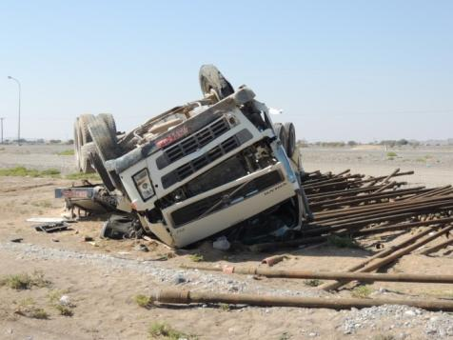
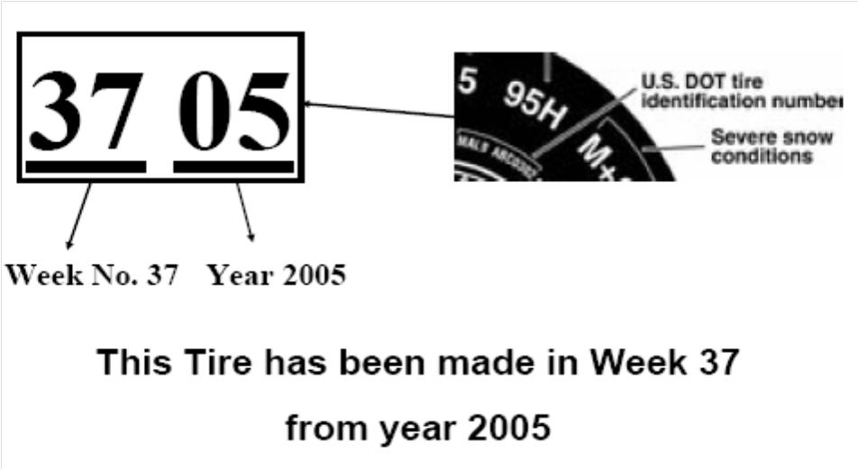
PDO Safety Advice
Use this Alert: Discuss in Tool Box Talks and HSE Meetings ➔ Distribute to contractors ➔ Post on HSE Notice Boards ➔ Include in site HSE Induction
Date: 24 Jan 2014
Injury: Fatality
What happened?
An articulated truck was towing a trailer loaded with 30 tonnes of 3½ “ rental drill pipe from a hoist back to Nizwa. While travelling through road works on the road between Adam & Nizwa near to Izz, the trucks passenger side front tyre punctured and then blew out resulting in a loss of control and the vehicle leaving the road and rolling over resulting in driver death.
Your learning from this incident….
Always drive at a speed suitable for the road conditions.
Always query your journey plan if you think it is wrong.
Always inspect your tyres before starting the journey.
Periodically check to ensure your tyres are no older than 4 years.
Always replace the spare back to its holder after a punctured tyre has
been replaced.
“Check condition of tyres and do not use tyres older than 4 years from date of manufacturing”
“Slow down in road works, where there is often sharp debris on the road”
Contact: MSE54 for further information or visit the HSE Website Learning No 04 24/01/2014

Slide 2
Management learning's
Use this Alert: Discuss in Tool Box Talks and HSE Meetings ➔ Distribute to contractors ➔ Post on HSE Notice Boards ➔ Include in site HSE Induction
Date: 24 Jan 2014
Injury: Fatality
As a learning from this incident and ensure continual improvement all contract
managers are to review their HSE HEMP against the questions asked below
Confirm the following:
Does your company have a maintenance system to discard tyres that are in bad condition or over four years of age?
Does your company have a system to replace spares back to the spare holder after a punctured tyre has been replaced?
Do you audit your Safe Journey Management System annually and ensure the competency of your journey managers?
Have you ensured your Safe Journey Managers have attended the latest SJM course?
Is your IVMS system driver specific (with use of personal key) rather than vehicle specific ?
Have you ensured that the IVMS system you have bought is in compliance with the PDO standards in SP-2000 & PR-1993?
Do you have a process to pro-actively monitor the IVMS system regularly and conduct feedback session with your drive drivers and do you ensure your sub-contractors are performing these tasks too?
Do you ensure (audit) that your sub-contractors performance is monitored regularly and in compliance with PDO standards and procedures, like SP-2000 & PR-1993?
Contact: MSE54 for further information or visit the HSE Website Learning No 04 24/01/2014

