Slide 1
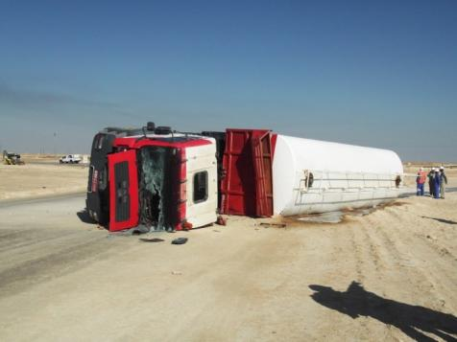
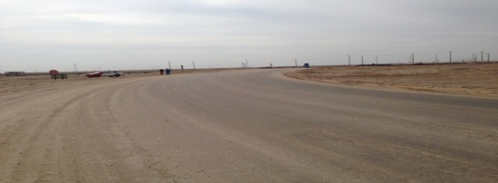
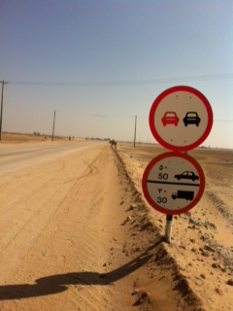
PDO Safety Advice
Use this Alert: Discuss in Tool Box Talks and HSE Meetings ➔ Distribute to contractors ➔ Post on HSE Notice Boards ➔ Include in site HSE Induction
Date: 24 Jan 2014
Injury: Shoulder Dislocation
What happened?
MAN Truck was pulling diesel tank on a flat bed trailer. The truck rolled over when negotiating a severe bend on the road. The driver suffered a dislocated shoulder and the passenger escaped with minor bruises.
Your learning from this incident..
Adhere to the posted speed limits
Always slow down when approaching severe bends
Be aware that partial liquid loads make the vehicle more difficult to control
60
80
100
40
Km/h
110
20
0
120
60
80
100
40
110
20
Km/h
0
120
Drive to the road conditions and vehicle load
Contact: MSE54 for further information or visit the HSE Website Learning No 05 24/01/2014

Slide 2
Management learning's
Use this Alert: Discuss in Tool Box Talks and HSE Meetings ➔ Distribute to contractors ➔ Post on HSE Notice Boards ➔ Include in site HSE Induction
Date: 24/01/2014
Injury: Shoulder Dislocation
As a learning from this incident and ensuring continual improvement, all contract managers are to review their HSE HEMP against the questions asked below .
Confirm the following:
Do you actively manage the IVMS, by generating a RAG reports and provide feedback to the drivers?
Is positive reinforcement or consequence management applied for individual driving performance ?
Do your drivers hold individual key ?
Do you carry out route survey prior to Rig Move, and discuss the route hazards and risks in TBT ?
Contact: MSE54 for further information or visit the HSE Website Learning No 05 24/01/2014

