Slide 1
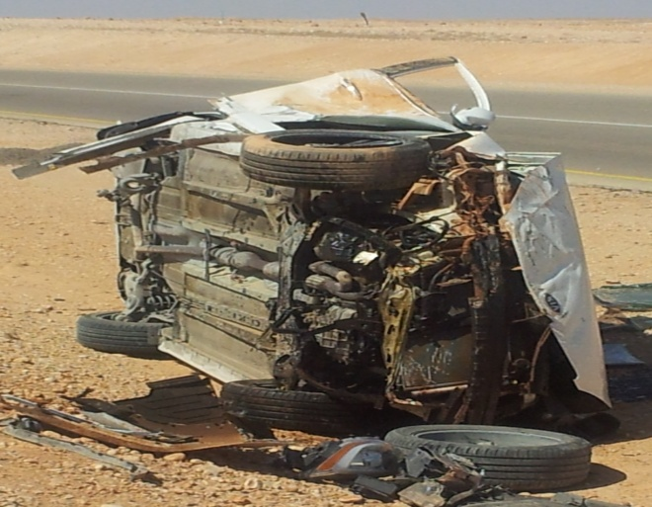
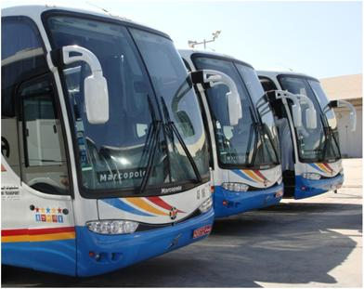
PDO safety advice
Use this Alert: Discuss in Tool Box Talks and HSE Meetings ➔ Distribute to contractors ➔ Post on HSE Notice Boards ➔ Include in site HSE Induction
Date: 14th Feb 2014
Driver suffered minor injury from private commuting rollover
What happened?
An Omani PDO employee was commuting alone using his private saloon car from Marmul to Salalah. At 09:30am before reaching the Harweel/Salalah blacktop junction he had a rollover incident (MVI). The crash resulted in only minor injury as he was wearing his seatbelt.
Your learning from this incident..
Seat belt save lives.
Do not undertake any unauthorized journey.
Only use company approved transportation.
Speed kills, please adhere to the legal speed limits.
It’s proven it safer to use PDO approved bus
Contact: MSE54 for further information or visit the HSE Website Learning No 06 14/02/2014

Slide 2
Management learnings
Use this Alert: Distribute to contractors ➔ HSE Meetings
Date: 14th Feb 2014
Driver suffered minor injury from private commuting rollover
As a learning from this incident and ensure continual improvement all contract managers are to review their HSE HEMP against the questions asked below
Does your organization have a commuting policy?
Have you communicated the commuting policy effectively to all your staff?
Do you monitor your staff commuting compliances?
Have you facilitated a safe and comfort means of commuting?
Is commuting departure timing suitable for the operation and optimized for staff?
Did you initiate controls and mitigation to discourage the use of private vehicles for commuting ?
Do you sufficiently communicate and engage with staff for learnings from commuting incidents?
Contact: MSE54 for further information or visit the HSE Website Learning No 06 14/02/2014

