Slide 1
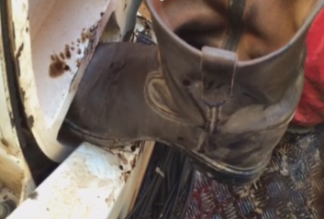
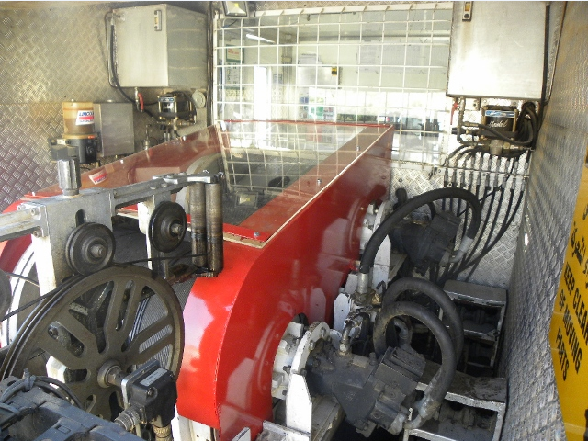
PDO Safety Advice
Use this Alert: Discuss in Tool Box Talks and HSE Meetings ➔ Distribute to contractors ➔ Post on HSE Notice Boards ➔ Include in site HSE Induction
Date:22/02/2014
Injury: Fractured foot
What happened?
A Wireline Assistant decided to do cleaning activity on the deck of the unit whilst the logging operation was in process of pulling out of the hole. His right foot was caught between the rotating drum and its support resulting in injury.
Your learning from this incident..
Be vigilant of unauthorised no go zones warning signs.
Do not enter the no go zone, and keep away from rotating and moving parts e.g. rotating drum.
Stop operation if it is not safe, and intervene for unsafe acts and conditions
Do not execute any task without given clear instruction
Photo explaining what was done wrong
Rotating drum
Guard
Never enter the “No Go Zone” areas
Contact: MSE54 for further information or visit the HSE Website Learning No 08 22/02/2014

Slide 2
Management learning's
Use this Alert: Distribute to contractors ➔ Discuss in Meetings
Date:22/02/2014
Injury: Fractured foot
As a learning from this incident and ensure continual improvement all contract
managers are to review their HSE HEMP against the questions asked below
Confirm the following:
Are “no go zones” defined and communicated to staff?
Do you have physical barriers to stop the crew entering the no go zone where applicable?
Are caution warning signs (i.e Keep away from moving parts) in use?
Does your induction covers no go zone entry?
Does your site induction TBT covers no go zone entry?
Is the no go zone areas/entry part of the supervisors roles and responsibilities to inspect, identify and communicate to their crew ?
Do you have a system to ensure actions from lateral learnings are implemented.
Is the alert/learning advice understood by the crew members?
Contact: MSE54 for further information or visit the HSE Website Learning No 08 22/02/2014

