Slide 1
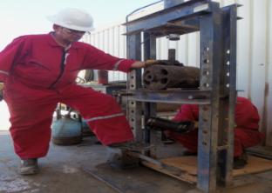
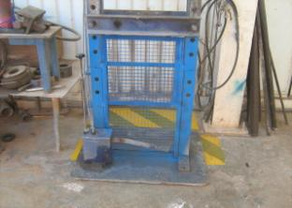
PDO Safety Advice
Use this Alert: Discuss in Tool Box Talks and HSE Meetings ➔ Distribute to contractors ➔ Post on HSE Notice Boards ➔ Include in site HSE Induction
Date: 26/02/2014
Injury: Fractured foot
What Happen?
During installation of pin on the cross head of a Pump, the pin (weighing approx. 18 kg) slipped out of the Mechanic’s hand and dropped onto the Chief Mechanics left mid foot.
Learning from this incident:
Always use TRIC, even for simple routine tasks
Supervisory role is to supervise the job and ensure it is executed safely but not to take part in the task.
Plan your work and carry out risk assessment to avoid and minimize risks e.g. manual handling
Identify and eliminate hazards and use suitable mitigations
Do not enter the no go zone, and keep away from anticipated drop objects.
Stop operation if it is not safe, and intervene for unsafe acts and conditions
Avoid unnecessary manual handling
Contact: MSE54 for further information or visit the HSE Website Learning No 09 26/02/2014

Slide 2
Management learning's
Use this Alert: Distribute to contractors ➔ Discuss in Meetings
Date: 26/02/2014
Injury: Fractured foot
As a learning from this incident and ensure continual improvement all Contract Managers are to review their HSE HEMP against the questions asked below:
Confirm the following:
Does your HSE MS address workshop/machine shop hazards and ergonomics? Are there any standards that you adhere to?
Have you conducted a specific risk assessment for Foot Operated Hydraulic Press machines at you work shops ?
Have you looked at your Hydraulic press machines design and ergonomics related safety aspects?
Are all machine shop hazards identified in your HEMP?
Do you have a system to ensure actions from lateral Learnings are implemented.
Is the alert/learning advice understood by the crew members?
Contact: MSE54 for further information or visit the HSE Website Learning No 09 26/02/2014

