Slide 1
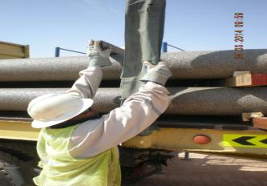
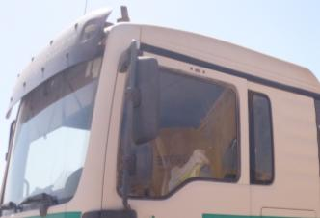
PDO Safety Advice
Use this Alert: Discuss in Tool Box Talks and HSE Meetings ➔ Distribute to contractors ➔ Post on HSE Notice Boards ➔ Include in site HSE Induction
Date: 25/02/14
Injury: Fractured finger
What happened?
A driver was injured when he jumped up to push dunnage from his trailer he grabbed hold of the stanchion and his momentum carried the stanchion forward trapping his hand against the pipe. As a result he sustained broken and lacerated fingers.
Your learning from this incident..
Drivers upon delivering of stock to rigs should report to the relevant supervisor and then return to their cab for the unloading to be completed.
Never conduct an activity unless you are instructed to do so and trained to execute the task safely
Only perform tasks under your responsibility
Contact: MSE54 for further information or visit the HSE Website Learning No 10 25/02/2014

Slide 2
Management learning's
Use this Alert: Distribute to contractors ➔ Discuss in HSE Meetings
Date: 25/02/14
Injury: Fractured finger
As a learning from this incident and ensure continual improvement all contract
managers are to review their HSE HEMP against the questions asked below
Confirm the following:
Do you manage changes in your operations correctly?
Do you ensure TBT is always conducted and recorded for your jobs and activities at site ?
Do you have competent sufficient supervisors at site ?
Are Supervisors always at site and Supervising?
Are staff aware of Empowerment to ‘STOP the WORK’ ?
Do management conduct site visits to ensure compliance?
Do you have a system to ensure actions from lateral Learnings are implemented.
Is the alert/learning advice understood by the crew members?
Contact: MSE54 for further information or visit the HSE Website Learning No 10 25/02/2014

